Slide 1
The Role of SAP Analytics Cloud Smart Predict Time Series Feature in Evaluating Energy Consumption Trends and Environmental Impact of the SAP Metronom Business Center Office Location
Bachelor’s Thesis
Academic Supervisor: prof. Ing. Martin Hanel, Ph.D.
Supervisor at SAP: Ing. Pavel Strnad
Author: Vera Vavan, SAP
2023
Czech University of Life Sciences Prague
Faculty of Environmental Sciences

Slide 2
Agenda
  Thesis Objectives
    SAP Perspective
    Data Analysis Perspective
  Research Methodology
    Data Wrangling
    Visualizations
    Forecasts
  Results and Discussion
    Energy Consumption and CO2 Production
    Time Series Chart Forecast and Predictive Scenarios
  Conclusions

Slide 3
Thesis Objectives
SAP Objectives
Environmental impact of office buildings monitoring
Data Democratization (DDEM) empowerment with SAP BTP solutions
The chances of becoming carbon neutral in 2023
Data Analysis Objectives
Investigating the energy consumption changes and their environmental impact in the context of COVID-19 shutdown in one of the Prague SAP offices
Assessing the accuracy and reliability of smart predict forecast features in SAP Analytics Cloud

Slide 4
Research Methodology
Data Wrangling
Data acquirement through the SAP Metronom Business Center landlord (White Star Real Estate) for the period between January 1, 2019 and March 31, 2022
Importing the energy consumption data for the heating, cooling, water and electricity consumption into the SAC Modeler tool and editing the dataset semantic
Data quality checks and calculations for the corresponding CO2 productions using the given emission factors:
      0.382/1000 for electricity
      0.055*1000 for cooling and heating
      0.00038*1000 for water

Slide 5
Research Methodology
Sensor | Sensor Type | Unit | Floor | Building | Location | TimeStampNew | Consumpption
2RSC.D_PW_23 | electricity meter | Wh | 2.NP | C | Bucharova 2817/11 | 1/1/2020 0:00 | 768
8RSB.D_PW_83 | electricity meter | Wh | 8.NP | B | Bucharova 2817/11 | 8/11/2021 11:00 | 140
8WM.B.67_160422517A | water meter | m3 | 8.NP | B | Bucharova 2817/11 | 10/23/2021 23:00 | 0
2WM.A.33_16210433 | water meter | m3 | 2.NP | A | Bucharova 2817/11 | 8/16/2020 1:00 | 2.66
5CM.B.1_51722749 | calorimeter cooling | GJ | 5.NP | B | Bucharova 2817/11 | 1/7/2022 14:00 | 0
9CM.A.1_62016499 | calorimeter cooling | GJ | 9.NP | A | Bucharova 2817/11 | 3/25/2020 23:00 | 0.09
9HM.B.1_53872591 | calorimeter heating | GJ | 9.NP | B | Bucharova 2817/11 | 1/25/2022 16:00 | 0.11
6HM.C.1_61107075 | calorimeter heating | GJ | 6.NP | C | Bucharova 2817/11 | 1/27/2022 19:00 | 0.1
Table 1: Data Sample of 8 Rows for the Provided CSV data

Slide 6
Research Methodology
Visualizations
Creation of two pages using the SAC Story tool, one focused on energy consumption and one on CO2 production
Finding the individual consumptions/productions per variable for each year and finding their variance compared to the previous year
Producing time series charts, separating the consumption/production per variable for different buildings (A, B and C)

Slide 7
Research Methodology
Forecasts
Applying the time series chart forecast functionality to CO2 production visualizations in SAC Story on each variable (heating, cooling, electricity, water and total production)
Training a predictive model using the Predictive Scenario tool in SAC, with the target variable being consumption separated by the sensor types and suppressing negative values
  Forecast periods: 92
  Predicted date range: April 1, 2022 until July 1, 2022

Slide 8
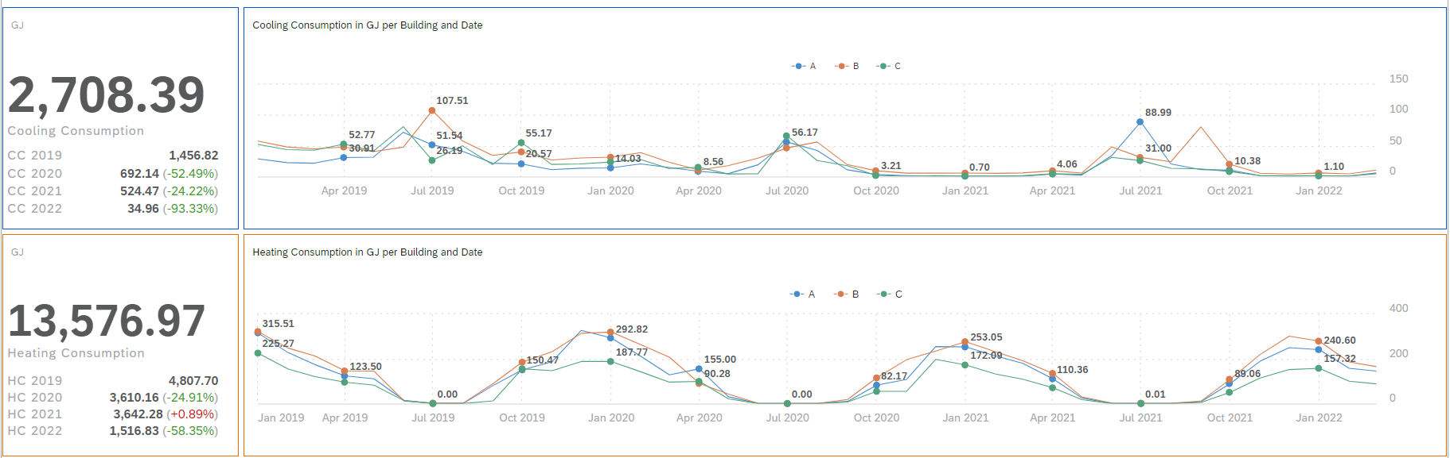
Results and Discussion
Figure 1: Energy Consumption SAC Story Page (Cooling and Heating)

Slide 9
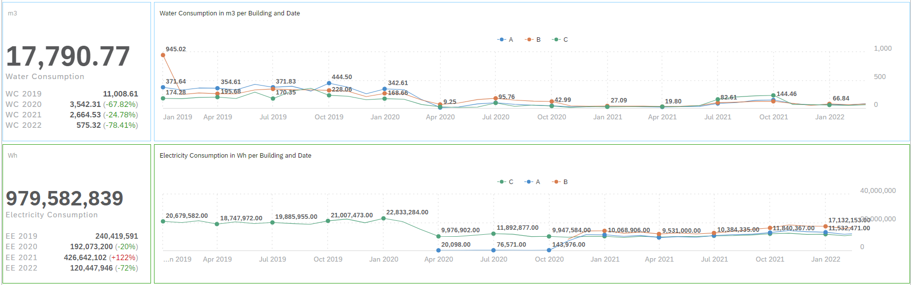
Results and Discussion
Figure 2: Energy Consumption SAC Story Page (Water and Electricity)

Slide 10
Results and Discussion – Energy Consumption
Negative trend for cooling and water consumption kept over the years
Slight increase in cooling, attributed to the catch-up effect and low temperatures
High increase in electricity, connected to the missing sensor data before 2021
High seasonal changes for cooling and heating, steady trend for electricity and slight yearly trend for water consumption with an increase between June and October
Highest usage in building B, followed by building A
Overall, the consumption is lower than the pre-pandemic level

Slide 11
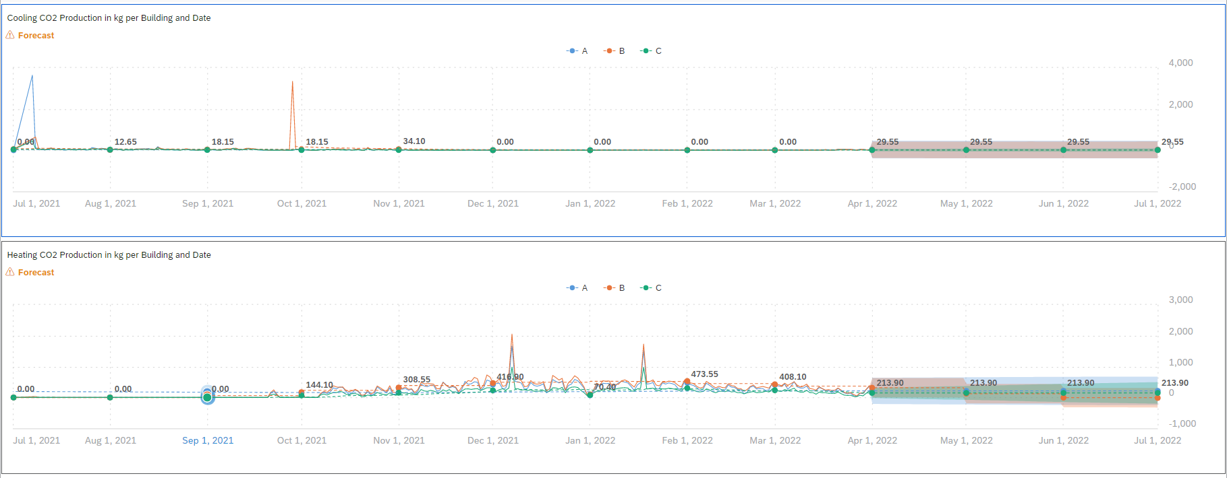
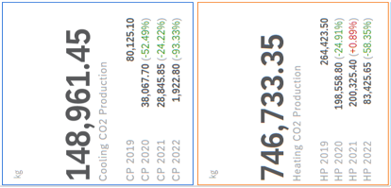
Results and Discussion
Figure 3: CO2 Production SAC Story Page with Time Series Chart Forecasting (Cooling and Heating)

Slide 12
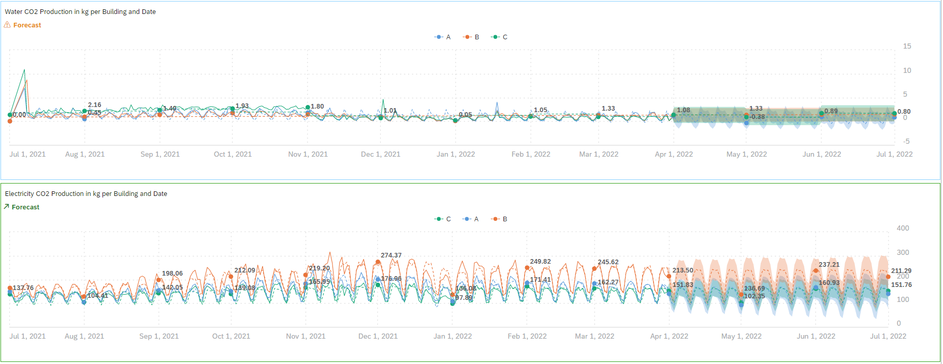
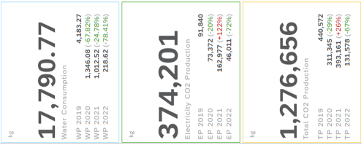
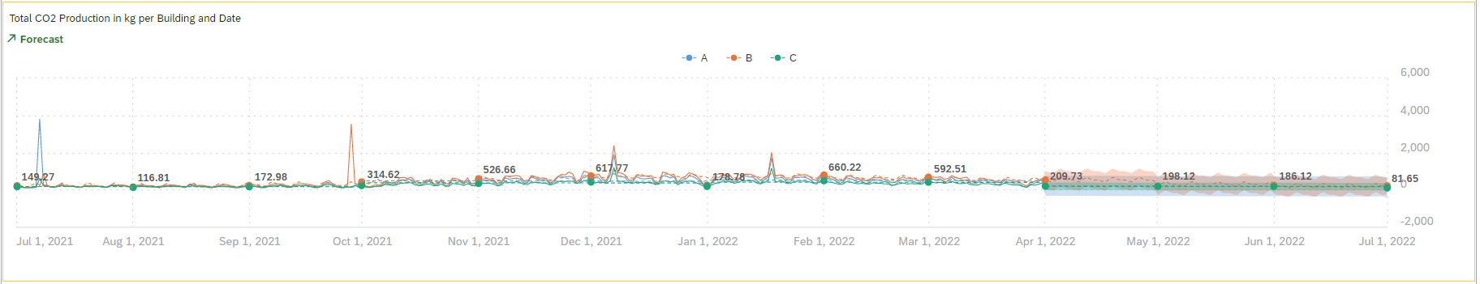
Results and Discussion
Figure 4: CO2 Production SAC Story Page with Time Series Chart Forecasting (Water, Electricity and Total)

Slide 13
Results and Discussion – CO2 Production Forecast
Direct relation of CO2 production to energy consumption, but the units are the same (kg)
Low confidence in heating, cooling and water consumption
Highest confidence in electricity consumption where the weekly patterns are recognized
Total CO2 production heavily influenced by heating consumption
Decreasing trends interpreted as future negative values, making the predictions unrealistic
The tool is easy to use and interpret

Slide 14
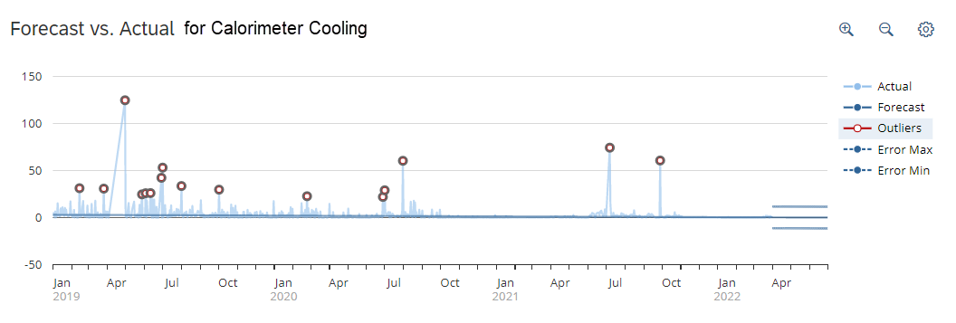
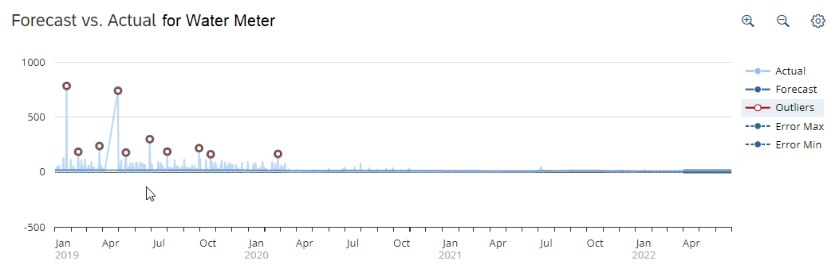
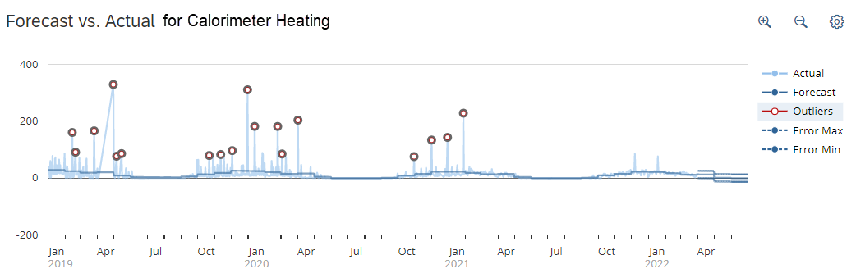
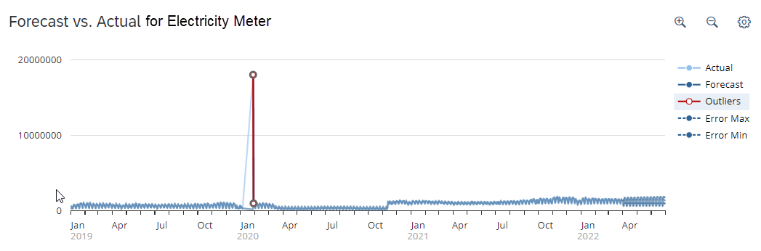
Results and Discussion
Figure 5: Predictive Scenario Charts for Cooling, Heating, Water and Electricity

Slide 15
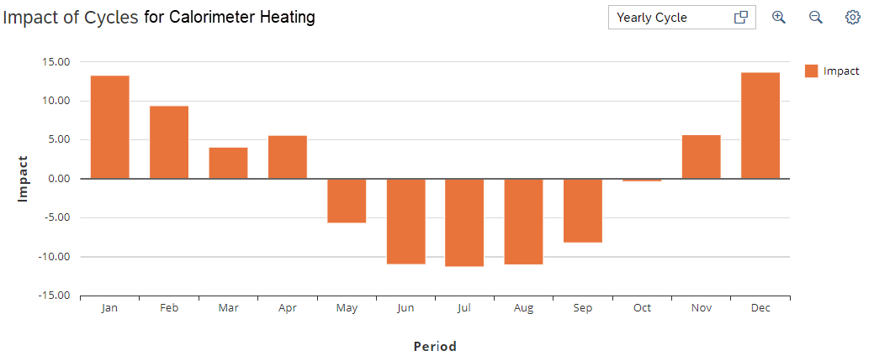
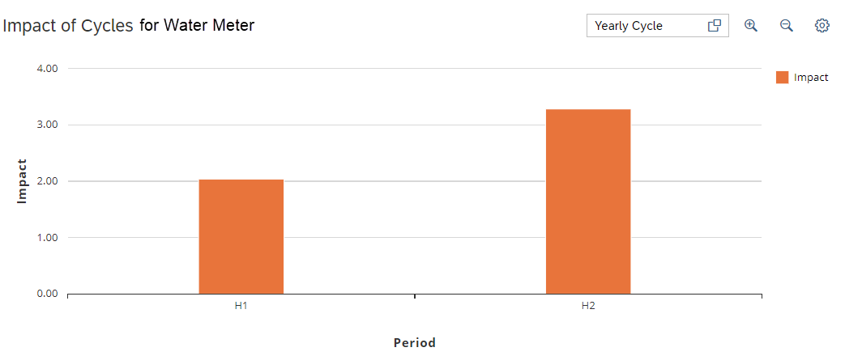
Results and Discussion
Figure 6: Predictive Scenario Cycle Impact for Heating and Water Consumption

Slide 16
Results and Discussion – Energy Consumption Responsibility Scenario
MAPE median expected value of 193.15% and the MAPE average of 163.36%
MAPE 12.13% for electricity, 131.15% for water, 254.79% for cooling and 255.01% for heating
No negative values, only confidence intervals which are quite large
Poor weekly trend recognition, resulting in bad data fittings for the prediction model and high MAPE
Yearly trend recognized only for heating and water consumption, and the impact is low
Limited results insights and personalization
Missing data and COVID-19 shutdown not impacting results

Slide 17
Results and Discussion
General negative trend is recognized in comparison to 2019, with a catch-up effect only in heating and electricity consumption, due to employee preference of the remote working model
Limited information due to missing and restricted data which also affects CO2 production
Poor confidence and prediction reliability due to scarce personalization options and weekly pattern recognition inconsistencies
Easy to use, however, addition of data insights and data semantic options would increase reliability and data-driven decision making
Metronom Business Center implements energy usage restrictions based on occupacy

Slide 18
Conclusions
Overall, historical data shows a negative trend in consumption with a slight catch-up effect which is not higher than the consumption before COVID-19
Highest influence on CO2 production is from heating consumption, hence implementing new policies and investing in greener energy sources can help SAP become carbon neutral
Future predictions have low confidence in most variables due to poor recognition of daily patterns, but the trend seems to be decreasing on a higher monthly scale
While both tools empower DDEM, Predictive Scenarios are more accurate but time series chart forecasts are easier to use, which can result in ill-informed user misinterpreting data
Including data insights and suggestion can highly improve user experience and DDEM

