Slide 1


Impact of the WTO Accession on Tajikistan Agriculture
Muhammadjon Mamdjonov

Slide 2
Content
Introduction
Aim and Methodologies
WTO Agricultural regulation
Tajikistan as member of WTO
Obligations of Tajikistan under WTO
Comparison of commitments among CIS countries
Discussions
Conclusion
References

Slide 3
Introduction
In March 2013 the Republic of Tajikistan became a full-fledged member of the World Trade Organization
Agriculture produces up to 20 percent of GDP, 30% of exports and employs 66% of economically active population of the country.
Agriculture is an exceptional topic in a framework of the WTO rules and principles of trade liberalization.
Many acceding countries dedicate special attention to obligations on agriculture during their negotiating process on their commitments.

Slide 4
Methodology
The methodology of the thesis is based on statistical analysis of primary data on trade, tariffs and subsidies.
Trade statistics are obtained from quarterly reports of Customs Service of the Republic of Tajikistan
Most-Favored-Nation (MFN) applied and bound tariff statistics are obtained through web Tariff Download Facility of WTO
Non-Tariff measures applied by members in trade with goods are also obtained from WTO Integrated Trade Intelligence Portal (I-TIP).
Commitments on subsidies are compiled from final reports of Working Groups on accession of each member country as.

Slide 5
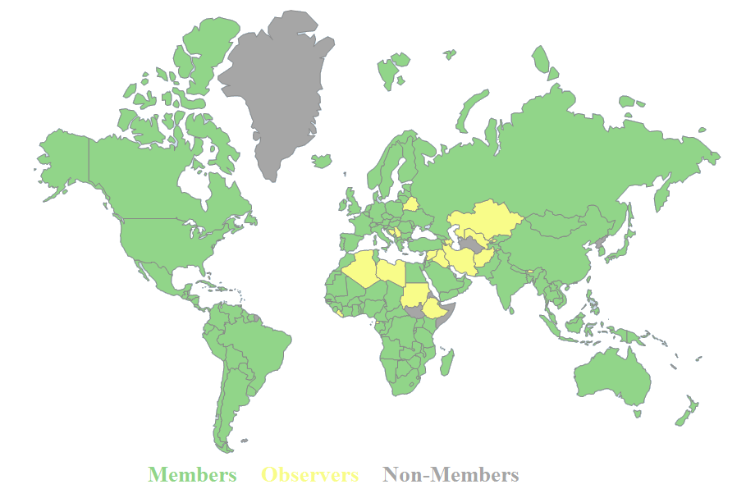
WTO Agricultural regulation
Map of Membership of WTO

Slide 6
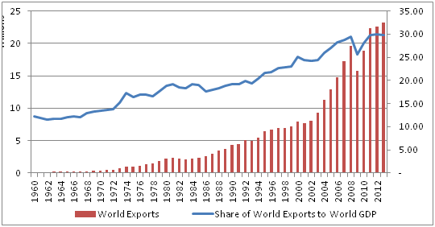
World Exports and Share of World Exports to World GDP

Slide 7
Tajikistan as member of WTO
General Socio-Economic Indicators
 | 2009 | 2010 | 2011 | 2012 | 2013 | 2014 | Jan-June 2015
Gross domestic product in current prices, bln. US dollars | 5,0 | 5,6 | 6,5 | 7,6 | 8,5 | 9,2 | 3,28
Growth rate, % | 103,4 | 106,5 | 107,4 | 107,5 | 107,4 | 106,7 | 106,4
Per capita, US dollars | 663 | 742 | 847 | 952 | 1051 | 1114 | 392,7
Volume of industrial production bln. US dollars | 1,51 | 1,8 | 1,6 | 2,1 | 2,2 | 2,3 | 0,929
Growth rate, % | 93,7 | 109,7 | 105,9 | 110,4 | 103,9 | 105,1 | 114,2
Agricultural production bln. US dollars | 1,90 | 2,1 | 3,2 | 3,5 | 3,5 | 4,2 | 0,852
Growth rate, % | 110,5 | 106,8 | 107,9 | 110,4 | 107,6 | 108,5 | 106,9
Capital Investment bln. US dollars | 0,9 | 1,0 | 1,1 | 0,9 | 1,2 | 1,5 | 0,692
Inflation, за период, % | 5,0 | 9,8 | 9,3 | 6,4 | 3,7 | 7,4 | 6,3
Unemployment, % | 2,2 | 2,3 | 2,6 | 2,5 | 2,5 | 2,5 | 2,6
Trade turnover mln. US dollars | 3578,7 | 3853,1 | 4443,3 | 5137,6 | 5284,8 | 5316,2 | 2009,1
Growth rate, % | 76,4 | 107,6 | 115,4 | 115,1 | 102,9 | 106,6 | 78,1
Export mln. US dollars | 1010,0 | 1195,2 | 1256,9 | 1359,4 | 1163,4 | 977,7 | 434,4
Import mln. US dollars | 2568,7 | 2657,8 | 3186,4 | 3778,2 | 4121,3 | 4338,8 | 1574,7
Exchange rate of Somoni to Dollars | 4,1 | 4,4 | 4,61 | 4,76 | 4,77 | 4,76 | 5,83

Slide 8
Structural Changes of Crop Production in 2000 - 2013

Slide 9
Share in Production of main agricultural products between CA countries in 2013

Slide 10
Dynamics of Trade in 2003-2014 (in thous. US dollars)

Slide 11
Structure of Exports in 2003-2014 (in thous. US dollars)

Slide 12
Structure of Exports of Agricultural Products in 2014

Slide 13
Markets of Main Exporting Products of Tajikistan in 2014
Table 4 Markets of Main Exporting Products of Tajikistan in 2014
 | Cotton | Dried Fruits | Onions | Nuts | Total | In %
 | $132.3 mln. | $21.4 mln. | $7.7 mln. | $2.6 mln. | $164 mln. | 100%
Turkey | 40.7% | 1.0% | 0.0% | 19.5% | 54.57 | 33%
Iran | 21.4% | 1.0% | 0.0% | 4.0% | 28.63 | 17%
Kakakhstan | 0.0% | 78.0% | 91.3% | 57.6% | 25.22 | 15%
Russia | 15.7% | 3.0% | 0.0% | 0.0% | 21.41 | 13%
Pakistan | 13.4% | 0.0% | 0.0% | 0.0% | 17.73 | 11%
China | 2.2% | 1.0% | 0.0% | 7.4% | 3.32 | 2%
Belarus | 1.0% | 6.5% | 0.0% | 3.0% | 2.79 | 2%
Iraq | 0.0% | 3.7% | 0.0% | 1.0% | 0.82 | 0%
Afganistan | 0.0% | 0.0% | 3.4% | 3.0% | 0.34 | 0%
Others | 5.6% | 5.8% | 5.3% | 4.5% | 9.18 | 6%

Slide 14
Structure of Imports in 2014

Slide 15
Structure of Imports of Agricultural Products in 2014

Slide 16
Countries of Origin of Main Importing Products of Tajikistan in 2014
 | Wheat | Wheat Flour | Sunflower oil | Sugar | Bakery | Rice | Margarine | Total | In %
 | $231.5 mln. | $80.6 mln. | $75.7 mln. | $65.6 mln. | $59.8 mln. | $22 mln. | $17.6 mln. | 552.8 mln. | 100%
Kazakhstan | 99.9% | 95.9% | 13.4% | - | 18.8% | 38.6% | - | 338.4 | 61%
Russia | - | 4.1% | 32.9% | - | 44.7% | 35.1% | 92.3% | 78.9 | 14%
Pakistan | - | - | - | 62.7% | - | 3.3% | - | 41.9 | 8%
Turkmenistan | - | - | 50.4% | - | - | - | - | 38.2 | 7%
Afghanistan | - | - | - | 24.8% | - | 15.3% | - | 19.6 | 4%
Iran | - | - | - | - | 21.3% | 7.0% | - | 14.3 | 3%
Belarus | - | - | - | 5.9% | - | - | - | 3.9 | 1%
Kyrgyzstan | - | - | - | - | 3.1% | - | - | 1.9 | 0%
Azerbaijan | - | - | 1.4% | 0.9% | - | - | - | 1.7 | 0%

Slide 17
Obligations of Tajikistan under WTO
The General Agreement on Tariffs and Trade 1994 (GATT);
The Agreement on Agriculture;
The Agreement on the Application of Sanitary and Phytosanitary Measures (SPS Agreement);
The Agreement on Technical Barriers to Trade (TBT Agreement);
The Agreement on Trade-Related Investment Measures;
The Agreement on Implementation of Article VI of the GATT 1994 (the Agreement on Customs Valuation);
The Agreement on the Implementation of Article VII of the GATT 1994 (the Anti­dumping Agreement);
The Agreement on Preshipment Inspection;
The Agreement on Rules of Origin;
The Agreement on Import Licensing Procedures (the Agreement on ILP);
The Agreement on Subsidies and Countervailing Duties (the SCM Agreement);
The Agreement on Safeguard Measures.

Slide 18
Main principles of WTO
Tariff Rates
The Most Favored Nation (MFN)
National Treatment
Subsidies
Agreement on Agriculture
Agreement on Customs Valuation
import licenses
Anti-dumping Agreement
Countervailing Duties
Safeguard Measures
Technical Barriers
Sanitary and Phytosanitary Measures

Slide 19
Obligations for Agricultural Sector
Market access: benefits
Market access: constraints
Constraints from SPS and TBT measures
Domestic agricultural support measures
Agricultural Subsidies

Slide 20
Agricultural Subsidies
Support measures under “Green Box”
 | 2003 | 2004 | 2005 | 2008 | 2009 | 2010
Research | 217 | 503 | 513 | 1586 | 1531 | 1793
Pest and disease control | 311 | 998 | 980 | 1291 | 1277 | 1474
Training services | 131 | 177 | 338 | 728 | 726 | 710
Inspection services | 33 | 74 | 117 | 54 | 54 | 62
Services on distribution of information, expertise and knowledge | 0 | 0 | 0 | 28 | 0 | 0
Infrastructural services | 2408 | 6553 | 7445 | 4139 | 3144 | 2747
Public stockholding for food security purposes | 0 | 0 | 3048 | 0 | 0 | 0
Regional assistance programmes | 0 | 0 | 963 | 0 | 0 | 0
Assistance of structural changes through investment stimulation | 0 | 0 | 0 | 482 | 789 | 1,607
Total | 3101 | 8306 | 13404 | 8308 | 7520 | 8393

Slide 21
Support Measures under “Amber Box”
 | Year | Product-specific AMS | Gross production | Current Total AMS (aggregate)
 |  |  |  | %
Potato | 2008 | 381 | 213939 | 0.17 | 0
 | 2009 | 0 | 226662 | 0 | 0
 | 2010 | 1348 | 265364 | 0.5 | 0
 | Average | 576 | 235324 | 0.24 | 0
Corn | 2008 | 381 | 48354 | 0.78 | 0
 | 2009 | 0 | 0 | 0 | 0
 | 2010 | 0 | 34023 | 0 | 0
 | Average | 127 | 22682 | 0.55 | 0
Wheat | 2008 | 355 | 284381 | 0.12 | 0
 | 2009 | 0 | 231973 | 0 | 0
 | 2010 | 0 | 212455 | 0 | 0
 | Average | 118 | 272936 | 0.04 | 0
Cotton | 2008 | 0 | 250966 | 0 | 0
 | 2009 | 548,000 | 199561 | 274.6 | 548,000
 | 2010 | 0 | 698760 | 0 | 0
 | Average | 182,667 | 383096 | 48.7 | 182,667
Total |  |  |  |  | 182,667

Slide 22
Comparison of commitments among CIS countries
CIS Commitments on Domestic Support
 | Year of Acession | Currency | Base AMS | Transition period | Final Bound AMS | De minimis %
Tajikistan | 2013 | mln USD | 182.7 |  | 182.7 | 10%
Russia | 2012 | bln USD | 4.4 | 2012-2018 | 4.4 | 5%
Ukraine | 2008 | mil UAH | 3043 |  | 3043 | 5%
Armenia | 2003 | USD | 0 |  | 0 | 5%
Moldova | 2001 | mln SDR | 16 | 2001-2004 | 13 | 5%
Georgia | 2000 | GER | 0 |  | 0 | 5%
Kyrgyzstan | 1998 | KGS | 0 |  | 0 | 5%

Slide 23
Average Bound and Applied Tariffs for Agricultural Products

Slide 24
Average Applied and Bound Tariff
 | Armenia |  | Georgia |  | Krygyzstan |  | Moldova |  | Ukraine |  | Russia |  | Tajikistan
 | Bound | App. | Bound | App | Bound | App | Bound | App | Bound | App | Bound | App | Bound | App
Animal products | 15 | 7 | 11 | 8 | 10 | 8 | 17 | 15 | 13 | 11 | 23 | 20 | 9 | 10
Dairy products | 15 | 10 | 12 | 5 | 12 | 11 | 15 | 15 | 10 | 10 | 15 | 17 | 13 | 13
Fruit, vegetables | 15 | 9 | 13 | 9 | 16 | 10 | 14 | 13 | 13 | 10 | 9 | 11 | 13 | 12
Coffee, tea | 14 | 9 | 12 | 5 | 11 | 7 | 11 | 8 | 6 | 6 | 6 | 7 | 7 | 7
Cereals & preparations | 15 | 5 | 14 | 7 | 12 | 8 | 13 | 10 | 13 | 13 | 10 | 12 | 11 | 10
Oilseeds, fats & oils | 14 | 8 | 3 | 0 | 11 | 6 | 11 | 6 | 11 | 8 | 7 | 8 | 7 | 7
Sugars and confectionery | 15 | 8 | 12 | 11 | 10 | 4 | 56 | 19 | 18 | 18 | 13 | 13 | 10 | 6
Beverages & tobacco | 15 | 8 | 39 | 24 | 19 | 15 | 16 | 13 | 9 | 12 | 24 | 29 | 31 | 31
Cotton | 15 | 0 | 9 | 0 | 10 | 0 | 0 | 0 | 1 | 1 | 0 | 0 | 20 | 15
Other agricultural products | 15 | 3 | 11 | 0 | 10 | 2 | 9 | 5 | 8 | 6 | 5 | 6 | 7 | 7

Slide 25
Non-tariff measures applied by WTO members in 2014
 | ADP | CV | LIC | QR | SG | SPS | SSG | TBT | TRQ | XS | Total
World | 1881 | 177 | 643 | 1087 | 299 | 14002 | 658 | 19494 | 1256 | 429 | 39926
USA | 297 | 89 | 15 | 31 | 10 | 2762 | 173 | 1200 | 52 | 13 | 4642
China | 112 | 5 | 4 | 21 |  | 1019 |  | 1082 | 10 |  | 2253
Brazil | 199 | 5 | 2 |  | 4 | 1055 |  | 755 | 1 | 16 | 2037
EU | 131 | 21 | 18 | 11 |  | 552 | 27 | 908 | 87 | 20 | 1775
Canada | 70 | 30 | 17 | 26 | 3 | 937 |  | 585 | 21 | 11 | 1700
Japan | 5 |  | 17 | 42 | 1 | 420 | 97 | 720 | 18 |  | 1320
Israel | 9 |  | 2 |  | 2 | 9 |  | 866 | 12 | 6 | 906
Chile | 2 |  | 1 |  | 15 | 507 |  | 380 | 1 |  | 906

Slide 26
Discussions
Main market of imports - CIS countries
Kazakhstan and Russia share 75% of main agricultural imports of Tajikistan
Free Trade Agreement of CIS
Substitution of domestic wheat to imports from Kazakhstan
Elimination the risk of illegitimate measures
Potential markets
182 million dollars plus the amount of 10% de minimis of production value of Amber box support
“Cotton Four” group

Slide 27
Conclusion
taken by Tajikistan in agricultural sector reveals no significant changes in policies and trade regime that was applied before accession. Negotiated terms are at acceptable level allowing smooth transition of economy without withstanding drastic competitive pressure from external markets
in a future perspective rather more important to liberalize food market with purpose of lowering prices and covering shortages of provisions
would make possible to identify competitive sectors and concentrate limited opportunities in their development

Slide 28
Continued
boost of trade flows and obvious improvements from better trade conditions should not be expected in a short term conditions
Amends from accession to WTO is a long-term unquantifiable investment
significant effects reached through indirect influences, such as of being under the protective shield of dispute settlement mechanism, defense of national interests in negotiation processes, technical support in reforms of government institutions, increasing investment attractiveness and credibility of country

Slide 29
References
CAFOD, 2002, Dumping on the Poor: The Common Agricultural Policy, the WTO and International Development, available at http://www.iatp.org/files/Dumping_on_the_Poor_The_Common_Agricultural_Po.htm: accessed 2015-11-15
Custom Service of Republic of Tajikistan, 2015, Customs Statistics Reports, Available at http://customs.tj/: accessed 2015-10-08.
FAO., 2015. FAOSTAT: Crop Production. Available at http://faostat.fao.org/ : accessed 2015-10-02.
Martin Khor, 2002, The WTO Agriculture Agreement, Features, Effects, Negotiations, and What is at Stake, available at: www.twn.my/title2/latestwto/AOAFAO.doc: accessed 2015-11-15.
Rodriguez Francisco, Rodrik Dani, 2001, Trade Policy and Economic Growth: A Skeptic's Guide to the Cross-National Evidence, National Bureau of Economic Research, Macroeconomics Annual 2000, Vol. 15: p.261 – 338, available at http://www.nber.org/chapters/c11058.pdf : accessed 2015-11-10
Rodrik Dani, 2002. Trade Policy Reform as Institutional Reform, available at www.sss.ias.edu: accessed 2015-11-15
Statistic Agency of the Republic of Tajikistan, Tajikistan in numbers 2006-2009, 2015. Available at www.stat.tj: accessed 2015-10-12
Tang Man-Keung, Wei Shang-Jin, 2006, Does WTO Accession Raise Income? CEPR, Working paper. available at: http://users.nber.org/~wei/data/tang&wei2006/WTO-Accession_journal_version_060706.pdf : accessed 2015-11-15
World Bank. 2015. World Bank Development Indicators. Available at http://data.worldbank.org/ : accessed 2015-11-15
WTO. 2015. Working Party Accession documents of Tajikistan WT/ACC/SPEC/TJK/3/Rev.2 and Rev. 3, Available at https://docs.wto.org/: accessed 2015-10-15.
WTO. 2015. Working Party Report on Accession of Russian Federation WT/ACC/RUS/70/Add.1 https://docs.wto.org/: accessed 2015-10-15.
WTO. 2015. WTO Trade Profiles 2012, 2013, 2015, Annual publication, available at https://www.wto.org/english/res_e/reser_e/tariff_profiles_e.htm: Accessed 2015-10-11.
WTO. 2015. WTO Integrated Trade Intelligence Portal Database. Available at http://i-tip.wto.org/goods/default.aspx?language=en: accessed 2015-11-02.

Slide 30
Thank You.

