Slide 1
UI Specification for delivery/catering application
Informatics
Author: Yernar Imangaliyev
Supervisor: Ing. Josef Pavlíček, Ph.D
Notes:
Opening slide: Thesis title, name, study program, supervisor's name

Slide 2
Objectives and methodology of work
Main goal: Create a User interface specification and functional prototype for a delivery and catering mobile application.
Partial goals:
Conduct usability testing
Application should contain features:
Online menu in the catering place
Delivery
Table reservation
Methodology:
Analyze existing solutions through study of literature sources and analysis of similar software
Test prototype on real users via Usability testing methods
Focus on UI specification for application, functional prototype creation, and usability testing

Slide 3
Theoretical Part
Human-computer interaction
User interface
User experience
UI specification
Analysis of similar software

Slide 4
Practical Part: Use of Methods
Design system
User Interface principles
User Personas, target audience.
Lo-fi and Hi-fi wireframes
Use cases and scenarios
Usability testing

Slide 5
Practical Part: Data Collection
Usability testing
Testing process

Slide 6
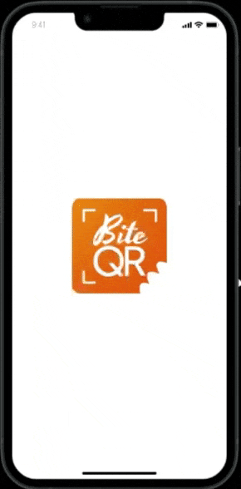
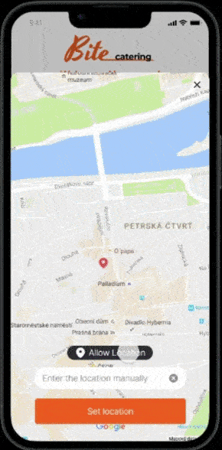
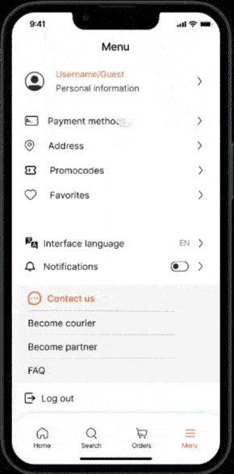
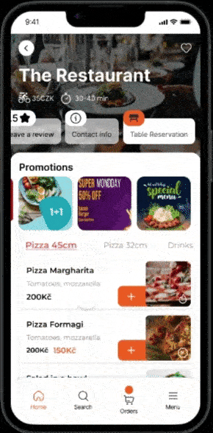
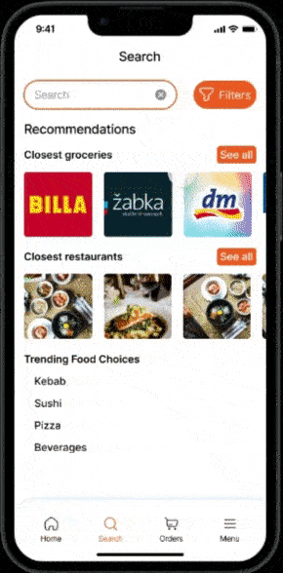
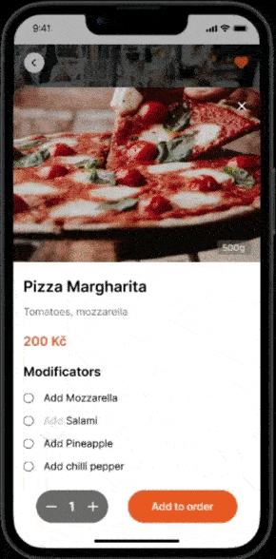
Results
Usability testing results
Modifications on found issues
Functional prototype
Conclusion

