Slide 1
INCREASE DIRECTIONS OF THE ENTREPRENEURSHIP STATE REGULATION EFFECTIVENESS IN THE TOURISM INDUSTRY
MINISTRY OF EDUCATION AND SCIENCE OF RUSSIAN FEDERATION
Federal State Budgetary Educational Institution of Higher Education
KUBAN STATE UNIVERSITY
Faculty of Economics
Marketing and Trading Business Department
Master’s Thesis
Scientific leader: Bogdashev I.V., Candidate of Economy Science
APALKOVA A.A.
2019

Slide 2
Goal, object and subject of the research.
Goal. The aim of the research is the developing of complex approach for studying mathematical methods in forecasting basic macroeconomic indicators of tourism industry and suggesting the recommendations for improving government policy for entrepreneurs in tourism sector.
Object. We consider basic macroeconomic indicators of tourism industry as an object of the research.
Subject. We consider mathematical methods of forecasting in tourism studies as a subject of the research.

Slide 3
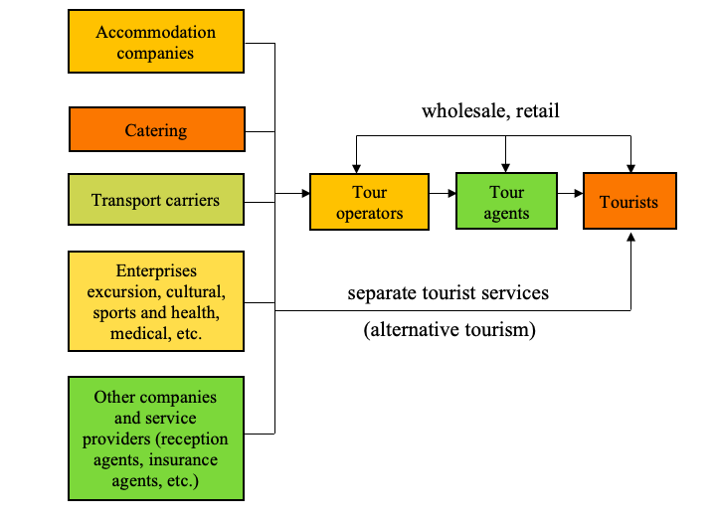
Figure 1 – Tourism infrastructure
“Tourism entrepreneur is a person or a group of persons producing and managing tourism products”

Slide 4
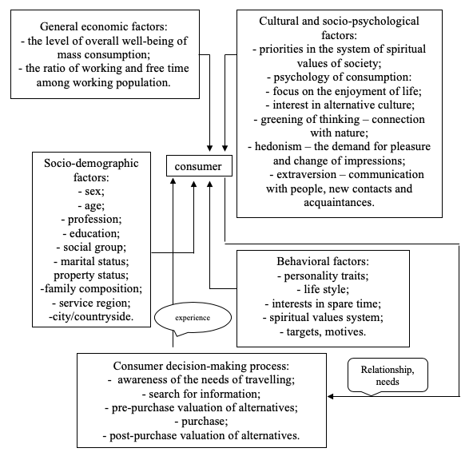
Main provisions of the theoretical part:
Figure 2 – Factors influencing on demand in the field of tourism
In part 1.1 we defined the concept, types and form of tourism entrepreneurship.
Part 1.2 is represented by main directions of entrepreneurship support. This study covers state entrepreneurial policies in the following categories: general perspective of entrepreneurship, tax and regulatory climate, access to capital, entrepreneurship education and intellectual capital.
Further in part 1.3 we characterized the tourism market and peculiarities of its regulation.
Then in part 1.4 we found out the essence of the econometric modeling of macroeconomic indicators in tourism industry.

Slide 5
Table 1 – The main indicators of tourism industry in Russia
Main indicators | Years |  |  |  |  |  |  | Rate of growth, %
 | 2011 | 2012 | 2013 | 2014 | 2015 | 2016 | 2017
Travel & Tourism Direct Contribution to GDP, $ million | 25000 | 26000 | 27000 | 26000 | 17000 | 16000 | 19000 | -24,0
Expenditures, current US$ million | 37343 | 48096 | 59504 | 55383 | 38434 | 27653 | 35585 | -4,7
Travel & Tourism Direct Contribution to Employment, thousand people | 851,8 | 808,5 | 814,2 | 838,3 | 807, 8 | 850,1 | 854,6 | 0,33
Inbound Tourism Indicators, $ million | 8830 | 11328 | 10759 | 11988 | 11759 | 8420 | 7788 | -11,8
Receipts, current US$ million | 16961 | 17876 | 20198 | 19451 | 13204 | 12820 | 14983 | -11,6

Slide 6
The main indicators of tourism industry in Cyprus and Czech Republic
Table 2 – The main indicators of tourism industry in Cyprus
Table 3 – The main indicators of tourism industry in Czech Republic
Main indicators | Years |  |  |  |  |  |  | Growth rate, %
 | 2011 | 2012 | 2013 | 2014 | 2015 | 2016 | 2017
Travel & Tourism Direct Contribution to GDP, $ million | 1000 | 1000 | 2000 | 1000 | 1000 | 1000 | 2000 | 100,0
Travel & Tourism Direct Contribution to Employment, thousand people | 22,4 | 24,4 | 26,5 | 25,3 | 23,5 | 24,7 | 26,1 | 16,5
Inbound Tourism Indicators, $ million | 2160 | 2554 | 2599 | 2893 | 2844 | 2487 | 2762 | 27,8
Receipts (current US$ million) | 2707 | 2732 | 3020 | 2920 | 2481 | 2757 | 3128 | 15,5
Expenditures (current US$ million) | 1730 | 1687 | 1621 | 1771 | 1439 | 1604 | 1781 | 2,95
Main indicators | Years |  |  |  |  |  |  | Rate of growth, %
 | 2011 | 2012 | 2013 | 2014 | 2015 | 2016 | 2017
Travel & Tourism Direct Contribution to GDP, $ million | 6000 | 6000 | 5000 | 5000 | 5000 | 5000 | 6000 | 0
Travel & Tourism Direct Contribution to Employment, thousand people | 249,7 | 226,4 | 207,3 | 211,8 | 213,5 | 218,4 | 223,4 | -10,5
Expenditures (current US$ million) | 4876 | 4556 | 4698 | 5173 | 4819 | 4963 | 5518 | 13,1
Receipts (current US$ million) | 8930 | 8174 | 7792 | 7614 | 6766 | 7041 | 7693 | -13,8
Inbound Tourism Indicators, $ million | 7172 | 8096 | 7456 | 7042 | 6822 | 6056 | 6308 | -12,0

Slide 7
Figure 3 - Direct contribution of tourism to GDP in Russia, Cyprus and Czech Republic
The red color – is Russia, the green one – is Cyprus, and the blue color – is Czech Republic.

Slide 8
Prediction for the direct tourism contribution to the Gross Domestic Product
The multiple linear regression model’ equation is the following as in the Formula 1:
$y=−5818,78+2,05x_{2}−0,13x_{3}$, (1)
Coefficient of determination R² = 0,9473 that shows close linear relationship between variables.
Table 4- Predicted values for the direct tourism contribution to GDP of Russia, $ mln.
# | Years | Value
1 | 2018 | 1299,7806
2 | 2019 | 1296,9556
3 | 2020 | 1295,5726
4 | 2021 | 1294,1895
5 | 2022 | 1292,8065

Slide 9
Figure 4 - The set of instruments of state regulation:

Slide 10
Conclusion
After analysis we made, such suggestions and recommendations for improving the government policy for tourism sector will be offered. The main ways to stimulate the state investment activity in the tourist regions of the country include:
- tax regulation of investment activities;
- institutional transformation of the economy associated with the creation of industrial groups;
- real protection of property rights.
In general, government regulation of tourism is an effective means of stimulating investment activity, improving the quality of services provided and solving social problems in terms of the real health of the nation. However, it is important to bear in mind that the main directions of state policy should be the stability and competitiveness of the tourist complex.

Slide 11
List of publications:
Articles in journals, anthologies:
1. Apal’kova A.A., Zhuravleva E.A. Identifying key macro-economic factors of the development strategy in tourism industry by using econometric modeling instruments // In collection of articles: Problems and perspectives of marketing strategies formation in condition of unstable market (Materials of III International scientific-practical conference. Kuban State University; Resp. red. A. N. Kostetskiy. 2018. P. 29-35.
2. Apalkova A.A., Bogdashev I.V., Votchenko E.S. Tourism industry in Russia and the EU: are there any consequences of multi-tiered national agenda? // in scientific journal "Bulletin of Peoples' Friendship University of Russia. Series: Economics" (the article is being peer reviewed); 2019.
3. Apalkova A.A., Votchenko E.S. Suggestions and Recommendations for Improving the Governmental Policy for Tourism Sector // Sciences of Europe # 40, (2019).

Slide 12
Thank you for your attention !

