Slide 1
Impact of pollutants on the efficiency of PV panels in the Czech Republic.
Author: Ivan Ekimov
Supervisor: Vladislav Poulek

Slide 2
Aim of the thesis
Evaluate data from various polluted PV panels in Prague.
Compare data from a clean panel to data of the contaminated panel.
Make conclusions according to the data.

Slide 3
Methodology
Data from clean and contaminated solar panels were collected at 12 o’clock (noon) over the coarse of about five months.
To evaluate the impact of the environment conditions, data were collected in two locations with different levels of air pollution, during the sunny weather with a clear sky.
To estimate the area of pollution of the solar panel, Photoshop cs6 was used.
To compare the data and for the statistical analysis, Microsoft Excel was used.

Slide 4
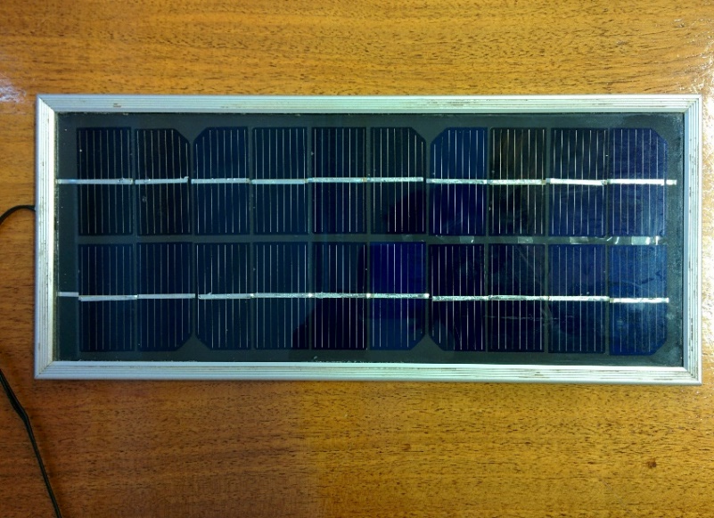
Solar panel
The panel used was a polycrystalline silicon solar panel. This PV panel was chosen, because it is the most common and popular type of panel today.
Solartec SMP 8-350.

Slide 5
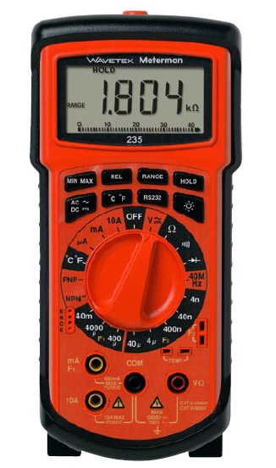
Multi-meter
This multi-meter includes many functions and is a high-quality measuring tool. Since the dimensions of the panel are small enough, the values obtained are small, which is why it is necessary to use a multi-meter with an accurate measurement.
                Wavetek model 235 digital multimeter.

Slide 6
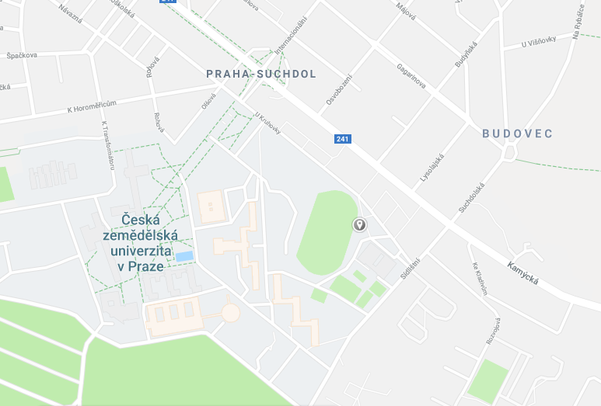
Locations
The first location, close to the Czech University of Life Sciences stadium, was chosen because there are no large buildings and trees nearby that could interfere with the proper collection of information.
Location №1
GPS 50.130136, 14.379580.

Slide 7
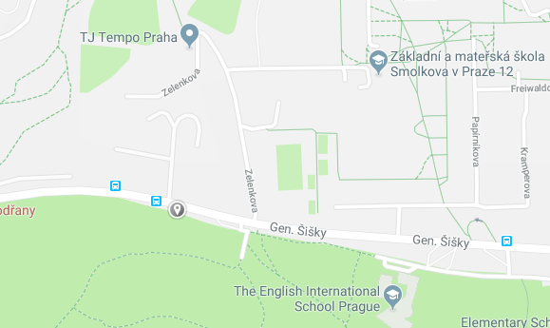
Locations
The second location was close to Observatoř Libuš bus station. That place was chosen because earlier data was used from EEA and it could help determine the effect of pollution on efficiency.
Location №2
GPS is 50.006571, 14.446786.

Slide 8
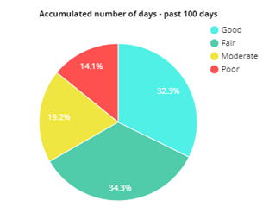
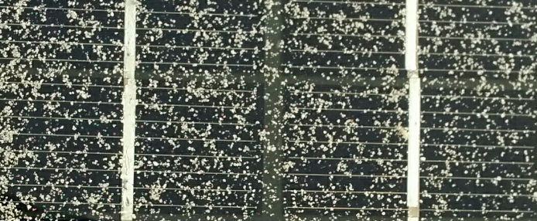
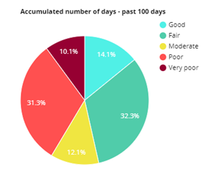
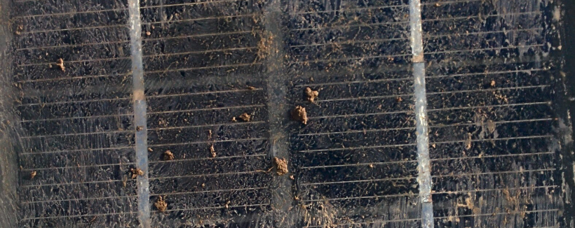
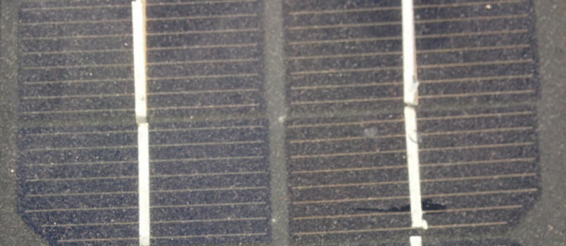
Pollutants
Dust
Mud
Sand
Air pollution

Slide 9
Results
The influence of dust (relative power decrease) was about 10%, which is quite large, as the efficiency of modern polycrystalline silicon panels is up to 18%. In the cloudy weather, the effect of pollution is reduced to about 6-7%, but during the sunny weather the reduction of the power ​​is highly undesirable because the pollution effect reaches rather high values ​​in 14-15%.
The average effect of sand on the efficiency of the solar panel is 12-13%, which is quite large. With cloudy weather, the effect is 6-10%, but the maximum effect can reach 17-19%.
The effect of mud was more significant when compared with other pollutants in the average effect of 15-16%. As in other cases, during the cloudy weather its about 9-10%, and the maximum effect is noticeable in sunny weather. These values can reach quite large values of 22-24%.
The effect of air pollution is within the error limits. When calculating the energy received, these values can be disregarded since there is no apparent correlation of the data.

Slide 10
Conclusion
The data were compared and analysed.
The influence of such types of pollution as dust, dirt, sand were estimated.
Unfortunately the influence of the environment was not evaluated.

Slide 11
Thank you for your attention!

