Slide 1
How culture affects doing business: Case study of China and U.S.A
CZECH UNIVERSITY OF LIFE SCIENCES PRAGUE
DEPARTMENT OF ECONOMICS
FACULTY OF ECONOMICS AND MANAGEMENT
Nikiti Alexandr – EADAN 2014/2015
Supervisor: Ing.Richard Selby, Ph.D

Slide 2
Objective of diploma thesis
Objective of this diploma thesis is to compare Chinese business culture and U.S.A. business culture according to five Hofstedes dimensions of national cultures, Trompenaars seven dimensions of culture and ten major areas of business life from the personal cultural profile, and then to find out in which aspects these cultures differ and coincide

Slide 3
Methodology
Methods used in this diploma thesis are descriptive method and comparative method

Slide 4
Theoretical part of diploma thesis
In the theoretical part of thesis I introduced the notion of culture , Hofstede’s cultural dimensions theory, Trompenaars seven dimensions and ten major areas of a business life from the personal cultural profile

Slide 5
Practical part of diploma thesis
In practical part of thesis Chinese and U.S.A cultures are compared with 5 Hofstede's dimensions of national cultures, seven Trompenaars dimensions and 10 major areas of a business life from the personal cultural profile

Slide 6
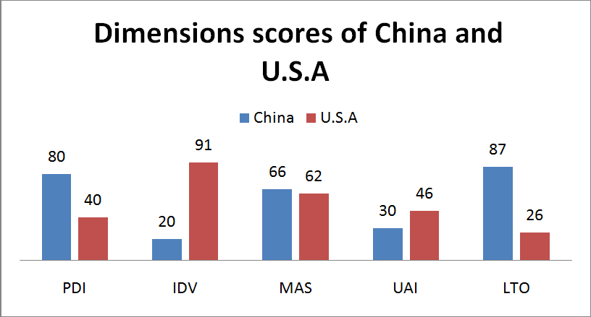
Comparison of Hofstede's dimensions of Cina and U.S.A

Slide 7
Comparison of seven Trompenaars dimensions of China and U.S.A
Dimensions | China | U.S.A
Universalism versus particularism | Particularist | Universalist
Individualism versus collectivism | Collectivist | Individualistic
From specific versus diffuse | Diffuse | Specific
Neutral versus affective | Neutral society | Mildly affective
Achievement versus ascription | Ascription-orientated | Achievement-oriented
Time orientation & sequential time versus synchronous time | Synchronous times oriented culture with long-term time horizon and where past, present and future have the same importance | Sequential time oriented culture with short-term time horizon and future orientation.
Internal–external control | External-control | Internal-control

Slide 8
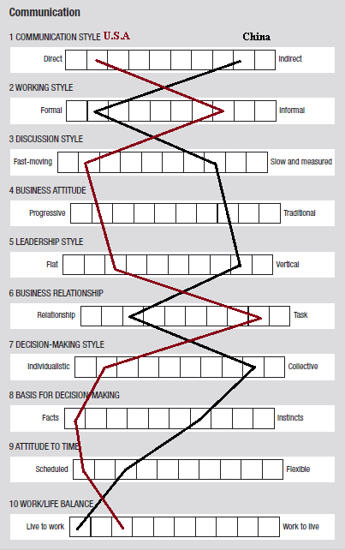
Comparison between personal cultural profiles of China and U.S.A

Slide 9
Conclusion of diploma thesis
According to five Hofstede's dimensions of national cultures China and U.S.A have very close results in 2 dimensions and they differ in 3 dimensions
If we evaluate China and U.S.A according to seven Trompenaars dimensions we would find that they differ in all 7 dimensions
According to the results from cultural profiles of China and U.S.A these two countries have similarities in 2 areas of business life and they differ in 8 areas of business life

Slide 10
Conclusion of diploma thesis
The results of this diploma thesis clearly shows that Chinese business culture and U.S.A business culture don’t have many similar characteristics
The business between these two cultures is affected by big cross-cultural differences
Chinese who want to do business with Americans or Americans who want to do business with Chinese have to study very carefully all the differences between their cultures so they don’t get into an uncomfortable situations.

Slide 11
Thank you for your attention

