Slide 1
Linux server system setup and configuration using terraform and ansible
TINASHE BVUKUMBWE

Slide 2
Agenda
-Introduction
-Main Objective
-Methodology
-Practical Part

Slide 3
Introduction
Imagine you are a DevOps engineer for a small and your main responsibility is to make sure that the application is deployed, code is up to dance, servers are up to date . How these technologies can work well and play well together.

Slide 4
Objectives
Topic 1

Slide 5
Objectives
Main Objective
Partial objectives
- Investigate how a small company can leverage open-source tools such as Ansible and Terraform to run efficient infrastructure using GitOps principles.
-Explain and evaluate the existing literature on cloud computing, google cloud platform, Linux, ansible, terraform, bitbucket and GitOps. -Explain and evaluate trends in IT infrastructure from physical hardware to virtual machines. -Explain how IT infrastructure can be managed using code, from setting up a Linux server using Terraform to configuring it using Ansible.

Slide 6
Methodology
Topic 2

Slide 7
Methodology
The study will analyze information sources, including books and online journals. The student will also use scientific and expert literature as well as data from academic journals that cover the topics of Linux infrastructure and configuration. The author will also create a virtual machine and configure it.

Slide 8
Practical
Topic 3

Slide 9
GitOps
GitOps is an operational framework that takes DevOps best practices used for application development such as version control, collaboration, compliance, and CI/CD, and applies them to infrastructure automation.

Slide 10
GITOPS PIPELINE

Slide 11
GITOPS PIPELINE

Slide 12
ansible

Slide 13
terraform

Slide 14
Terraform

Slide 15
terraform

Slide 16
Jenkins

Slide 17
Three column content
Summary
summary
summary
Add text, images, art, and videos.
Add transitions, animations, and motion.
Save to OneDrive to get to your presentations from your computer, tablet, or phone.
Open the Design Ideas pane for instant slide makeovers.
When we have design ideas, we’ll show them to you right there.
This PowerPoint theme uses its own unique set of colors, fonts, and effects to create the overall look and feel of these slides.
PowerPoint has tons of themes to give your presentation just the right personality.

Slide 18
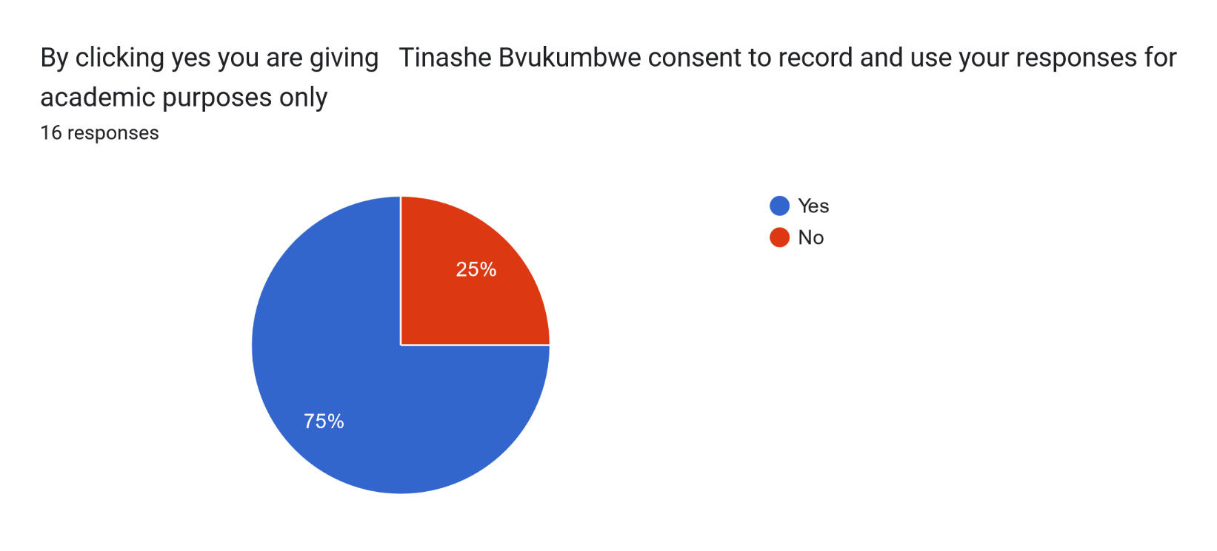
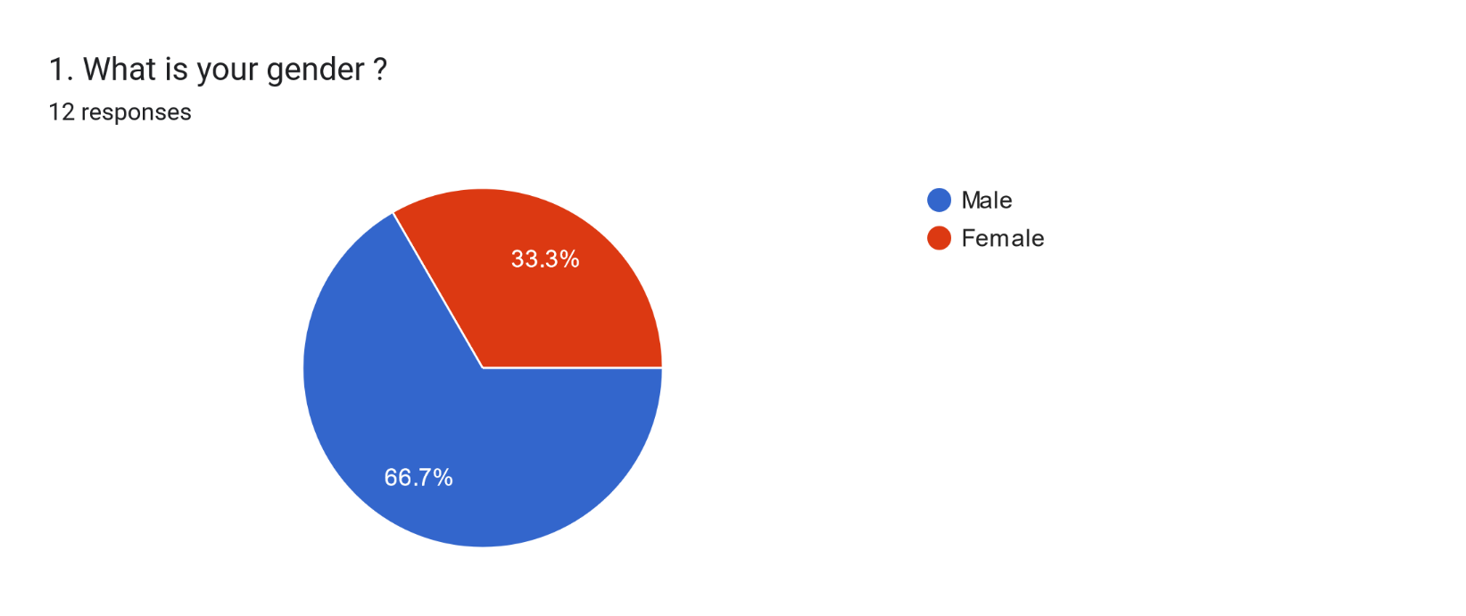
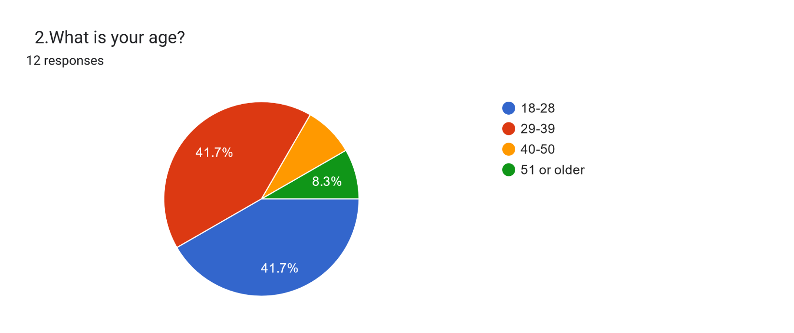
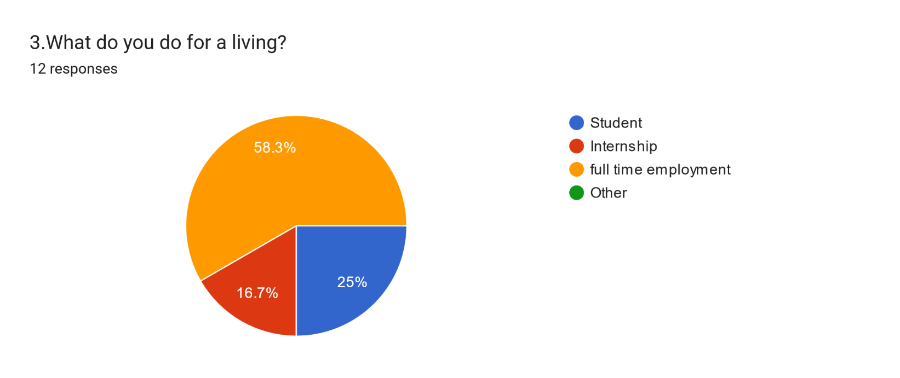
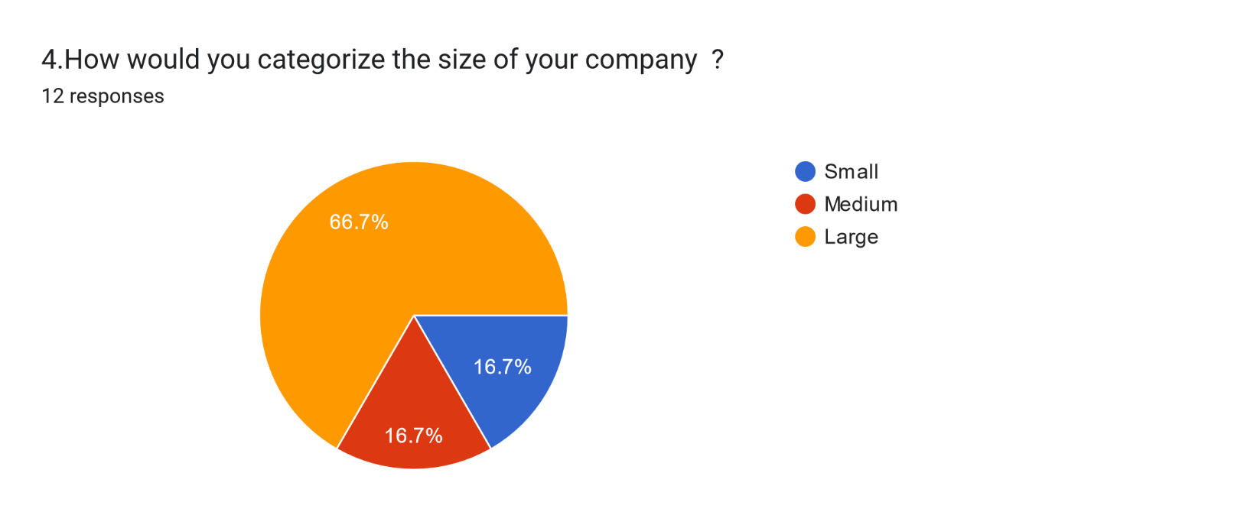
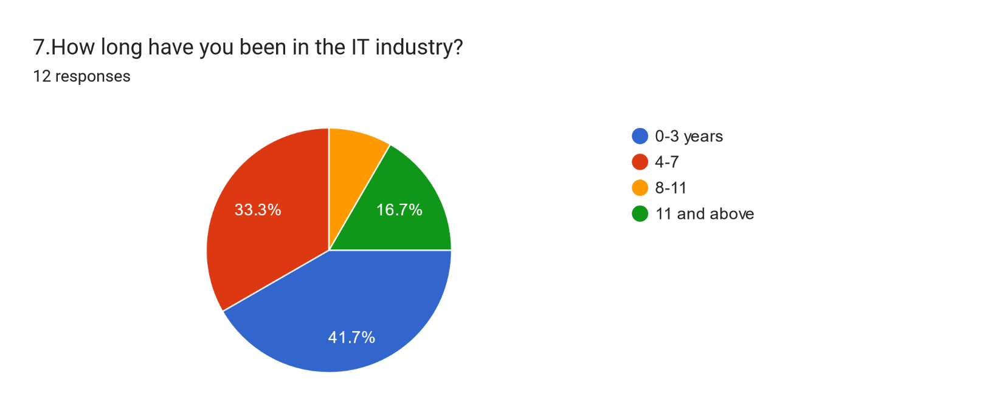
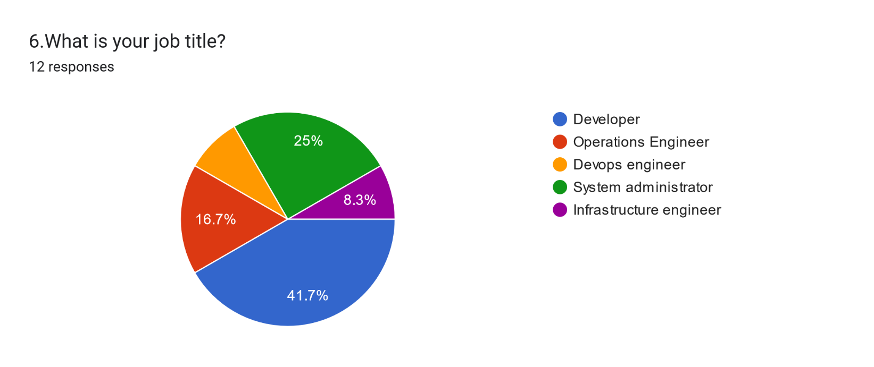
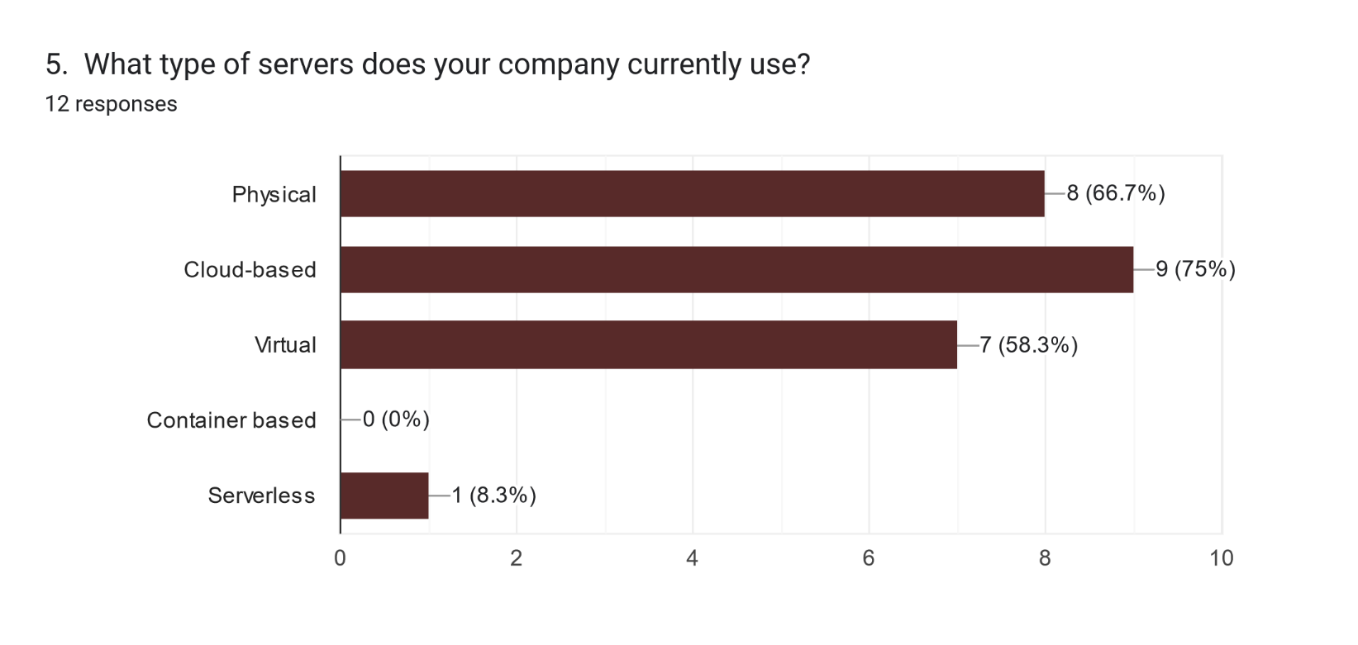
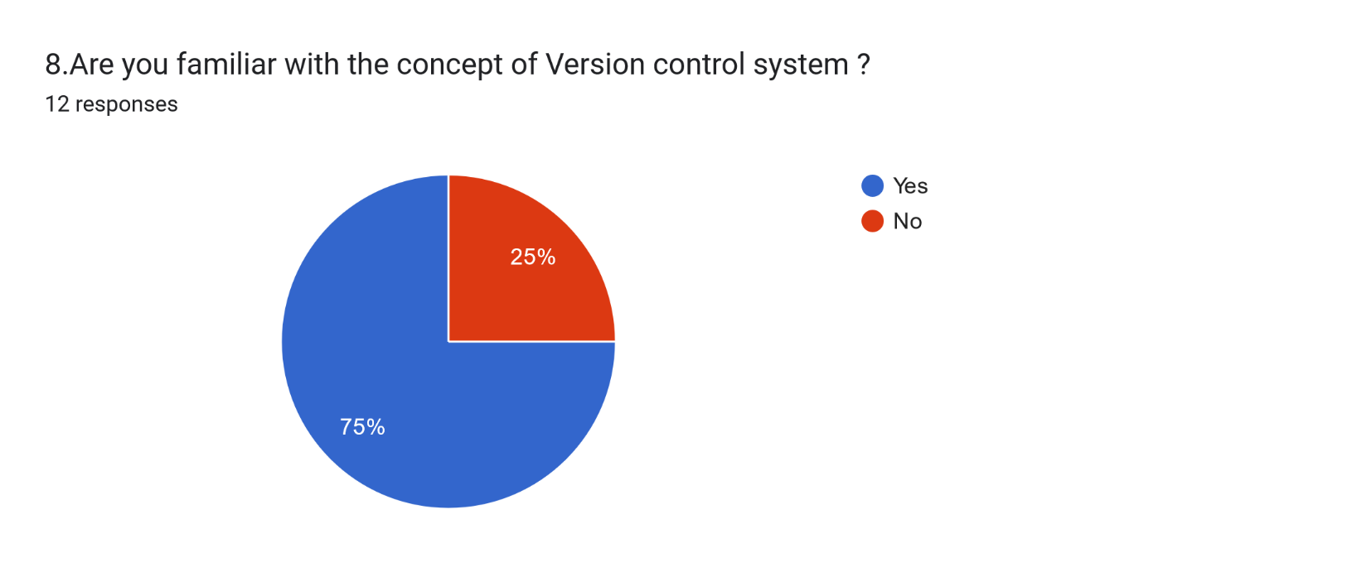
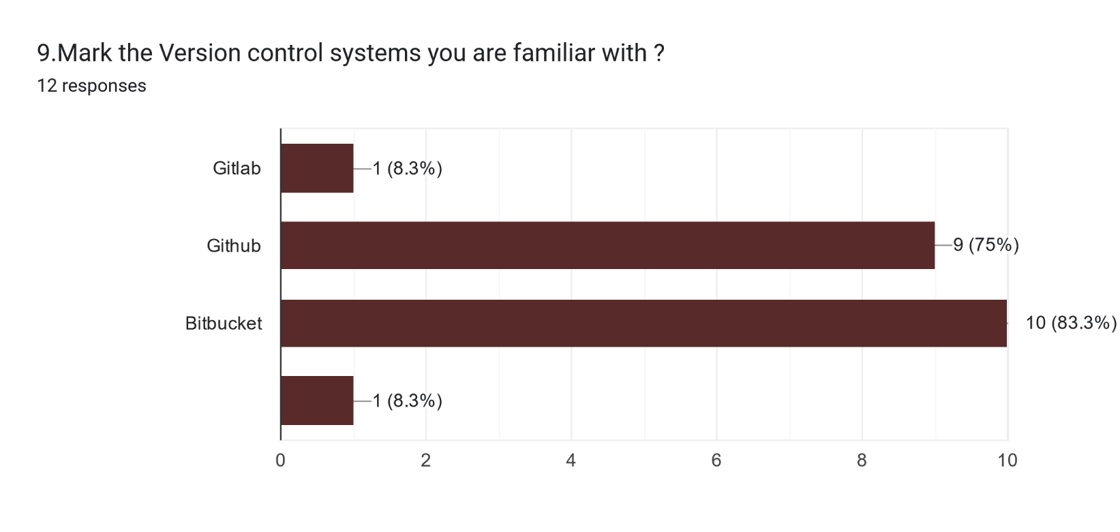
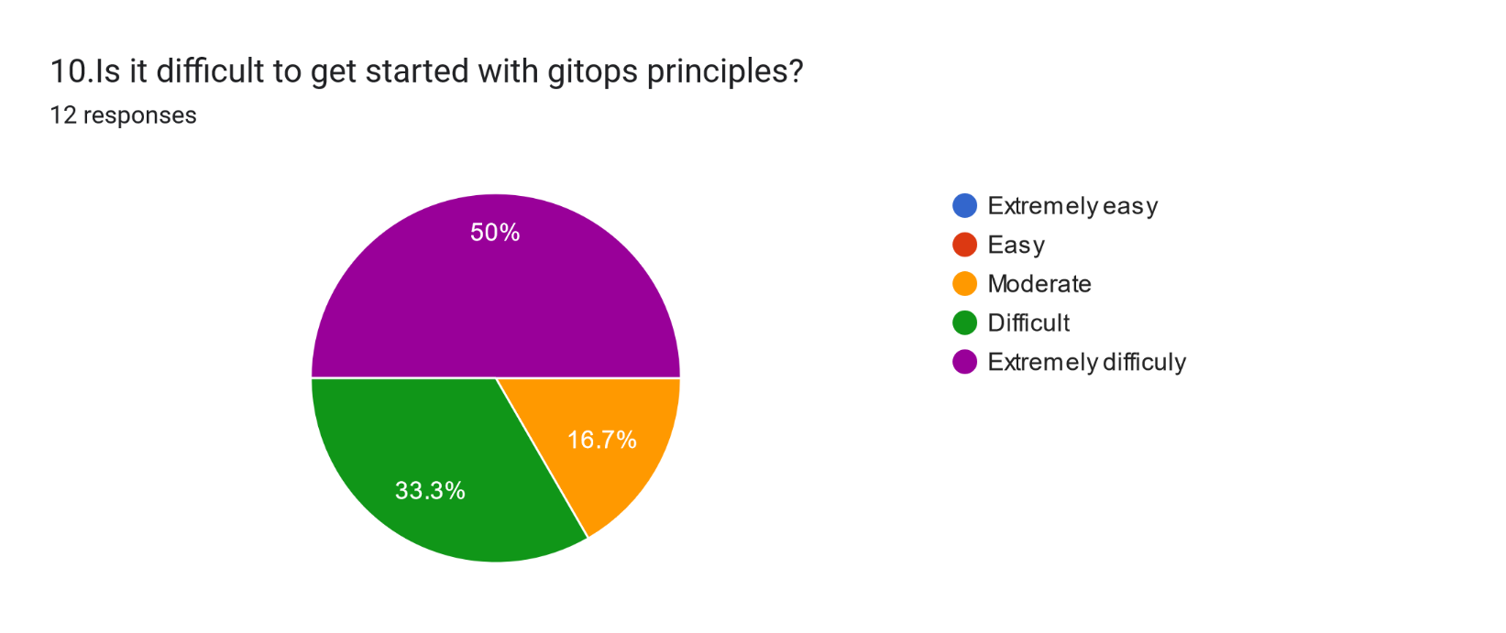
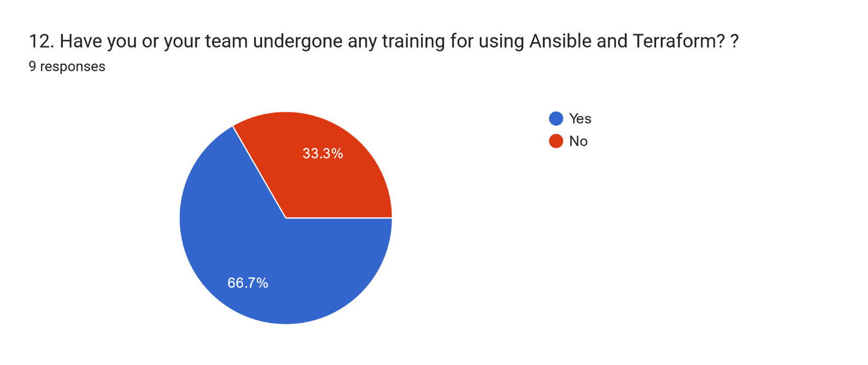
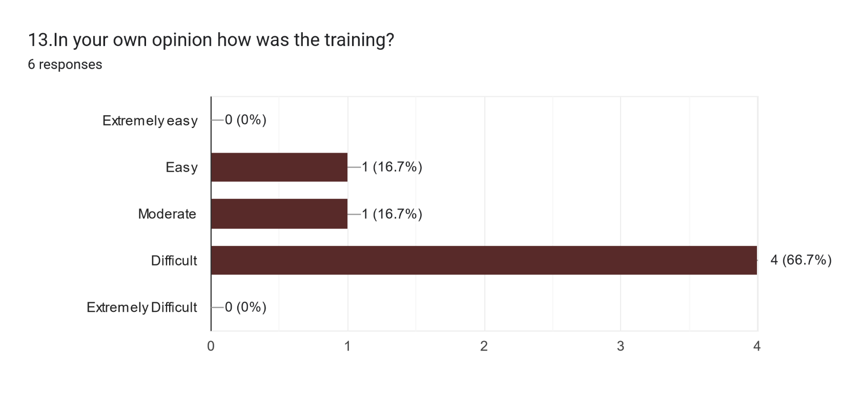
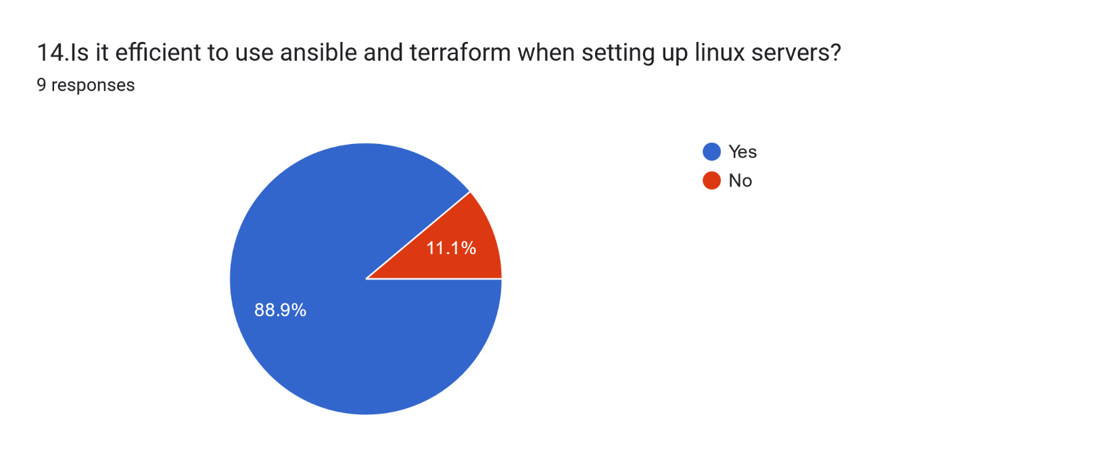
Conclusion
For the conclusion of this research paper, l created a survey to ask about the experiences of users, and below are the questions and results
From the survey above we can see that getting started with ansible and terraform is difficult. But people in the IT industry are still finding it useful to learn it since it will make life easier for them once they learn it.

Slide 19
Thank you
Dekuji

