Slide 1
FINAL THESIS
Transaction system of banking sector
Author: Maksim Porozhniuk
Supervisor: PhDr. Oldrich Ludwig Dittrich, Ph.D.
Department: Economics Theories

Slide 2
Aims of the Diploma thesis
1. Analyzing how the current system of interbank transactions works
2. To notify the difference between centralized and distributed ledger transaction systems
3. Show possible ways of developing of transactions and banks

Slide 3
Objectives and Methodology
Objective of thesis: The main objective of the thesis is to show the algorithm of transactions in the interbank system with description of the main payment systems a ways developing. The theoretical part describes the basics of transactions. The practical part is the analysis of data transactions in payment systems.
Methodology: Research of documentary and reports Analysis of companies that works with their own payment system or is an expert in the subject. Also it includes SWOT and PESTLE analysis. Theoretical part includes description of transactions history, legal laws, modern forms of transactions between banks. The practical part includes the analysis of the difference in the in a centralized and distributed systems.

Slide 4
Hypotheses
Current transaction system will changed to another one
New systems of transactions can make world process faster
A distributed ledger transaction system is more efficient than a centralized
Digital money can be a possible future for humanity

Slide 5
Content
1 Introduction
Objectives and Methodology
3 Literature Review
3.1 Fundamentals/Evolution of transactions and money
3.2 Payment systems
3.3 Legal regulation
4 Practical Part
4.1 From a centralized to a distributed model
4.1.1 SWIFT System
4.2 Analysis of transactions within a distributed registry, blockchain
4.2.1 Ripple
Results and Discussion
5.1 Current payment trends
5.2 The future of banks and the development of transaction system
6 Conclusion
7 References
8 Appendix

Slide 6
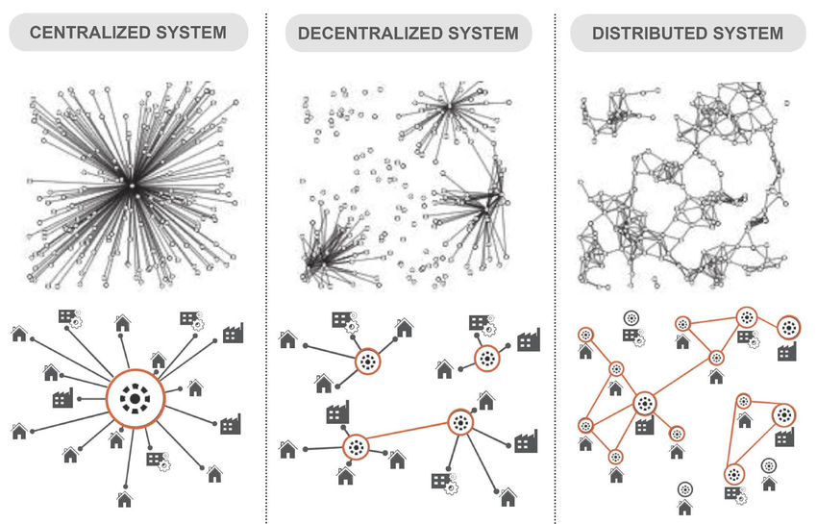
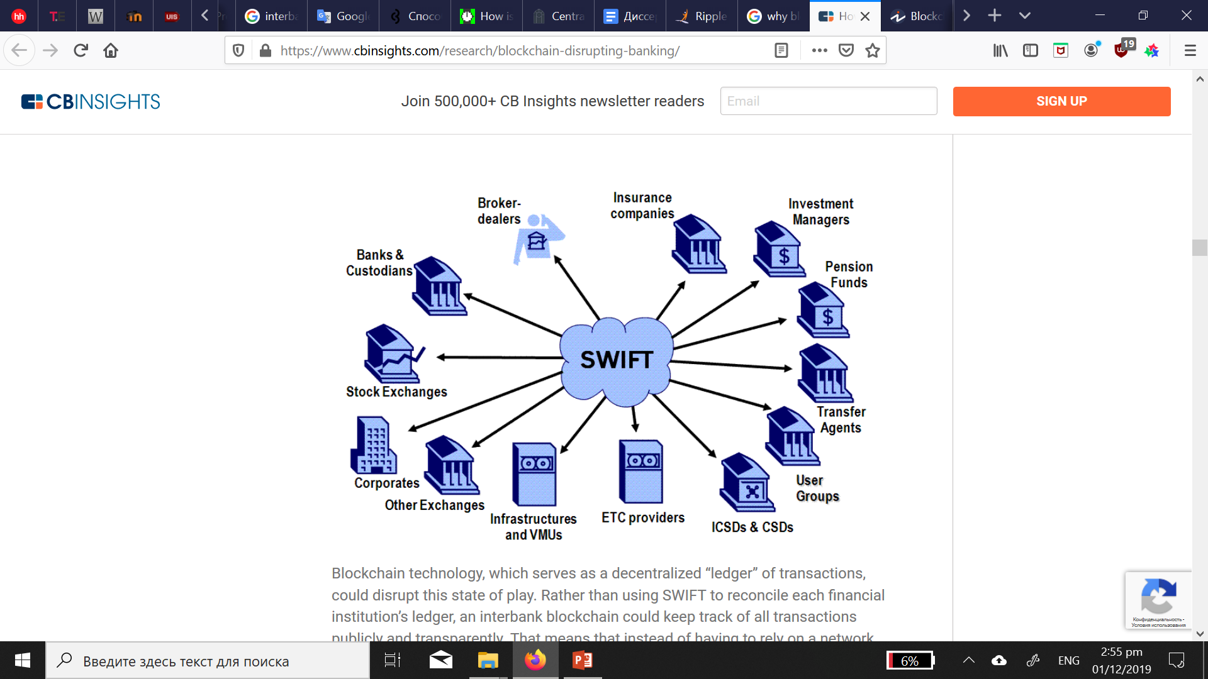
Centralization system
Source: Paul Baran, on distributed communications networks, 1962

Slide 7
Payment systems
The set of processes and technologies that transfer cash value from one entity or person to another are designated as a payment system. The payments themselves are made for various reasons, for example, the purchase of goods, payment for services or money transfer. Payments can be in different currencies and different methods are used for their delivery, cash, checks, electronic payments and plastic cards. All payments go through payment systems.
Fundamentals of Global Payment Systems and Practices, Treasury Alliance Group llc., 2018
Source: Fundamentals of Global Payment Systems and Practices, Treasury Alliance Group llc., 2018

Slide 8
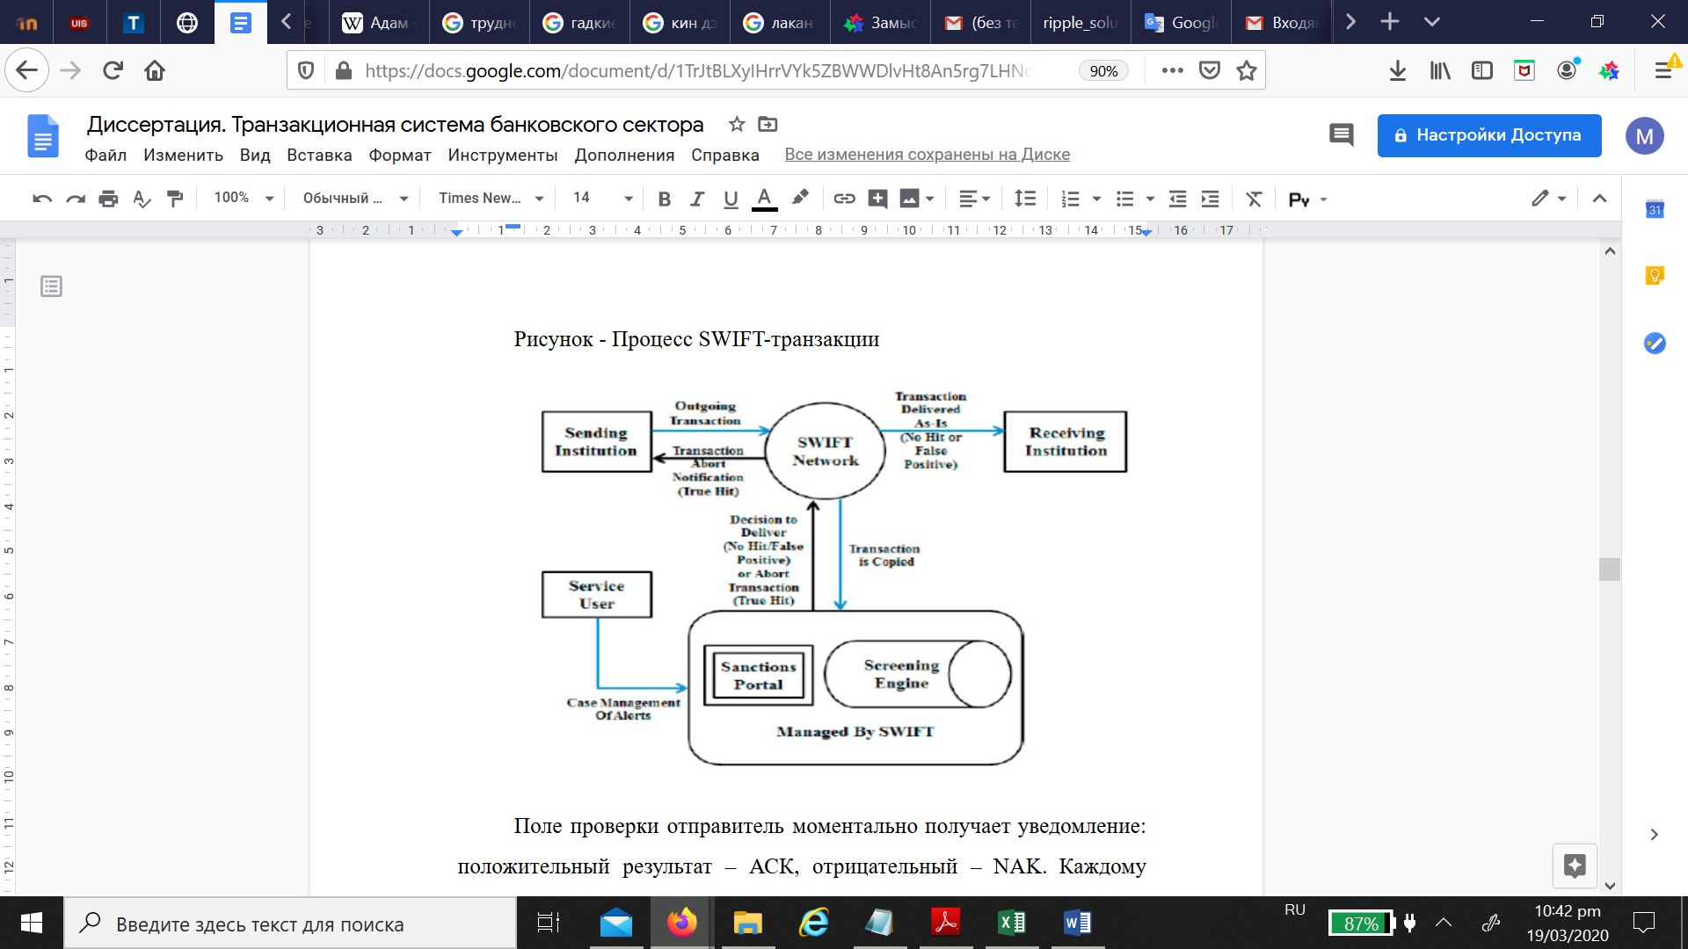
SWIFT
Source: C. Allison, “What is SWIFT? Tracking how money moves internationally from bank to bank”, 2018

Slide 9
Blockchain
The innovation of the blockchain technology is that information about transactions is no longer stored in a centralized database, but transferred to the computers of all network participants that store data locally. Most recently, a number of companies were created and individual projects were launched, the purpose of which is to apply the principles of blockchain in other industrie. In general, it is believed that blockchain applications are a very promising technology, but so far they are still at the development stages.
Source: PwC Report “Blockchain - new opportunities for producers and consumers of electricity”, 2016

Slide 10
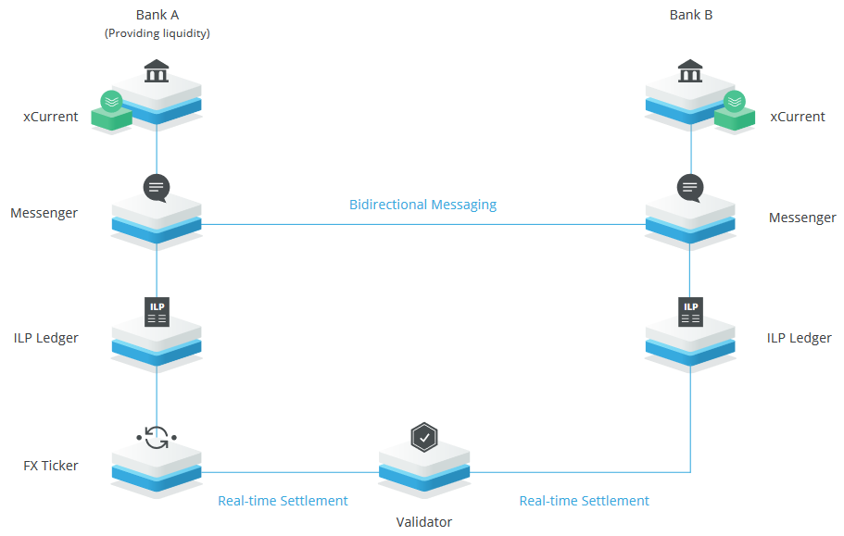
Ripple
RippleNet network provides a single, convenient for global payments functionality to all its members. Instead of combining disparate technologies, non-standard communications and centralized networks, RippleNet is a single global network of participants who send and receive payments through Ripple distributed financial technology, providing real-time messaging, clearing and settlement of transactions
Source: Ripple Report, 2018

Slide 11
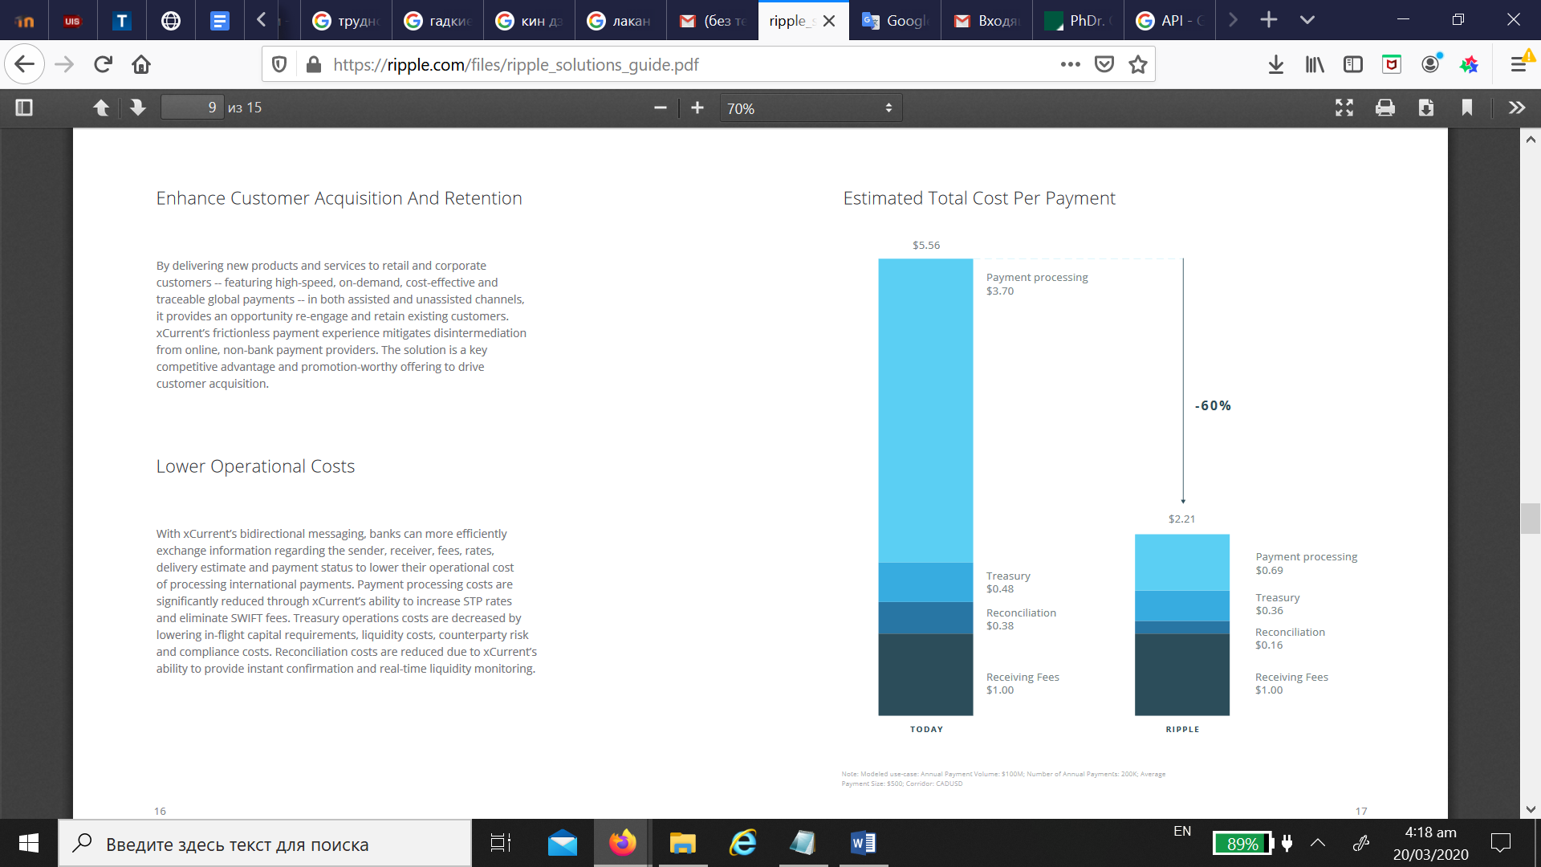
Estimated Total Cost Per Payment
The cost of treasury operations is reduced by lowering capital requirements during the flight, liquidity costs, counterparty risk, and compliance costs. Reconciliation costs are reduced thanks to xCurrent's ability to provide instant confirmation and real-time liquidity monitoring.
Source: Ripple Report, 2018

Slide 12
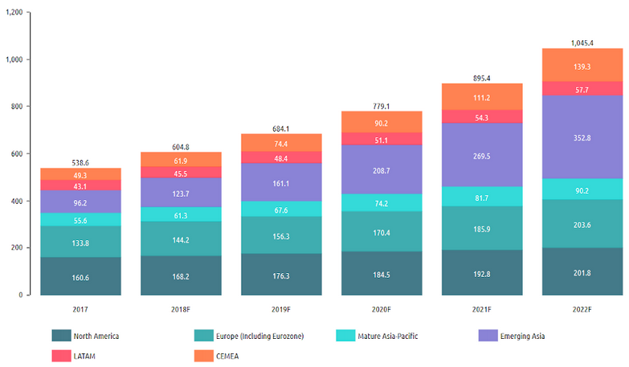
Number of non-cash transactions worldwide from 2013 to 2022, by region
(in billions)
Consider a chart with the level of cashless payments. In the diagram below, we see that in 2017, 160.6 billion US dollars were spent in non-cash operations in North America, which is higher than in any other region. This is followed by Europe and developing Asia, with transactions of 133.8 and 96.2 billion US dollars, respectively.
Source: Capgemini Financial Services Analysis, 2019; Countries’ Central Bank Annual Reports, 2018

Slide 13
Competition
General trends tell us about the movement of customer activity online and the high level of development of distance services, which means banks need to learn how to convert the huge traffic of contacts with customers in digital channels. Already today, the following figures are typical for a classic bank: more than 90–95% of contacts with customers occur in remote self-service services, and only 5–10% are accounted for by a network of offices and a call center.
Source: Control Engineering, Digitalization of classic banks, Technology in Finance and Banking, 2019

Slide 14
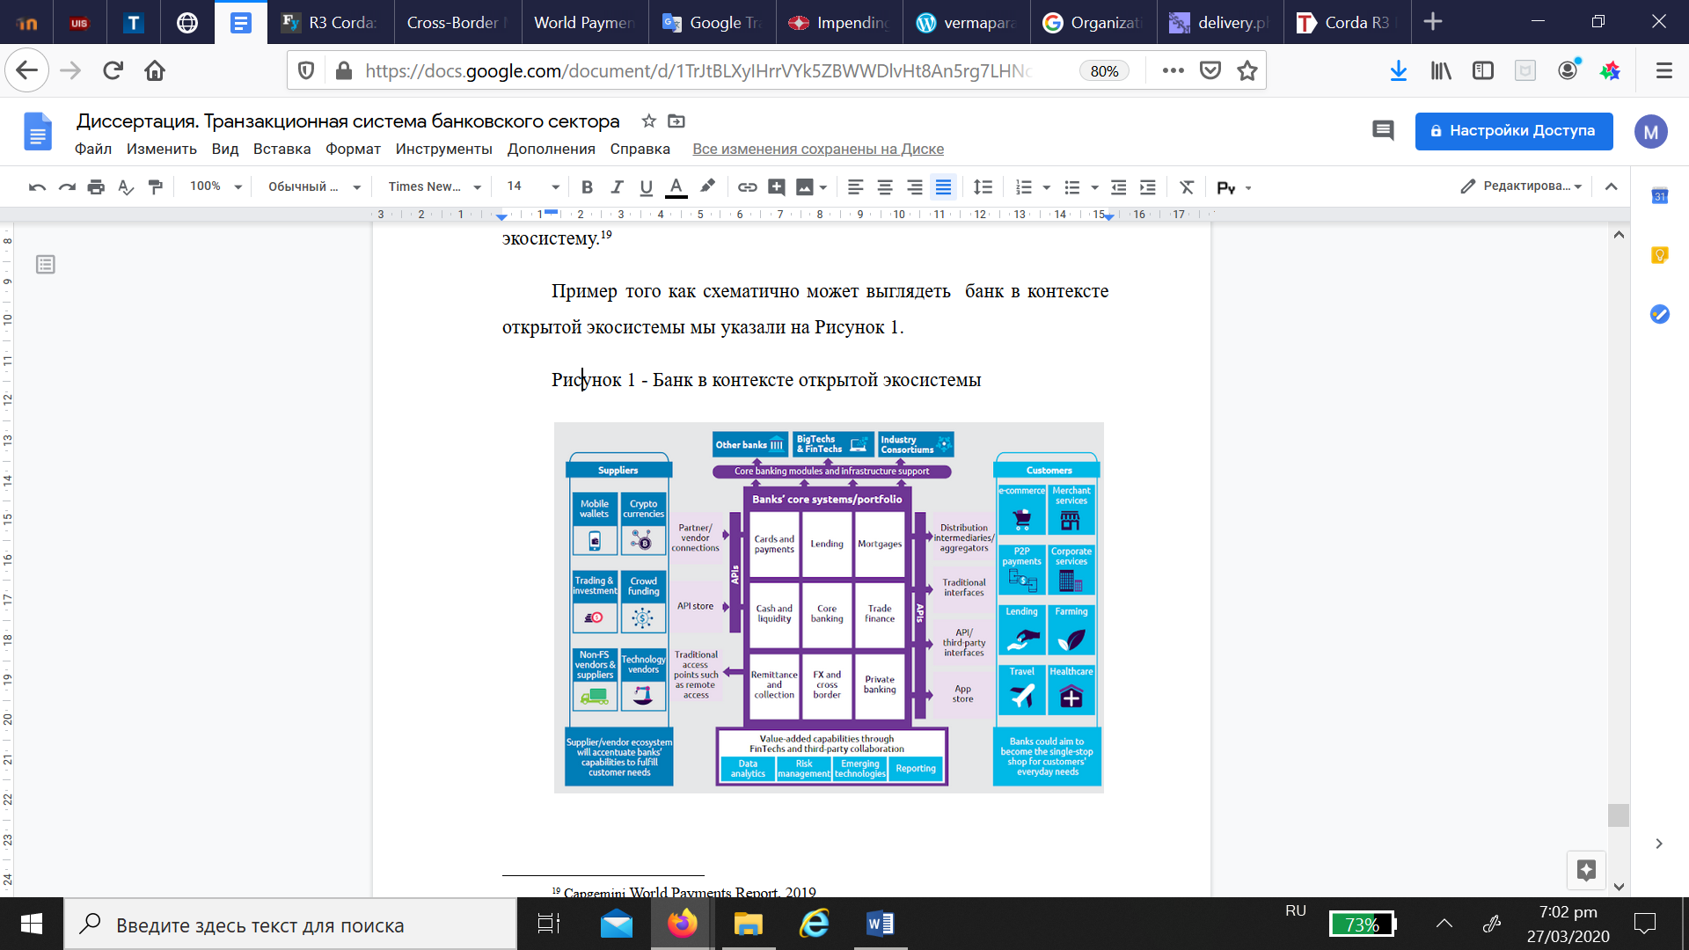
Conclusion
We believe that we have done a great job and can put forward several conclusions based on the entire body of information that we have studied. We want to note that the general trend remains in the direction of increasing non-cash payments and, according to experts, there will be only growth in the future. Therefore, changing the transaction systems themselves is only a matter of time. More precisely, these processes are already taking place, and many companies are using them, only their scale is not so global and obvious to everyone. We are too used to everything new that we often don’t even notice. The change in the transaction system will lead to cheaper and faster delivery, which in turn will affect business processes within companies
Source: Capgemini Financial Services Analysis, 2019

Slide 15
Sources
David Lee Kuo Chuen, Robert H. Deng, Handbook of Blockchain, Digital Finance, and Inclusion, Volume 1: Cryptocurrency, FinTech, InsurTech, and Regulation 1st Edition, Kindle Edition, 2017, ISBN-13: 978-0128104415
Jakub Gorka, Transforming Payment Systems in Europe, 2016, ISBN-13: 978-1137541208
BIS Report, Basel III: international regulatory framework for banks, 2019 Available from: https://www.bis.org/bcbs/basel3.htm
Capgemini Financial Services Analysis, 2019, Available at: https://www.capgemini.com/es-es/wp-content/uploads/sites/16/2019/06/World-FinTech-Report-WFTR-2019_Web.pdf;
Fundamentals of Global Payment Systems and Practices, Treasury Alliance Group llc., 2018
Ripple Report, 2018
PwC Report “Blockchain - new opportunities for producers and consumers of electricity”, 2016
Control Engineering, Digitalization of classic banks, Technology in Finance and Banking, 2019

