Slide 1
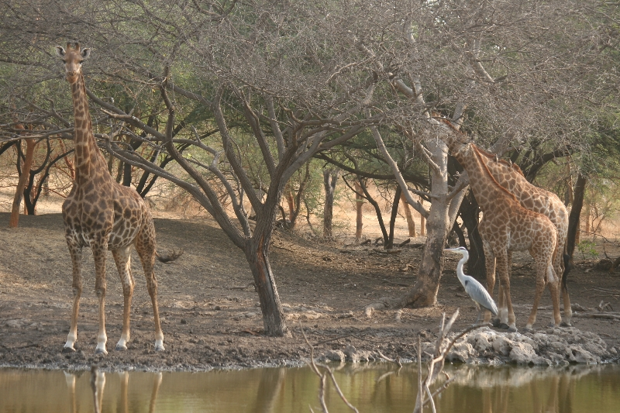
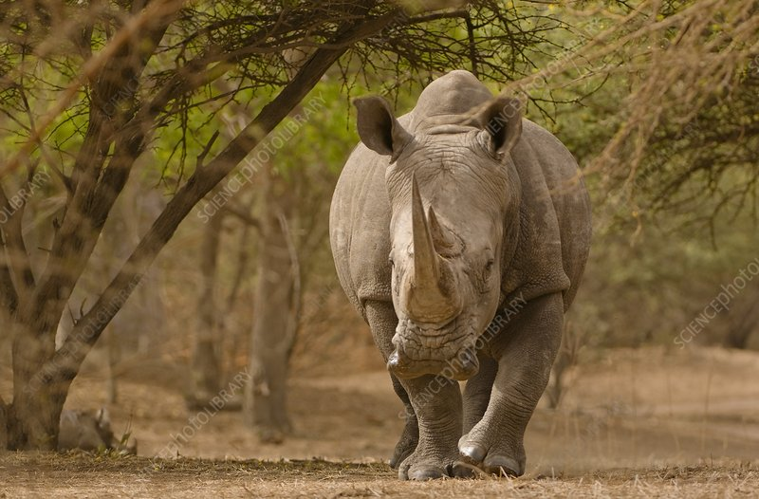
Tourist’s attitudes towards natural reservations in Senegal
Author: Ahmadou Badara Beye
Supervisor: Ing. Petra Chaloupková, Ph.D.

Slide 2
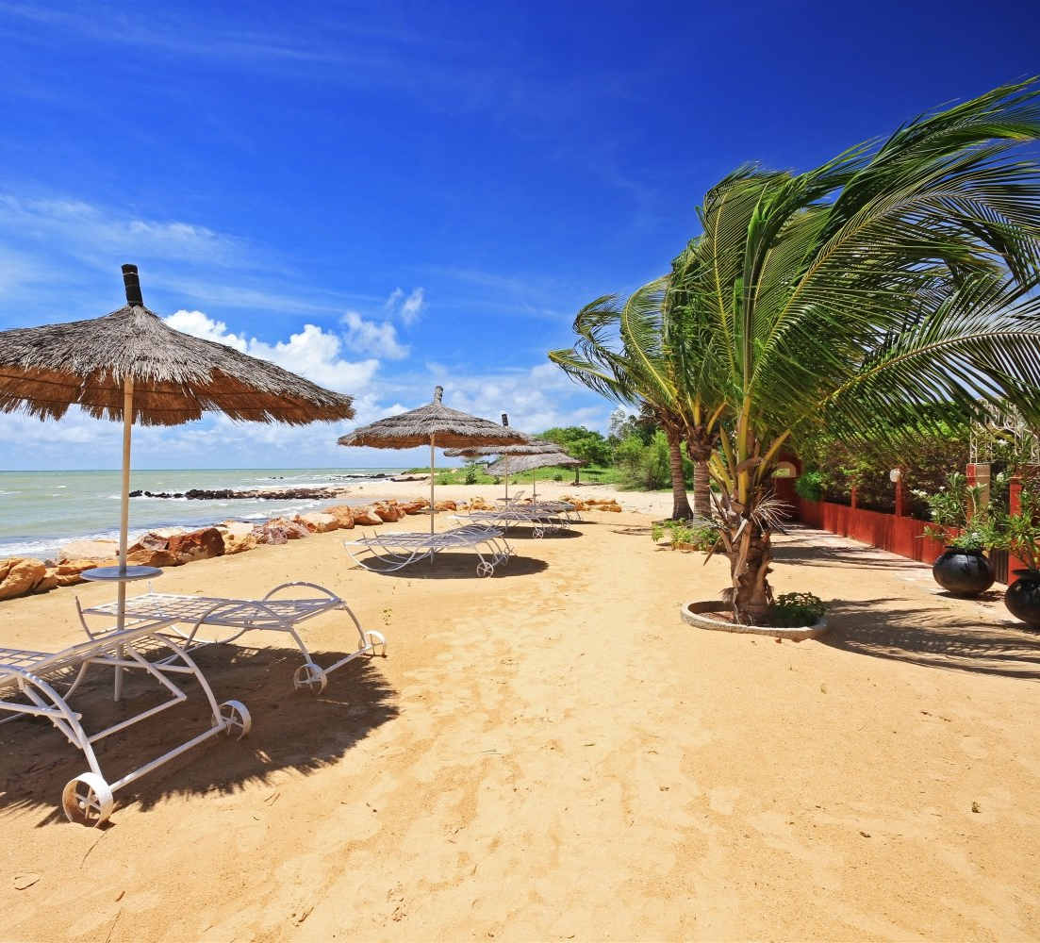
Introduction
Tourism is an important business generating 1,340 billion USD in 2017 and 10% of all jobs (UNWTO 2018).
20 to 40 % of total international tourism arrivals are from wildlife-related tourism (International Ecotourism Society 2000).
Senegal is the second country in West Africa with the highest international tourism receipts (Index Mundi 2019).
(https://www.alibabuy.com/guide-touristique/senegal/saly.html)

Slide 3
Literature review
Wildlife tourism is defined as “tourism based on encounters with non-domesticated animals” (Higginbottom 2004).
Efficient compromise between durable economic benefits and a good sustainable management of wildlife (Manfredo & Larson 1993).
Most visited wildlife animals are large mammals (Higginbottom 2004).

Slide 4
Research problem
Evident lack of data on eco-tourism visits in Senegal (MTTA 2016)
The lack of information is often a considerable problem for tourists in Africa (Loubser et al. 2001).

Slide 5
Aims of the thesis
Socio-economic characteristics
Animal preferences
Motivation and barriers
Availability of information

Slide 6
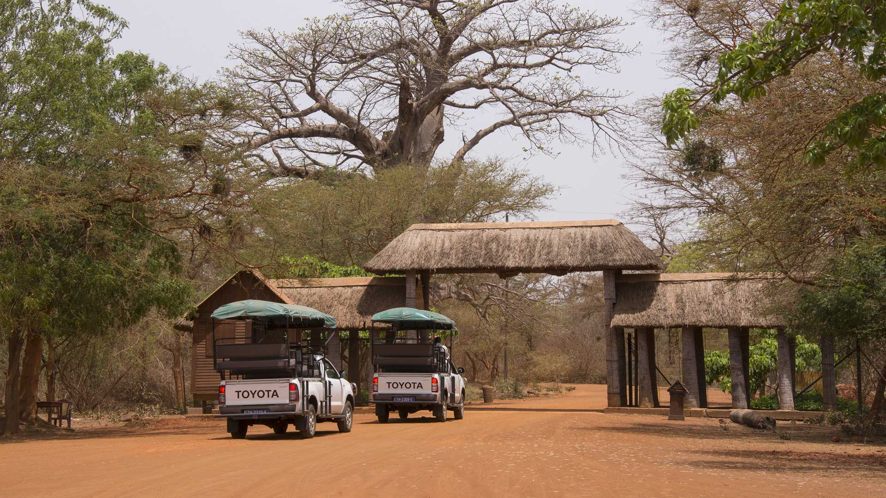
Study site
Bandia reserve
Between Senegal’s biggest touristic areas (Dakar and Saly)

Slide 7
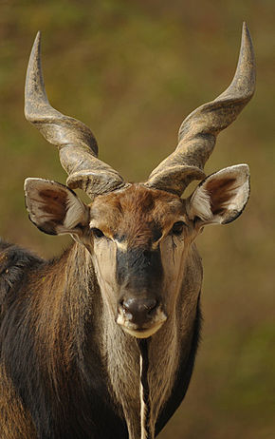
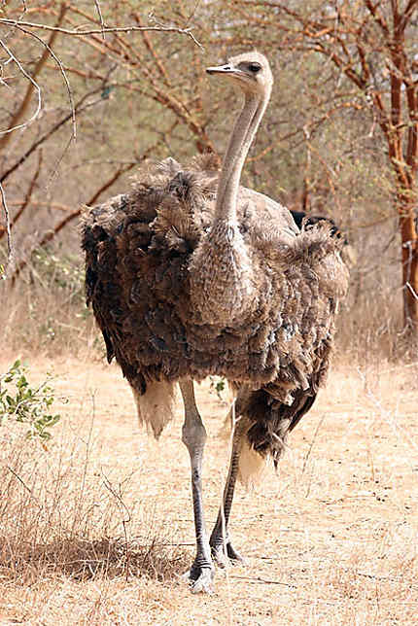
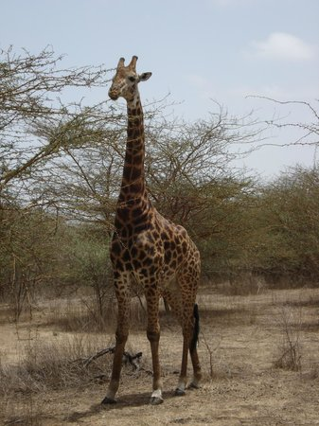
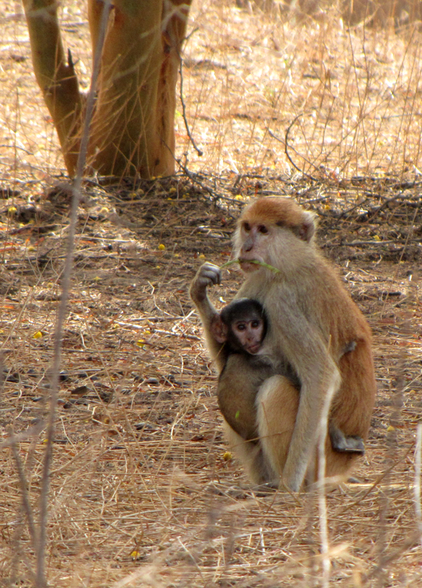
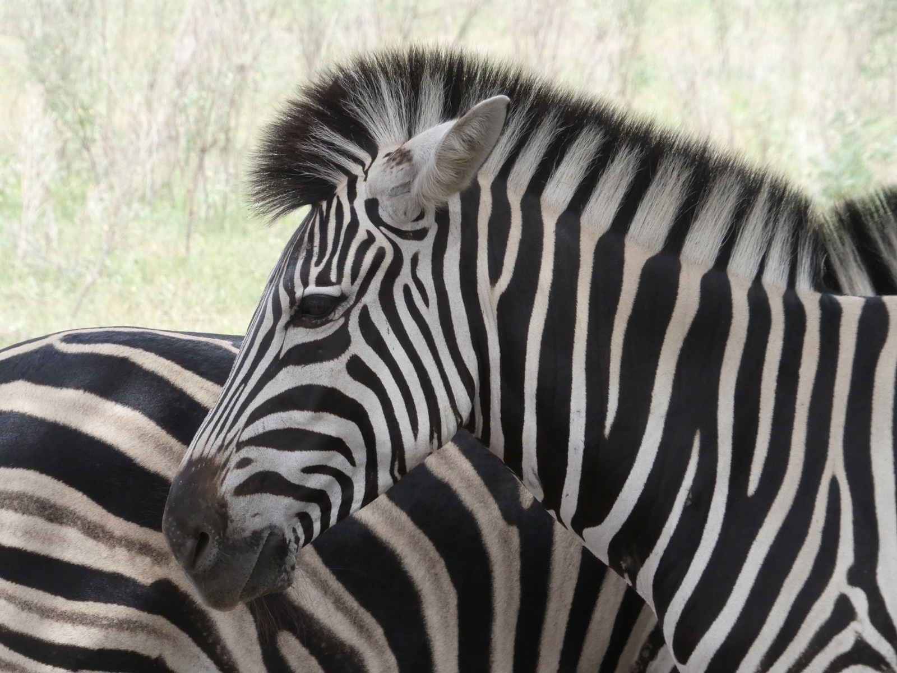
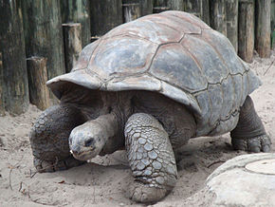
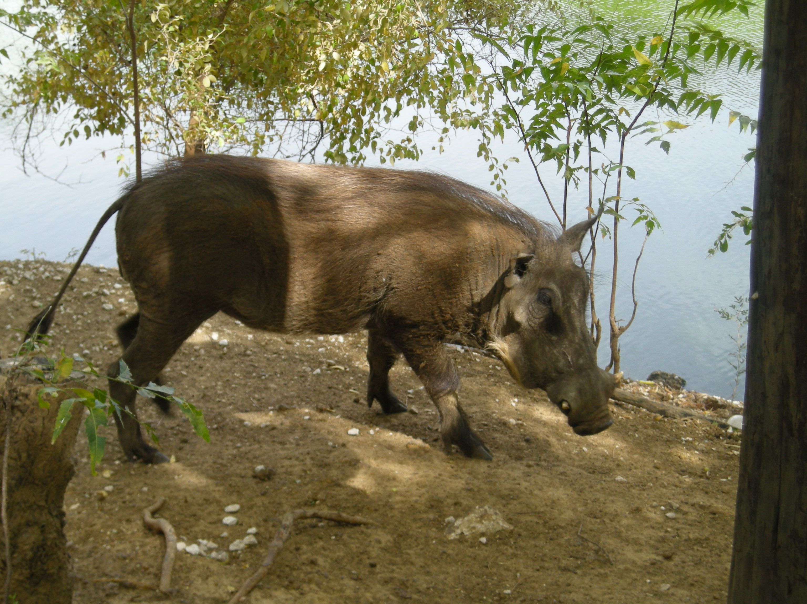
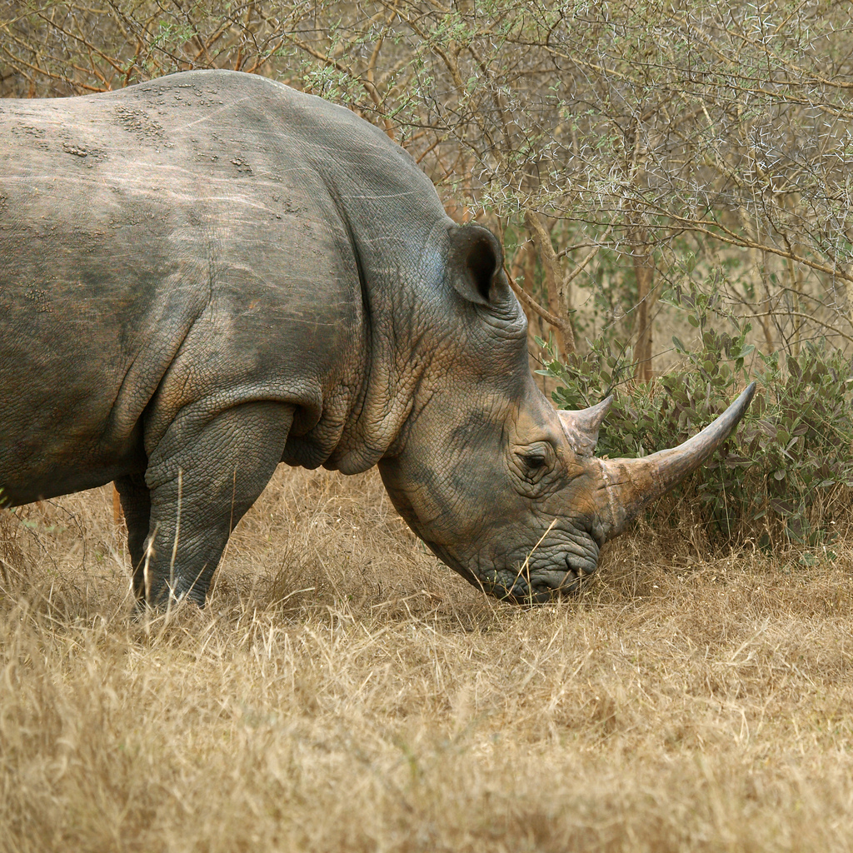
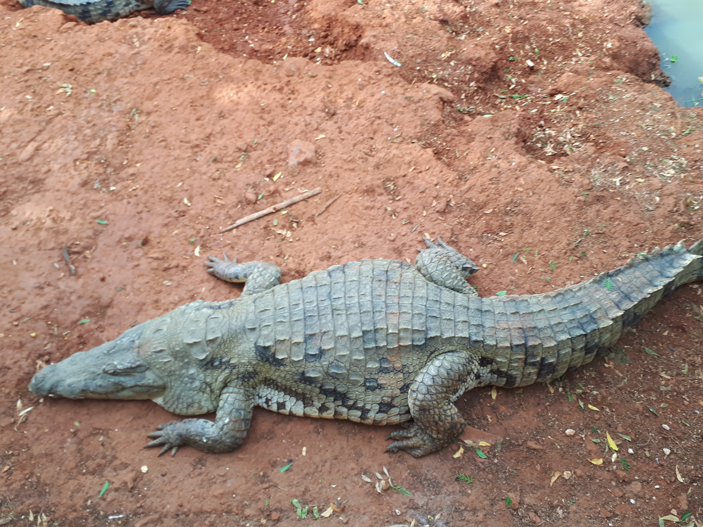
Animals of Bandia reserve
Taurotragus derbianus
Struthio camelus camelus
Giraffa camelopardalis peralta
Erythrocebus patas
Equus quagga
Aldabrachelys gigantea
Phacochoerus africanus
Ceratotherium simum
Crocodylus suchus

Slide 8
Methods of data collection
Questionnaire survey in French and English language
Sampling: convenience method

Slide 9
Questionnaire design
Number of questions: 19
Attitudes toward above mentionned animals
Opinion about available information
Sociodemographic data (gender, age, education …)

Slide 10
Data analyses
Basic descriptive statistics (frequency analysis, cross tabulation analysis…)

Slide 11
Results
Characteristic | Frequency (n) | (%)
Sample | 100 | 100
Gender | 100 | 100
Male | 46 | 46
Female | 54 | 54
Age | 100 | 100
Under 18 years | 7 | 7
19-29 | 53 | 53
30-39 | 14 | 14
40-49 | 20 | 20
50-59 | 3 | 3
60 and above | 3 | 3
Marital Status | 99 | 100
Single | 34 | 34.4
Married | 65 | 65.65
Socio-demographic characteristics of respondents

Slide 12
Results
Children | 96 | 100
0 | 63 | 65.62
1 | 9 | 9.37
2 | 8 | 8.33
>2 | 16 | 16.67
Came with family | 100 | 100
Yes | 44 | 44
No | 56 | 56
Education | 97 | 100
Primary school | 2 | 2.06
High School | 14 | 14.43
University | 36 | 37.11
Post graduate | 45 | 46.39
Religion | 99 | 100
Christian | 33 | 33.33
Muslim | 32 | 32.32
Atheist / Agnostic | 33 | 33.33
Other | 1 | 1.01
Socio-demographic characteristics of respondents

Slide 13
Results

Slide 14
Results
Length of stay of tourists in Senegal

Slide 15
Results
Attitudes of tourists towards selected animals

Slide 16
Results
Satisfaction about available information by tourists

Slide 17
Results
Amount of money willing to be paid by tourists for more information (cumulated frequencies, USD)

Slide 18
Results
Source of information about the natural reserve

Slide 19
Results
Motivation to visit the natural reserve
 |  | Gender
Variables | Male | Female
Influence choice | % | % | Total
Interest to discover exotic animals | 24.0 | 22.9 | 46.9
Interest in having new experiences | 11.5 | 18.8 | 30.2
Recommendation (friend/tourist/local person) | 10.4 | 9.4 | 19.8
Other | 1.0 | 2.1 | 3.1
Total | 46.9 | 53.1 | 100.0

Slide 20
Results
Potential reasons not to visit the natural reserve
 |  | Gender
Variables | Male |  | Female
Influence choice | % | Rank | % | Rank | Total | Rank
Fear of possible dangers | 8.9 | 3 | 7.1 | 3 | 16.1 | 3
Fear of trying new experiences | 0.0 | 5 | 5.4 | 4 | 5.4 | 5
Lack of time | 14.3 | 2 | 5.4 | 4 | 19.6 | 2
Price | 19.6 | 1 | 26.8 | 1 | 46.4 | 1
Other | 3.6 | 4 | 8.9 | 2 | 12.5 | 4
Total | 46.4 |  | 53.6 |  | 100.0

Slide 21
Discussion
Most popular animals: big herbivores (specially exotic ones: rhinoceros and giraffe)
The average ecotourist: educated, European (French), young (19-29 years old) and staying one to three weeks
Tourists are well informed about the fauna of the reserve and satisfied with their level of information

Slide 22
Conclusion
This study summarized tourist’s preferences and opinions on Senegalese ecotourism industry
This research can be used by Senegalese natural reserve owners or any ecotourism institutions in similar condition

Slide 23
Recommendations
Improve the visibility of the white rhinoceros
Having all informative documents in French and their translation in English
Improve derby eland’s advertisement
Accomodation facilities

Slide 24
References
Higginbottom K. 2004. Wildlife tourism: impacts, management and planning. Common Ground Publishing Pty Ltd, Australia.
Index Mundi. International tourism, receipts (current US$) – Africa. Available from https://www.indexmundi.com/facts/indicators/ST.INT.RCPT.CD/map/africa (accessed March 2019).
Loubser GJJ, Mouton PFN, Nel JAJ. 2001. The ecotourism potential of herpetofauna in the Namaqua national park, South Africa. South African Journal of Wildlife Research. Available from http://hdl.handle.net/10019.1/10711 (accessed March 2019).
Manfredo MJ, Larson RA. 1993. Managing for Wildlife Viewing Recreation Experiences: An Application in Colorado. Wildlife Society Bulletin 21: 226-236.
Ministère du Tourisme et des Transports Aériens. 2016. Etude sur la mise en valeur de l’offre écotouristique dans les régions de Fatick et Tambacounda. MTTA, Senegal.
The International Ecotourism Society. 2000. Ecotourism Statistical Fact Sheet. The International Ecotourism Society. Available from http://www.active-tourism.com/factsEcotourism1.pdf (accessed March 2019).
UNWTO. 2018. UNWTO Tourism highlights 2018 Edition. UNWTO. Available from https://www.e-unwto.org/doi/pdf/10.18111/9789284419876 (accessed March 2019).

Slide 25
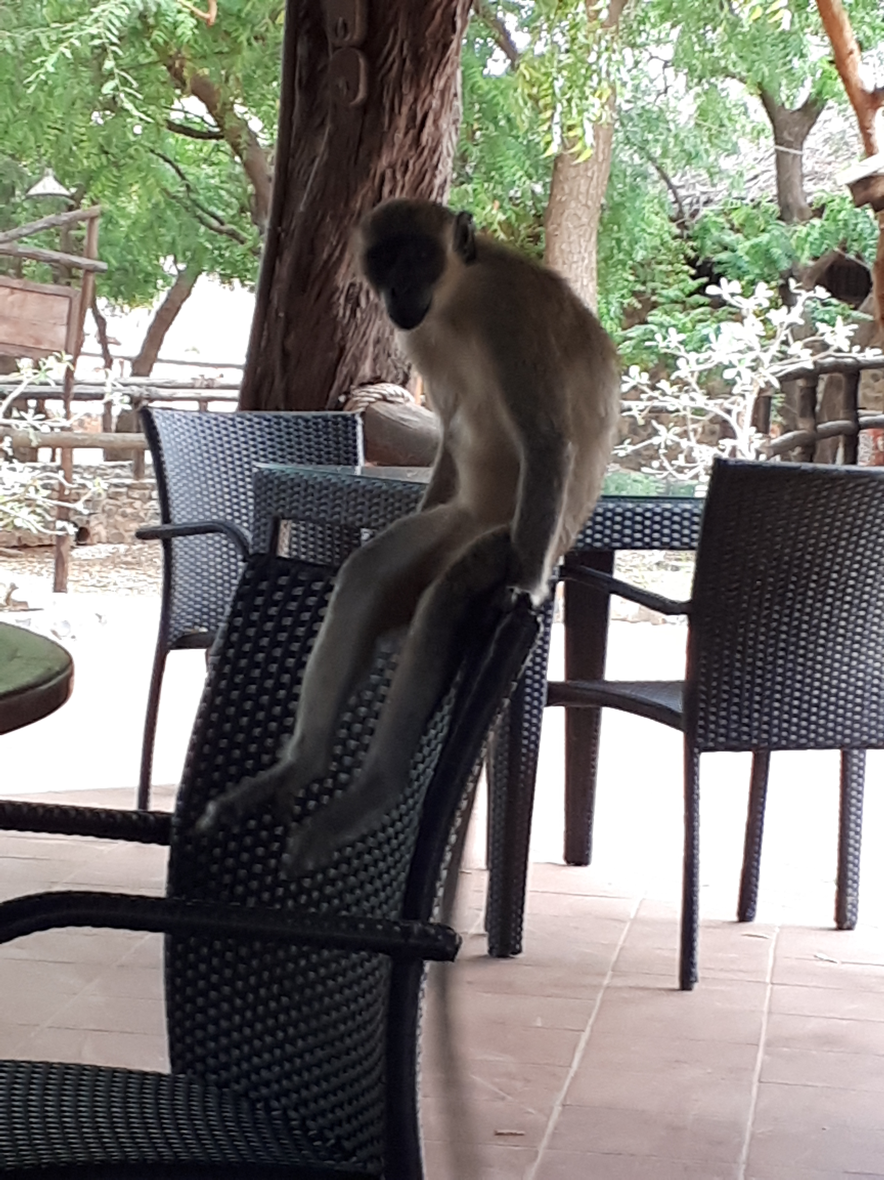
Thank you for your attention!

