Slide 1
Gap regeneration of Sessile oak stands with respect to site heterogeneity
Faculty of Forestry and Wood Sciences
Department of Silviculture
Author: Bc. Alexander Aguirre Guillen
Supervisor: doc. Ing. Lukáš Bílek

Slide 2
Introduction
European forest have been affected or managed by humans for many years. Forest cover in Europe 1.02 billion hectares and oaks are one of the most widespread tree species in the world and important for European communities.
Sessile oak (Quercus petraea (Matt.) Liebl.) mid-sessional tree native from Central Europe, have a great importance for the wood processing industry and the ecological interest concerning the climate change.
The collected data will help to response or understand the processes of the natural regeneration of sessile oak, the effect of solar radiation over the canopy affect the local population. The Effect of the ground competition within the gap, game damage, etc.

Slide 3
Literature review
Oak species in Central Europe: The genus “Quercus” is a native of the Northern Hemisphere, from the Fabaceae family, contain approximately 600 extant species of oak. Central Europe have four native species : Sessile oak, Pedunculate oak, Turkish oak, Pubescent oak.
Sessile oak and Pedunculate oak: these two species are important for central and rest of Europe for their ecological and economic value. Both are large deciduous trees, native to central Europe, they are the most frequent tree species in Europe.
Climate change and Oak species: The long-term accumulative impact of humans on the Earth’s ecosystems to some extent is affecting climate change. The consternation regarding the climate changes and the effects it has on the forests are widespread. The increase interest in the oaks and their ability to resist droughts have become an importan topic for the European authorities

Slide 4
Literature review
Resilient forest: are those that can adapt to disturbance easily, such like climate change, pest and diseases. The resistance of the ecosystems will be the key stones to combat the consequences of climate change.
Regeneration of oak: The regeneration of Quercus spp. has been studied in Europe and other countries, however the reasons for differing success of natural oak regeneration are still not well understood. Sessile oak does not occur naturally as far in the northeast as pedunculate oak. The natural regeneration of oaks is relatively rare on the territory of the Czech Republic, justifying its difficulty on heavily embedded soils and because oaks are usually not kept in such quantity to ensure a natural restoration.
Research locality: Kunratice Forest in the southern part of Prague, Czech Republic (284 ha, the highest point 310 m above sea level), surrounded by the development of Roztyl, Chodov, Kunratice, Krč and the Kačerov depot (or the Southern Junction).

Slide 5
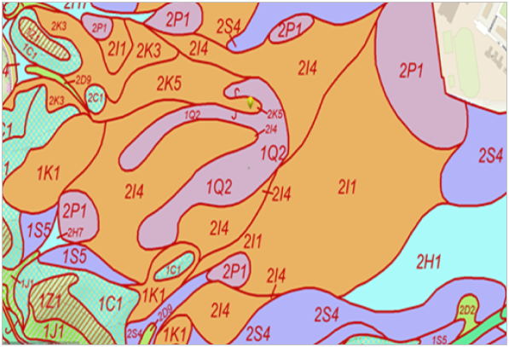
Material and Methods
Site characteristics :Forest stands presented in the area of Kunratice are specialized forests with a recreational function. The data was collected in the location of forest stand 149 A12 (Fig.1) with an age class VII, forest site soil composition is 2K5. beech-oak zone (Fagus sylvatica- Quercus petreae). Edaphic series K series- Acidic (oligotrophic): forest vegetation zone Fageto-Querceta acidophila (acidic beech-oak forests) prevail at lower uplands and basins on nutrient-poorer soil parent materials (Fig.2).
Figure 1. Kunratice forest (Kunraticky les) and research stand composition
Figure 2. Soil composition of the site in Kunraticky forest

Slide 6
Data Collection
The marking of the plots and collection of the data was executed during the months of October and November of 2019. The site consists of three research plots (RP) that are identified as: small gap (1), canopy (2), big gap (3) (Tab.1). Each RP is divided into 2 transections, each transection that crosses the RP is the length of 30 meters (m), which are measured from south to north and west to east.
Table 1. Classic characteristics of the research plot (RP)

Slide 7
Data evaluation
With the data collected from the site, characteristics for each Research Plot were gathered. The results are expected to represent aspects of gap regeneration and site heterogeneity. Data analysis was possible with the use of MATLAB 2016 and Microsoft Excel, all information collected has been set up to answer questions related to this work.

Slide 8
Results
Regeneration Density and Tree species composition
Height structure and diameter characteristics and quality of stem
Increment coverage
Light coverage
Game damage
Floor coverage

Slide 9
Regeneration Density and Tree species composition
Comparison of Sessile oak(dominant) density and Whitebeam (Codominant)
Comparison of Sessile oak density and Pedunculate oak
Graph 1. Number of individuals and regeneration density for each research plot (RP)
Graph 2. Regeneration density of sessile oak and pedunculate oak

Slide 10
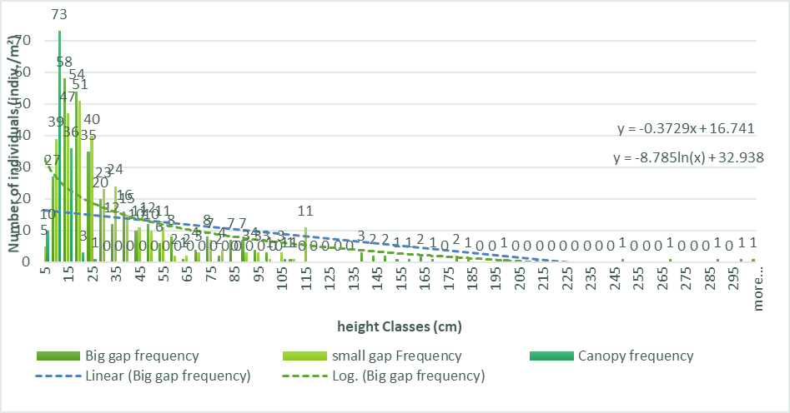
Height structure and diameter characteristics
Graph 3. Height curve for sessile oak individuals on the research plot (RP)
Graph 4. Height class structure from each research plot (RP), difference between plots and spatial distribution

Slide 11
Increment coverage
Table 2. Variations in measurements within the Small gap research plot (RP).
Note: N- Number of individuals, Av- Average, SD – Standard deviation, Var- Variance, Me- Median, Max- Maximum value, Min- Minimum value, Height (cm), Diameter (mm). Forest cover is expressed in percentage.

Slide 12
Table 3. Variations in measurements within the Canopy research plot (RP)
Table 4. Variations in measurements within the Big gap research plot (RP)
Note: N- Number of individuals, Av- Average, SD – Standard deviation, Var- Variance, Me- Median, Max- Maximum value, Min- Minimum value, Height (cm), Diameter (mm). Forest cover is expressed in percentage.

Slide 13
Light coverage
Table 5. Percentage of light above the canopy in the research plot (RP)
Table 7. Above canopy light percentage of each margin of the research plots
Note: Center- The center of the research plot, NM- Margin North, SM-Margin South, WM-Margin West, EM-Margin East, Aver. - Average, SD-Standard Deviation, Min- Minimum, Max-Maximum, %-Percentage.

Slide 14
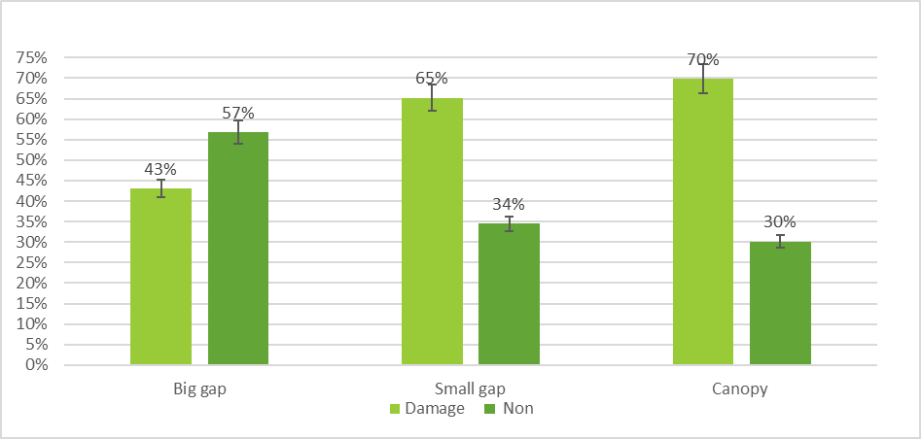
Game Damage
Graph 7. Effect of game damage on sessile oaks in each research plot (RP) as a percentage (%)
Graph 8. Effect of game damage on Sorbus spp. in each research plot (RP) as a percentage (%)

Slide 15
Floor coverage
Graph 9. Floor coverage distribution of the Small gap research plot (RP) as a percentage (%)
Graph 10. Floor coverage distribution of the Canopy research plot (RP) as a percentage (%)
Graph 11. Floor coverage distribution of the Big gap research plot (RP) as a percentage (%)

Slide 16
Discussion
Differences in Research plot density: The Small gap and the Big gap presented similar density of the Sessile oak; Meanwhile Whitebeam show higher on the density on the Big gap than Small gap.
In regard of the height structure, the majority of the high seedling is show on the Big gap.
Light coverage shows that Small gap have 11.67 percent of diffuse light above canopy, Big gap present 11.61 percent . Big gap shows the highest in diffuse radiation
Difference within in the gaps are visible. The Center of the gaps presented the greatest number of individuals. In the Big gap center margin concentrate the seedling with greatest high.
The heterogeneity within the gap is noncomplex. Showing that the Sessile oak is the Dominant tree of the site

Slide 17
Conclusion
From the result given, shows that the first stages of growth are important and where the seedlings are more affected by the direct light and diffuse light above the canopy .
This topic is open for more research.

Slide 18
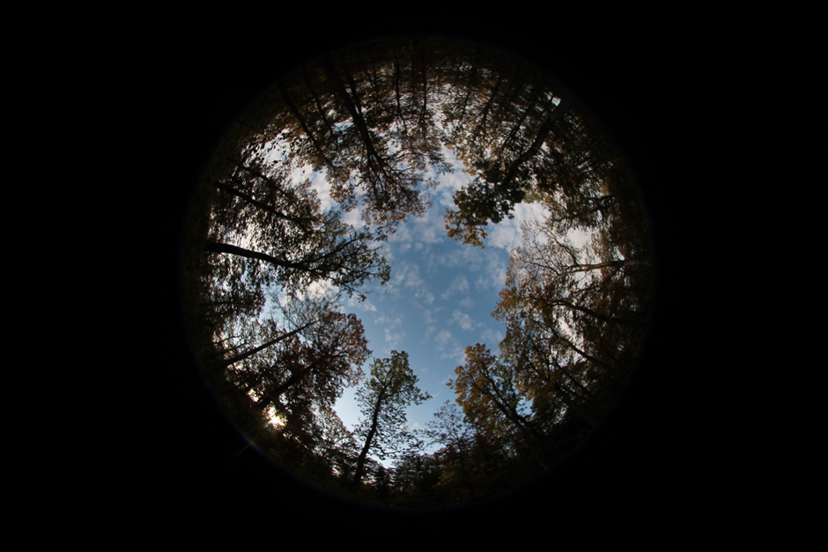
Appendix
Photo take of the canopy, second is the image changed to a monochrome .

