Slide 1

Diploma Thesis Presentation
BUSINESS MODELS:
Case study of Atelier Čarodějka
Czech University of Life Sciences Prague
Faculty of Economics and Management
Author: Barbora Zýková
Supervisor: prof. Ing. Ivana Tichá, PhD.
© 2016 CULS Prague

Slide 2
Analyzing the small family business Atelier Čarodějka, focused on flowers, decorations and seasonal markets
Creating the business model according to Osterwalder´s Business Model Generation
Keywords: Business model, business model canvas, business plan, small business

Slide 3
AIMS OF THE DIPLOMA THESIS
The main objective of the diploma thesis is to develop a business model for a small firm called Atelier Čarodějka by bringing sustainability to this business in a long- term perspective.
Recommendations for Atelier Čarodějka.

Slide 4
METHODOLOGY
Capturing theoretical information
Comparative analysis
Unstructured qualitative interview with Jaroslava Malinová, the owner of the firm
The business model canvas
SWOT analysis

Slide 5
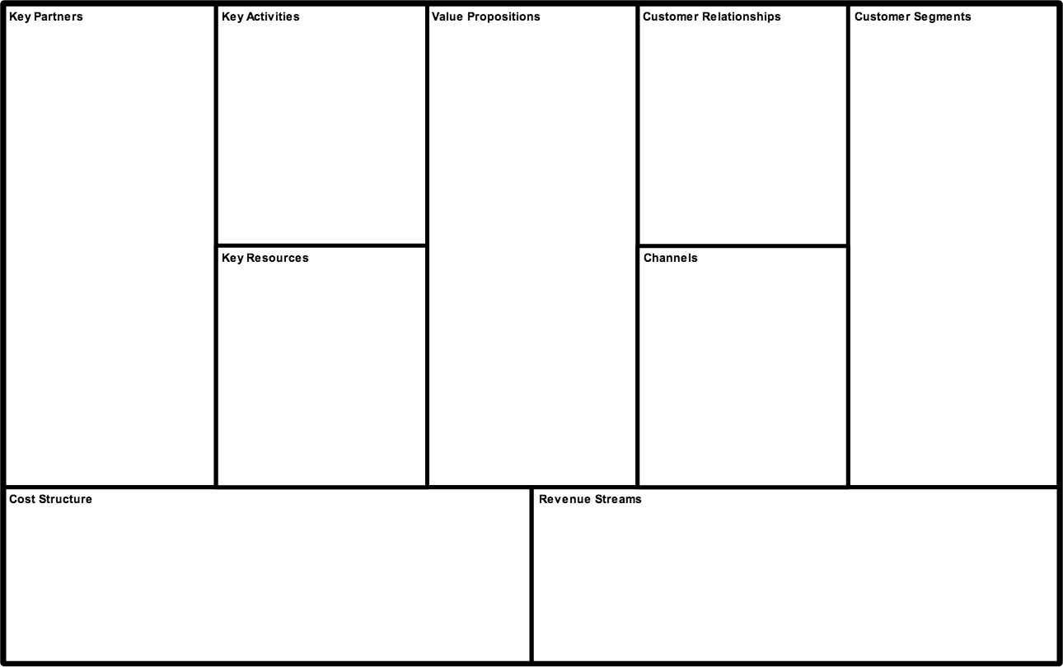
THE BUSINESS MODEL CANVAS

Slide 6
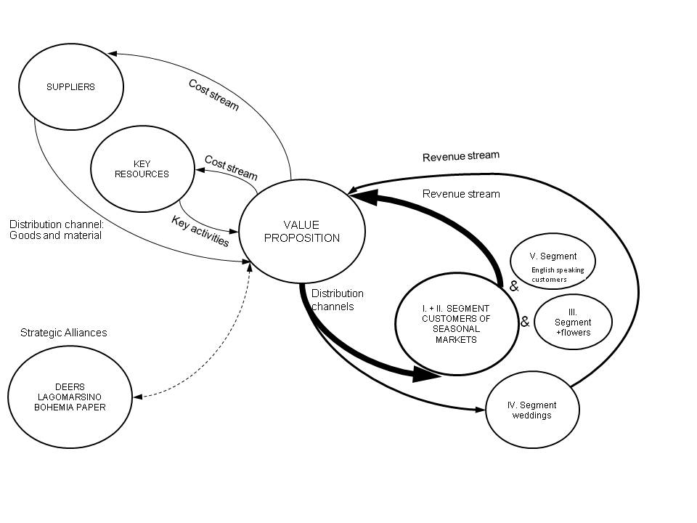
The recommended business model for AČ
Picture: The recommended business model for Atelier Čarodějka

Slide 7
CONCLUSIONS AND RECOMMENDATIONS
high- quality unique business model
Payment terminal
Customer relationship management
Focused on the most profitable value propositions and segments connected to it
→seasonal markets

Slide 8
SELECTED BIBLIOGRAPHY
Chesbrough, Henry. 2007. Business model innovation: it's not just about technology anymore. Emerald Insight. [Online] 2007. [Cited: 20 10 2015.] http://www.emeraldinsight.com/doi/full/10.1108/10878570710833714. 1087-8572.
—. 2009. Business Model Innovation: Opportunities and Barriers. Business Model Community. [Online] 2009. [Cited: 30 8 2015.] http://www.businessmodelcommunity.com/fs/root/8oex8-chesbrough.pdf. 0024-6301.
Johnson, Mark W. 2010. A New Framework for Business Models. Harward Business Review. [Online] 21 1 2010. [Cited: 12 10 2015.] https://hbr.org/2010/01/is-your-business-model-a-myste-1.
Magretta, Joan. 2002. Harvard business review: Financial Management. Why Business Models Matter. [Online] 5 2002. [Cited: 12 6 2015.] https://hbr.org/2002/05/why-business-models-matter.
Mayura, Ash. 2015. No Problems in Your Business Model is a Problem. Leanstack. [Online] Spark59, Inc., 23 3 2015. [Cited: 11 8 2015.] http://leanstack.com/no-problems-in-your-business-model-is-a-problem/.
Morris, Michael, Schindehutte, Minet and Allen, Jeffrey. 2002. The entrepreneur´s business model: toward a unified perspective. Journal of Business Research. [Online] 22 9 2002. [Cited: 15 6 2015.] http://www.emprendedoresparalasamericas.com/uploads/reports/a59860d3249b734b2b4a4583d9f68c6359599cfb.pdf. Journal of Business Research 58 (2005) 726–735.
Osterwalder, Alexander and Pigneur, Yves. 2010. Business Model Generation. New Jersey : John Wiley & sons, Inc., 2010. 978-0470-87641-1.

