Slide 1
Analysis of the Effects of Climate Change on Forest Ecosystem Services: Effects on Socio-Economic Benefits in the North-Central Region of Namibia
Dissertation Thesis Defense
Ing. Andreas Nikodemus
SUPERVISOR: doc. Ing. Miroslav Hájek, Ph.D.
Czech University of Life Sciences, Prague
FEBRUARY 2023

Slide 2
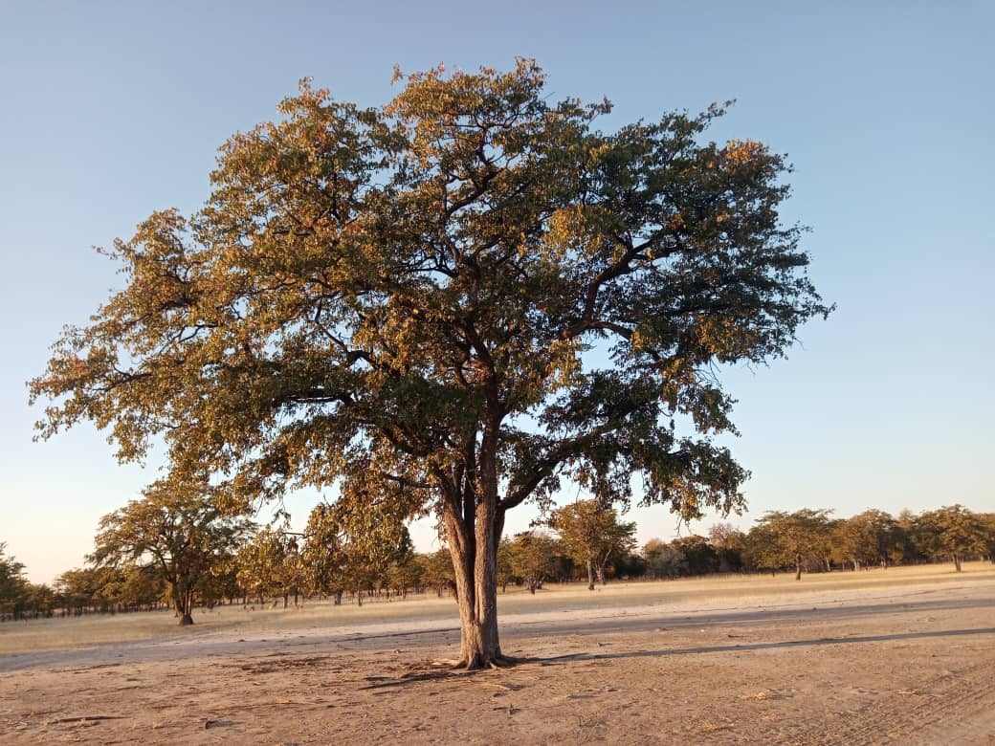
Outline
Background
Methods
Results
Discussion
Conclusions & Recommendations

Slide 3
1. Background
Millions of local rural communities depend on forest resources for their livelihoods (Ryan et al., 2016; Vrabcová et al., 2019).
Local communities benefit from forests in various forms (timber and non-timber forest products {NTFPs}) (De Cauwer et al., 2016).
Local rural communities in southern Africa mostly use forest resources for marketing (commercial) and subsistence uses, i.e. firewood, construction materials, medicine, and food (Langat et al., 2016).
Although forest ecosystems play an important role in sustaining human communities' livelihoods, the effects of climate change on forest ecosystems and their services around the world are unequivocal (Baciu et al., 2021).

Slide 4
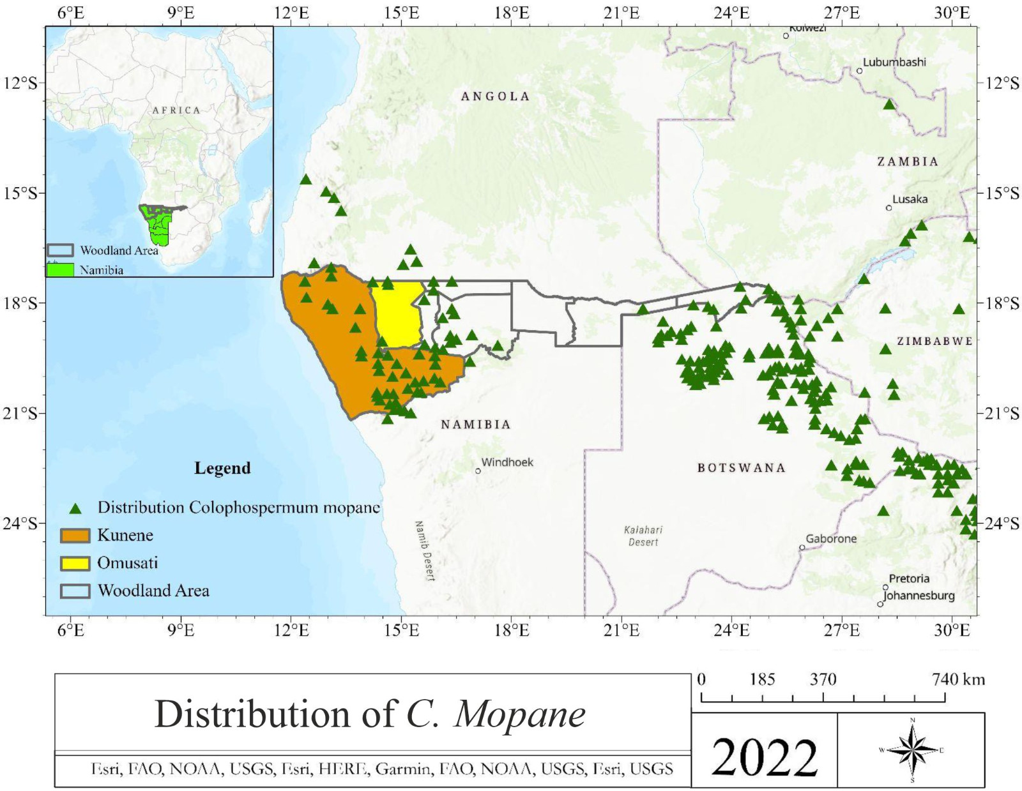
1. Background continues…
C. mopane (Krug, 2017; Potgieter, 2020) is characterized by good wood quality, the ability to endure harsh climatic conditions, and the pressure from rural communities.
Existing literature about C. mopane focuses on other aspects such as its uses, distribution, and adaptation (Mapaure, 1994; Holly, 2012; Makhado, 2014).
Policy instruments for climate change are directed by the Paris Agreement (United Nations, 2015).
All policy instruments (Namibia), including cross-sectoral climate change policies are governed by the constitution (Ruppel and Ruppel-Schlichting, 2022).

Slide 5
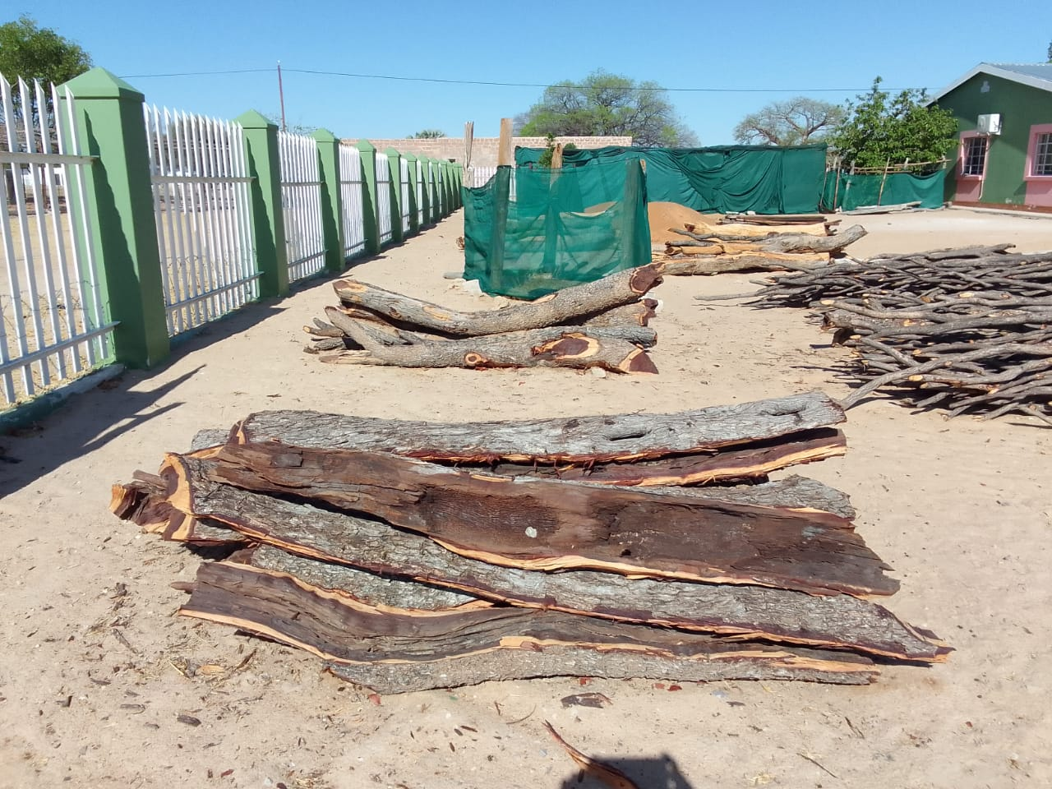
1. Background continues
Research objectives
Main objective: to investigate the socio-economic benefits of C. mopane in a changing climate in rural communities and the implementation of policy instruments for climate change adaptation actions in northern Namibia.
Specific objectives
To analyse the socio-economic benefits of C. mopane in a changing climate by focusing on the products harvested for use at the local community level in northern Namibia;
To assess trends in temperature and precipitation in C. mopane woodlands in northern Namibia;
To investigate the implementation of policy instruments for climate change adaptation actions in mopane woodlands in northern Namibia.

Slide 6
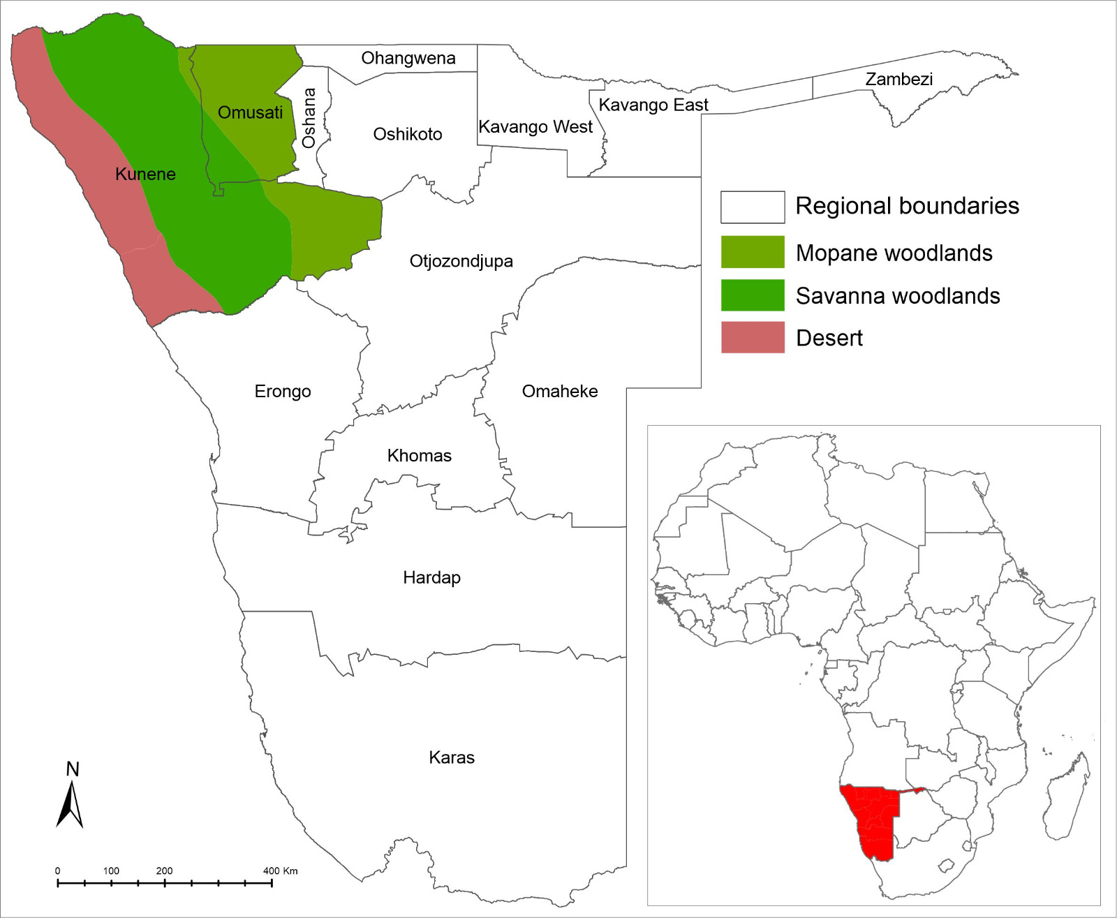
2. Research methods
Study area
The study focused on two regions in northern Namibia - Omusati and Kunene regions.
These two regions together cover 17% of the total area and constitute 13% of the population of Namibia.
The regions form part of the Baikiaea-mopane woodlands of southern Africa (Olson et al., 2001) and represent areas with the highest distribution of C. mopane in Namibia.
The Omusati region has the highest species distribution among the two regions (Vrabcová et al., 2019).
The northern part of Namibia is predominantly rural and is one of the hotspots for climate change-related impacts (Kapuka & Hlásny, 2020; Spear & Chappel, 2018).

Slide 7
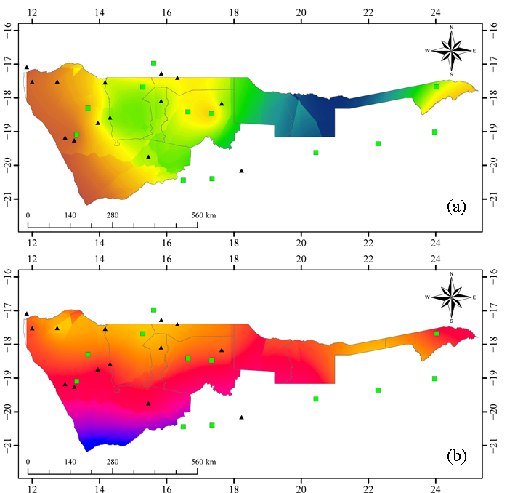
2. Research methods
Approaches, data collection, and analysis
Hybrid approach: quantitative and qualitative
Population: local communities, forestry officials, climate change experts
Sample: Random (local communities), purposive (forestry officials and climate change experts)
Sample size: Harvesting permits from 239 villages across the study area (Omusati and Kunene regions); 128 local communities, forestry, climate change, and other relevant environmental experts (manuscript 1), and 36 experts (manuscript 2)
Instruments: Semi-structured questionnaires (manuscripts 1 & 2)
Secondary data: SASSCAL weather stations, MEFT, Windhoek Meteorological Weather Services, Directorate of Forestry (DoF) (manuscript 3)
Data types:
Survey data
Precipitation
Temperature
Harvesting permits
Time frame: 11 years (2011-2021)

Slide 8
2. Research methods
Approaches, data collection & analysis
Statistical analysis (Quantitative): Statistical Package for the Social Sciences (IBM SPSS version 26, IBM Corp., Armonk, NY, USA) with a p-value less than 0.05 (p < 0.05)
Qualitative analysis: ATLAS.ti version 22.2 and Thematic Content Analysis (TCA)
Experts' perceptions
Local communities’ perceptions
The procedure flow for qualitative data analysis

Slide 9
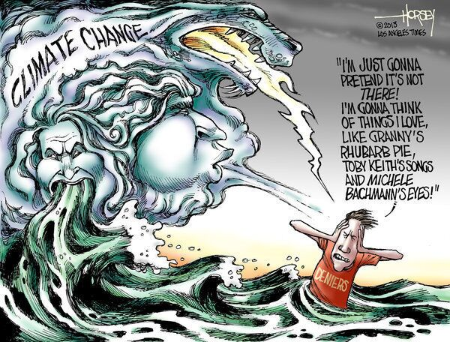
2. Research methods
Limitations
Lack of data and lack of literature
Poor understanding of forest ecosystems and climate change - ignorance
Poor interest in research
Unique climatic and vegetation conditions of Namibia
Ethical considerations
Ethical conduct of the National Commission on Research Science and Technology (NCRST)
Ethical clearance by MEFT and approved by DoF
Anonymity of the respondents
Rights to refuse or withdraw from the research were respected
No data leakage – data will be kept in a safe place

Slide 10
3. Results synthesis
3.1 Forest products (C. mopane)

Slide 11
3.2 Types of products (C. mopane)

Slide 12
3.3 Total precipitation and temperature changes

Slide 13
3.4 Various policy instruments
Policy instruments | Extremely ineffective | Very ineffective | Ineffective | Not sure | Effective | Very effective | Extremely effective | Total
Namibia’s Climate Change Strategy and Action Plan | 4 (3%) | 5 (4%) | 23 (18%) | 51 (40%) | 37 (29%) | 5 (4%) | 3 (2%) | 128 (100)
National Policy on Climate Change for Namibia | 4 (3%) | 4 (3%) | 20 (16%) | 49 (38%) | 41 (32%) | 9 (7%) | 1 (1%) | 128 (100)
National Environmental Education and Education for Sustainable Development Policy | 4 (3.1%) | 3 (2%) | 24 (19%) | 39 (31%) | 43 (34%) | 10 (8%) | 5 (4%) | 128 (100)
The Nature Conservation Ordinance No. 4 of 1975 | 4 (3%) | 5 (4%) | 14 (11%) | 41 (32%) | 44 (34%) | 16 (13%) | 4 (3%) | 128 (100)
The Communal Land Reform Act | 3 (2%) | 2 (2%) | 17 (13%) | 36 (28%) | 54 (42%) | 14 (11%) | 2 (2%) | 128 (100)
Namibia National Forest Policy | 3 (2.3%) | 2 (2%) | 14 (11%) | 53 (41%) | 35 (27%) | 18 (14%) | 3 (2%) | 128 (100)
Forestry Strategic Plan | 4 (3%) | 4 (3%) | 14 (11%) | 58 (45%) | 36 (28%) | 10 (8%) | 2 (2%) | 128 (100)
The Forest Act | 4 (3%) | 2 (2%) | 11 (9%) | 45 (35%) | 51 (40%) | 13 (10%) | 2 (2%) | 128 (100)

Slide 14
3.6 NPCC per Forest Ecosystem Service

Slide 15
3.9 Proposed improvements for policy instruments
Collective instruments
NPCC

Slide 16
4. Discussion
Local rural communities have a tendency of resorting to forest products as a survival mechanism due to the effects of climate change. - subsistence and commercial uses.
Forest products, i.e., firewood, roots, droppers, poles, wild berries, and mopane worms, are a significant component of the rural communities’ livelihoods, i.e., coping with climate variability and extreme weather events that affect agricultural productivity in some ways (Paumgarten and Shackleton, 2011).
The results further identified that local rural communities use forest products mainly in the form of NTFPs (fuelwood, poles, rafters, droppers, and roots).
The high demand for firewood is attributed to the area being primarily rural, where most residents depend on firewood for lighting and heating (Munyayi, 2015; Vrabcová et al., 2019).
Effective law enforcement is one strategy to harmonize adaptation and sustainably manage forest ecosystems to avoid illegal operations, such as unlawful harvesting.
The results showed that the most effective policy instruments were the Communal Land Reform Act, the Forest Act, Namibia National Forest Policy, and Forestry Strategic Plan.
Biodiversity showed the most significant adaptation actions after the introduction of NPCC (4.36 ± 1.52) than before NPCC (3.11 ± 0.92) (p < 0.001). In addition, carbon sequestration was also more significant after NPCC (3.06 ± 1.35) than before NPCC (2.75 ± 1.34).

Slide 17
5.2 Recommendations
Practical Applications of the Findings
It is critically vital to monitor the utilization of forest resources sustainably due to their importance for both livelihoods and ecological purposes.
There must be an emphasis on altering rural communities’ reliance on forest resources for their livelihood by improving their awareness of the impacts of climate change - awareness creation.
It is also essential to incorporate climate change topics in primary education to equip future generations with the necessary knowledge of climate change adaptation actions.
Future research
Predictive analysis for extreme weather events, including forest fires, droughts, floods, and other climate-related hazards that affect goods and services provided by forest ecosystems in the northern regions and the entire country.
SWOT analysis of the policy instruments’ framework for forest ecosystem services-based adaptation actions in the policy to improve adaptation actions.

Slide 18
THANK YOU!

