Slide 1
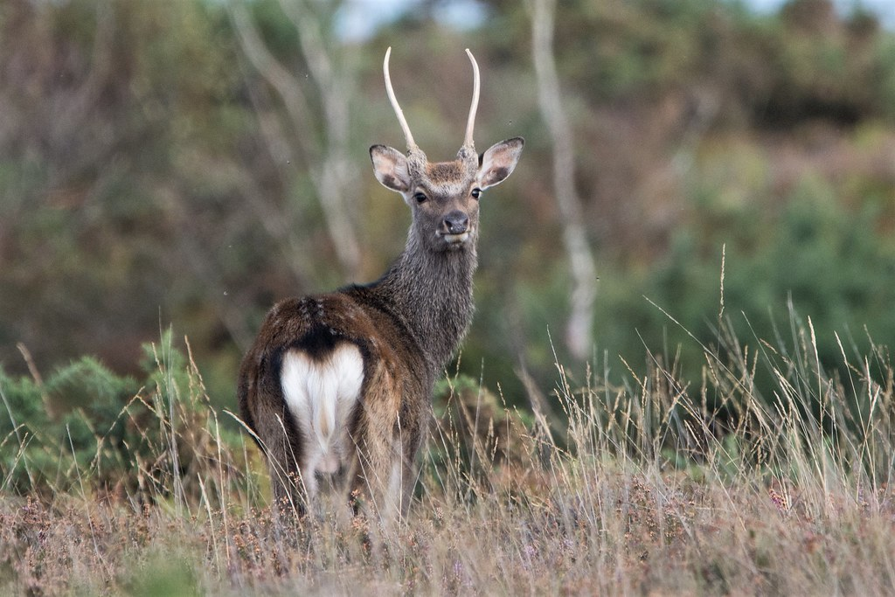
Sika deer as an alien species:
Perception in scientific literature and ecological traits of non­-native populations
Laura SAGGIOMO M.Sc.
Supervisor:
Prof. Ing. Jaroslav Červený
Advisor:
Ing. Miloš Ježek Ph.D
Prague, 2021

Slide 3
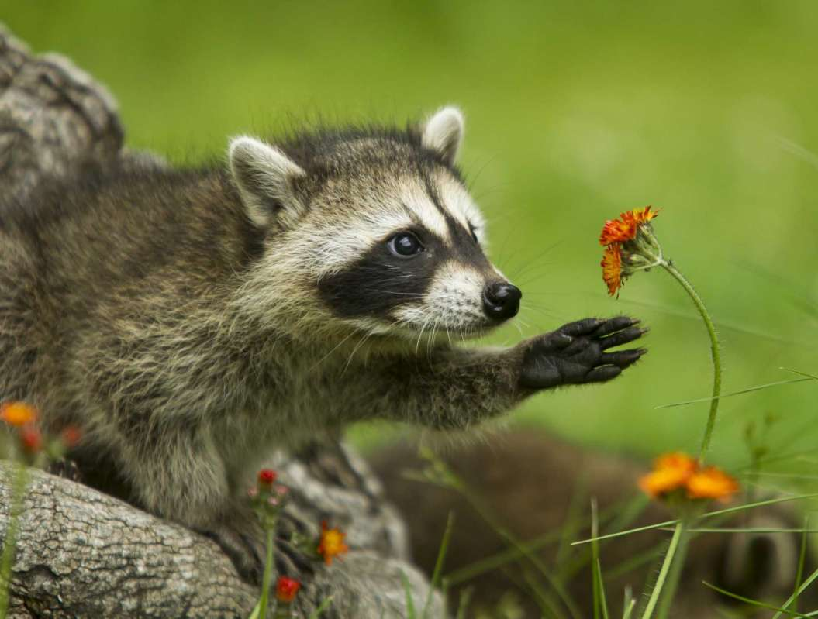
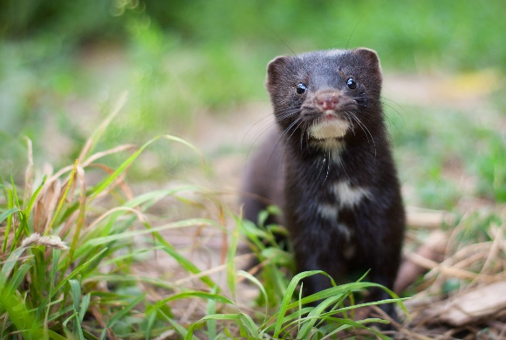
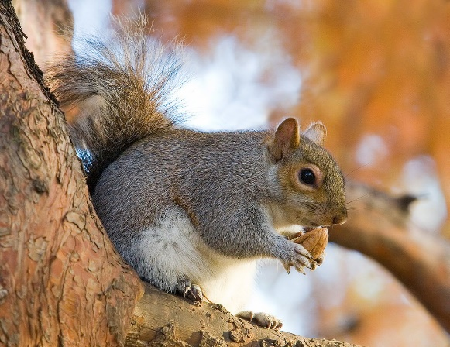
Alien Species
Worldwide problem
Second cause of biodiversity loss
Ecological issue
Intensifying process

Slide 4
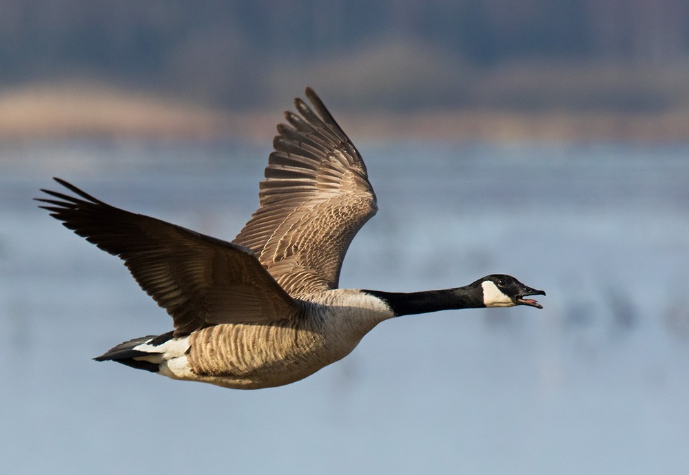
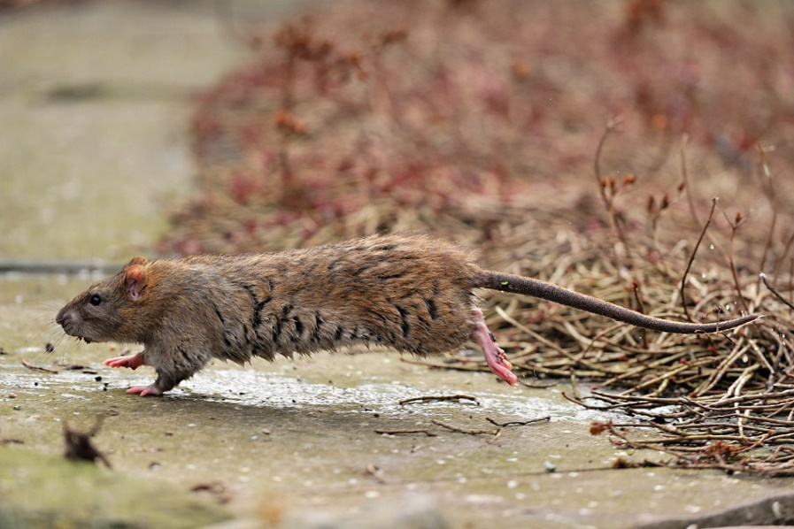
Alien Species in Europe
Currently among the most urgent nature conservation issues
Important economic cost
Several alien species in Europe
*Hulme, 2009

Slide 5
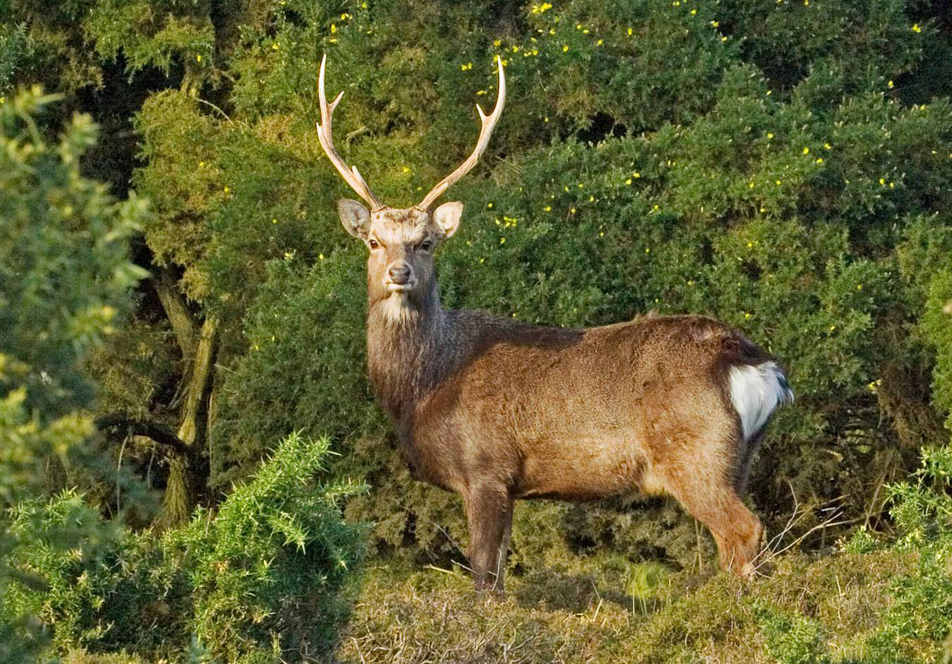

Slide 6
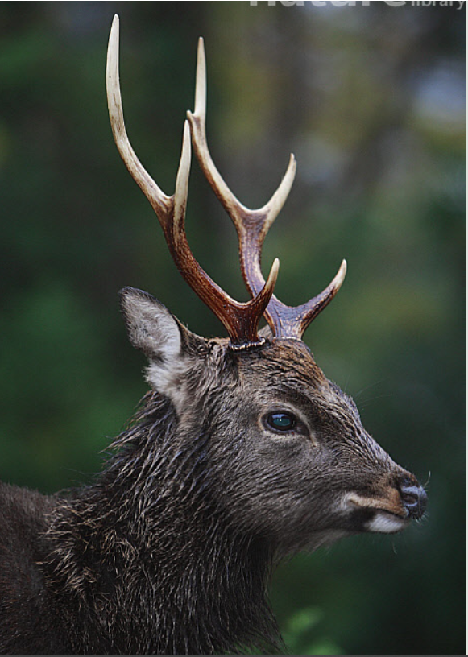
Member of the Asian fauna
Native of:
Japan, China, Korea, Taiwan, Viet Nam, Russia

Slide 7
Brought to many other countries
Aesthetic reasons/Game species
Europe, USA, New Zealand, Africa

Slide 8
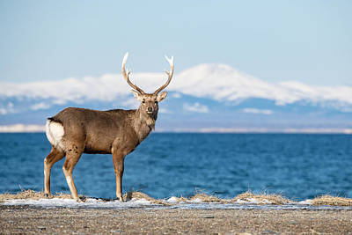
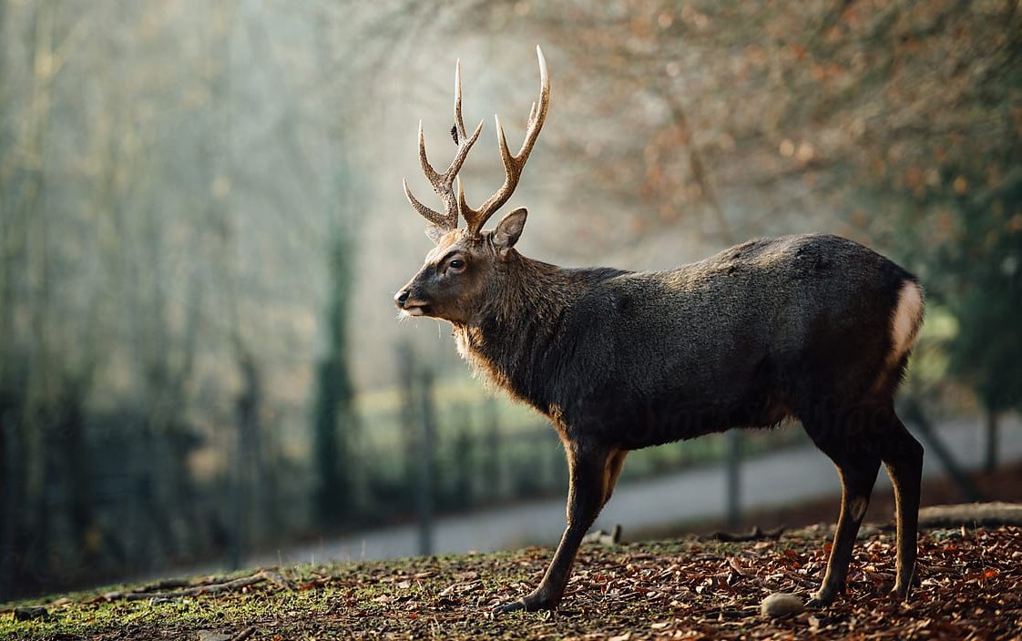
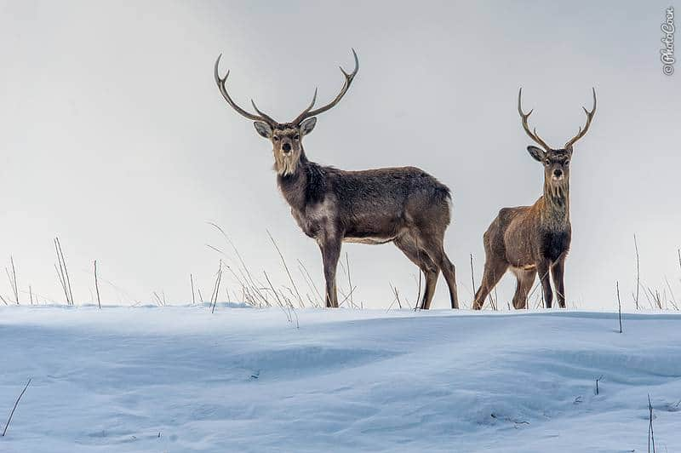
Highly Adaptable
Thrive in non native environments
Invasive populations

Slide 9
Aims and Goals
Scientific Literature
Diet Analysis
1
2
3
Management

Slide 10
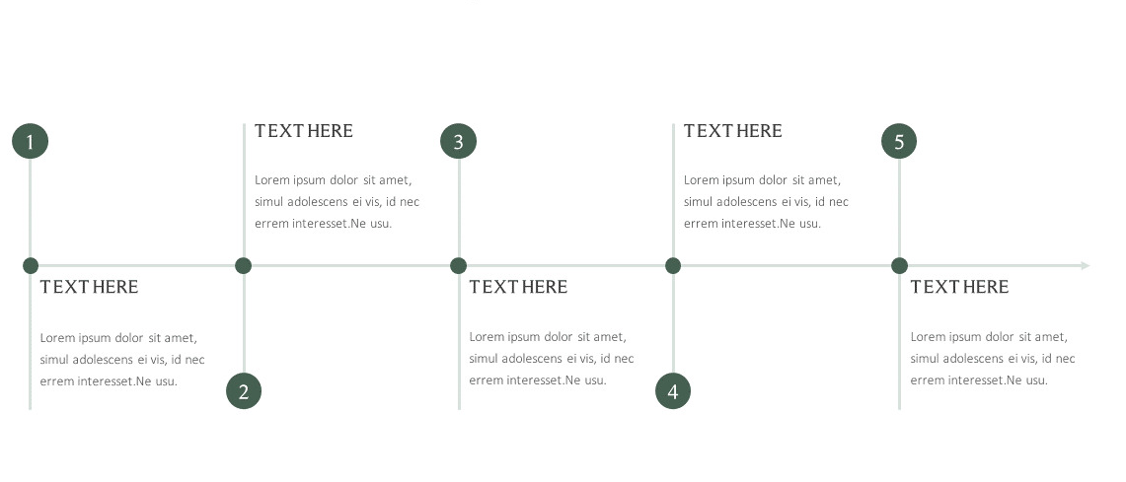
Research Timeline
Beginning of study
Literature Research
Erasmus +
Diet Analysis
Doctoral State Exam
Dissertation defence
2017/2018
2019/2020
Analysis:
Hunting Bags
Literature
Manuscript Preparation and submission
2016/2017
2018/2019
2020/2021

Slide 11
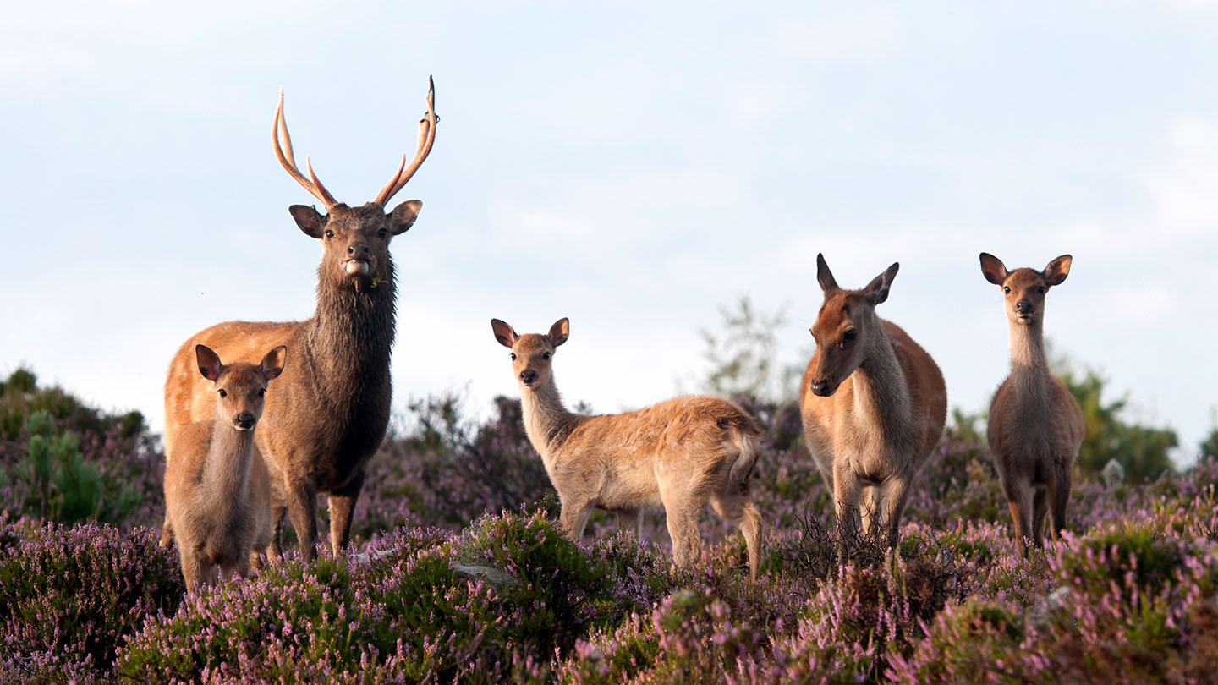
Bibliometric Analysis

Slide 12
Bibliometric Analysis

Slide 13
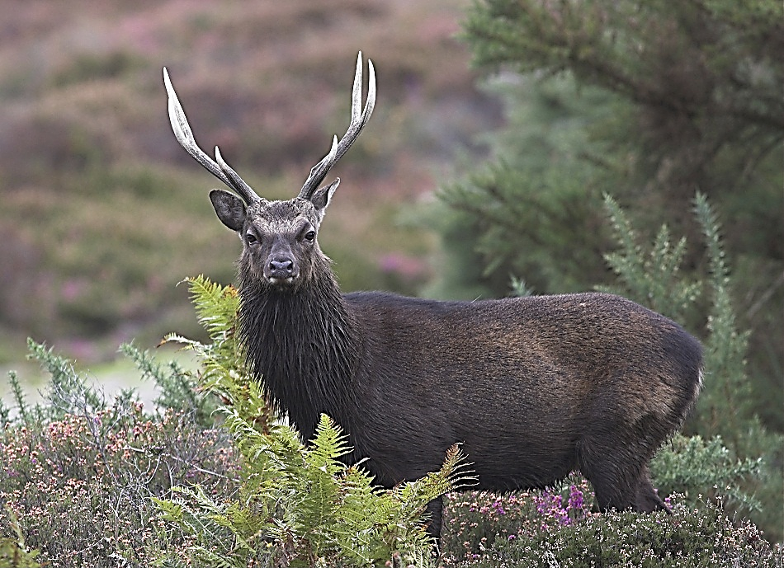
Investigation of:
Most used author keywords
Most and least productive countries
Temporal trends of discussed topics
Citation bursts of keywords

Slide 14
Literature Search
Literature Analysis

Slide 15
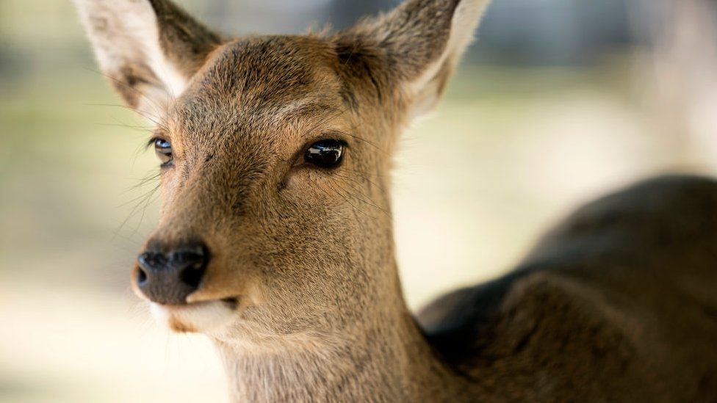
Global
Native
Non-native
European
Non-native
Non European

Slide 16
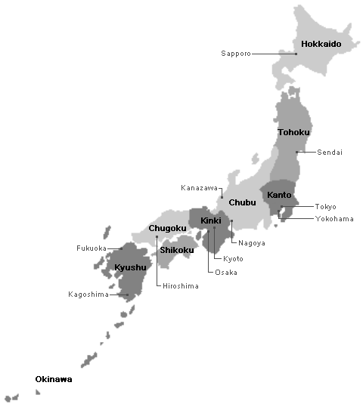
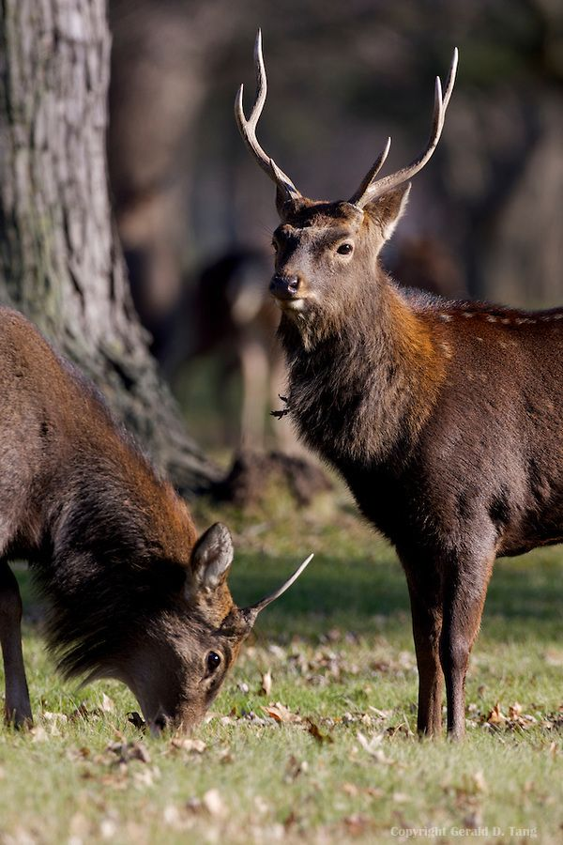
Global Literature
Results
1.374 documents
71 countries
3.262 author keywords
Japan
47%

Slide 17
Global Literature
Results
1.374 documents
71 countries
3.262 author keywords
Japan

Slide 18
Global Literature
Results
1.374 documents
71 countries
3.262 author keywords
Japan

Slide 19
Global Literature
Results
1.374 documents
71 countries
3.262 author keywords
Japan

Slide 20
Results
Global
Native
Non-native
European
Non-native
Non European

Slide 21
Results
Global
Native
Non-native
European
Non-native
Non European

Slide 22
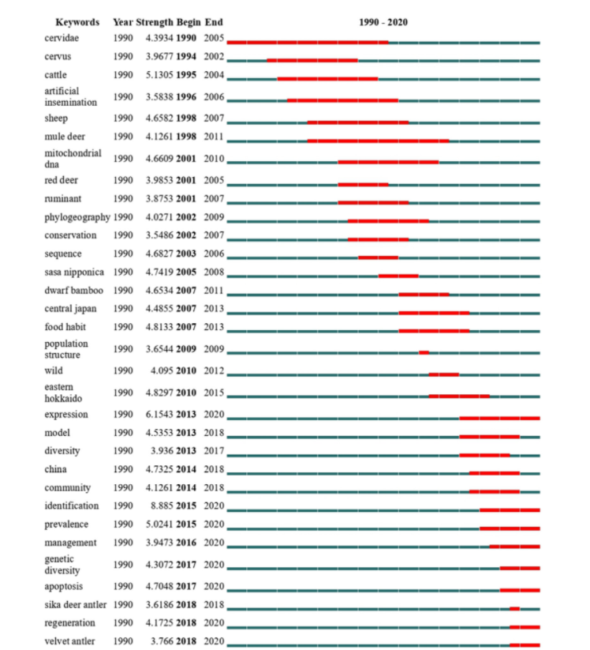

Slide 23
Aims and Goals
Scientific Literature
Diet Analysis
1
2
3
Management

Slide 24
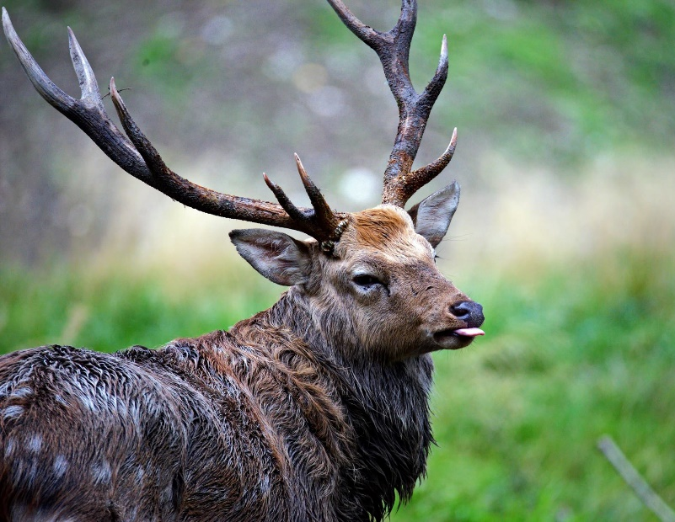
Evaluation of Czech Management
Identification of hunting subpopulations
Number of culled deer
Assessments of vegetation types
Analysis of available data

Slide 25
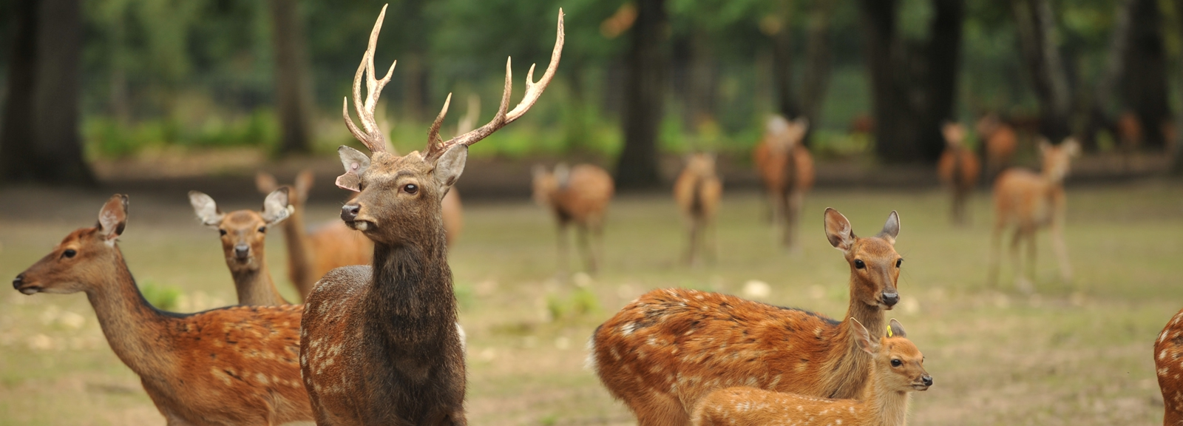
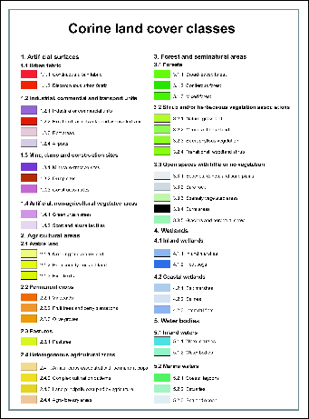
CORINE LAND COVER

Slide 26
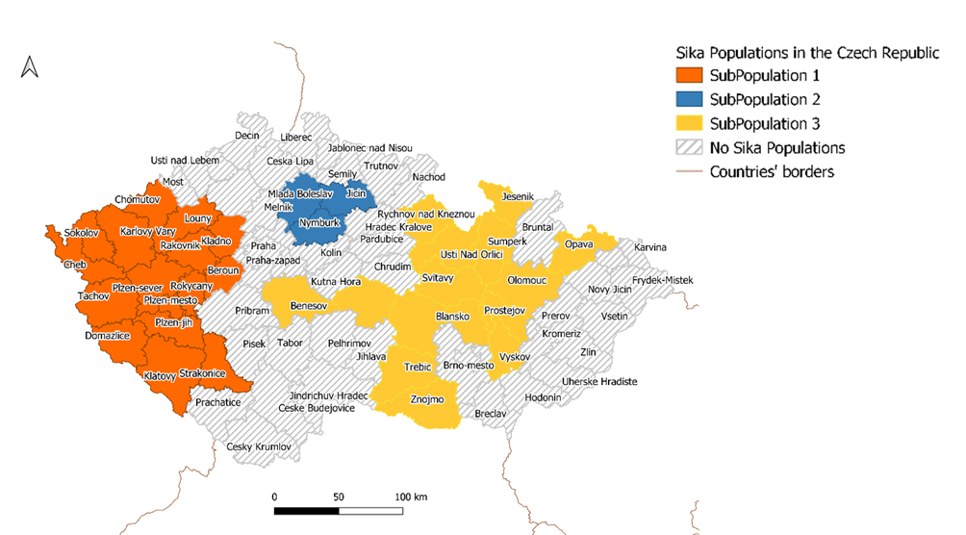
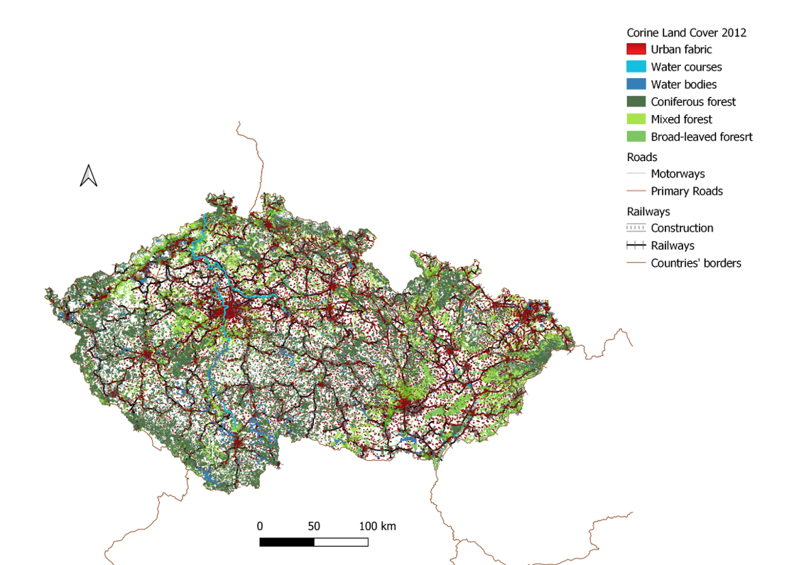

Slide 27
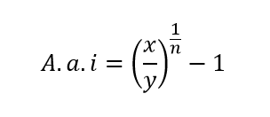
Annual Average increase
7.4%
1
2
x number of the deer culled in that subpopulation in 2018
y number of deer culled in that subpopulation in 1994
n number of years in the considered timeframe (25)
3.7%
1%
3

Slide 28
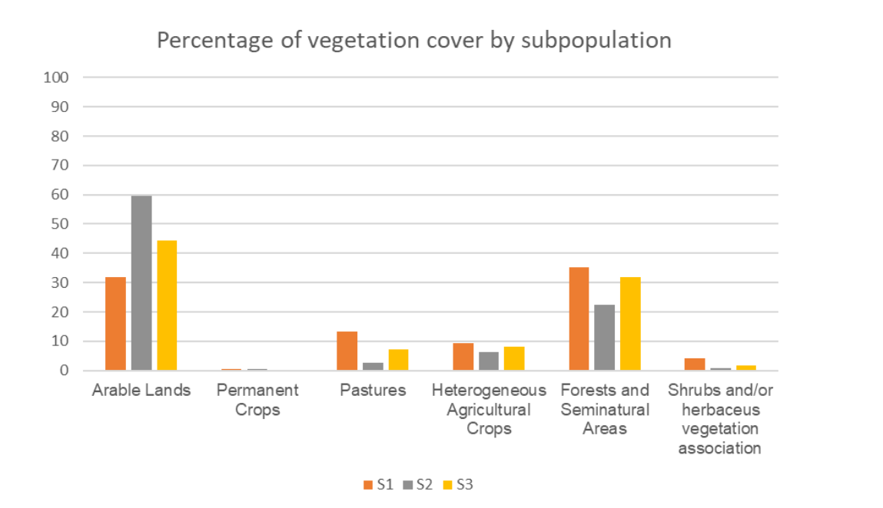

Slide 29
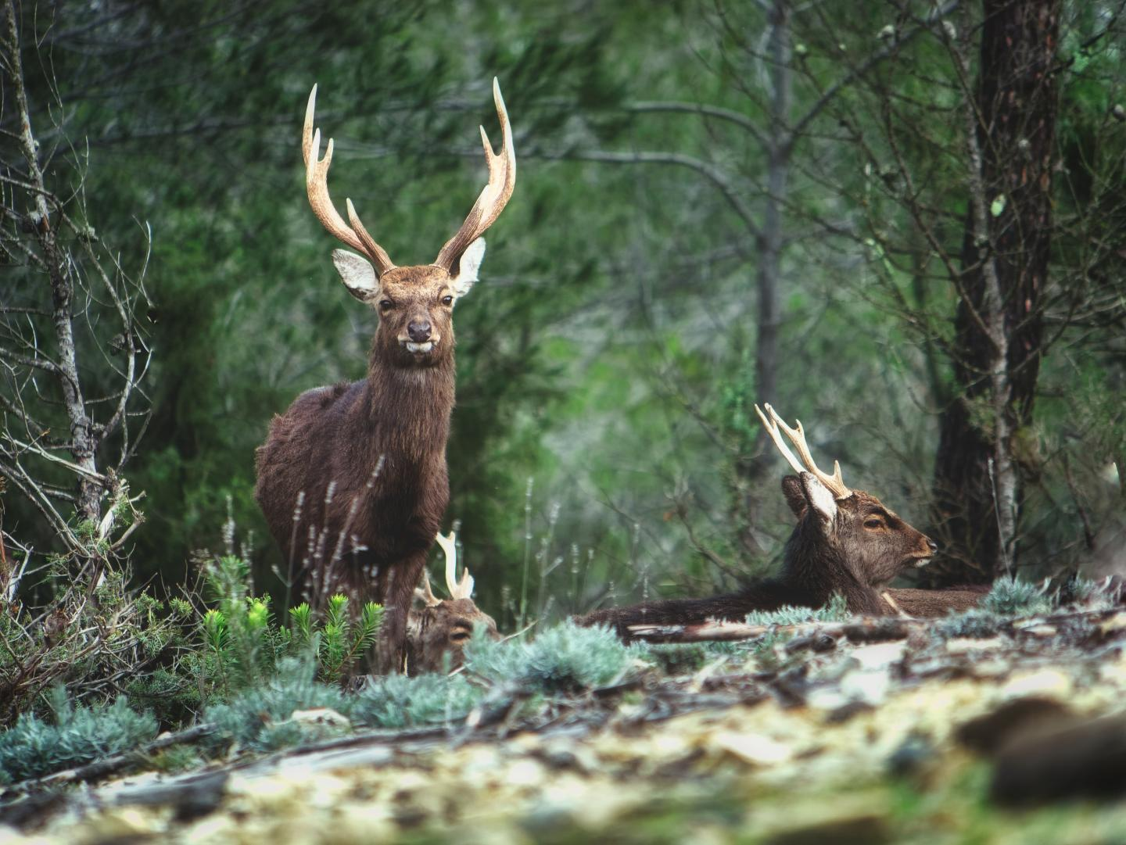
Other sources of mortality
WVC
Predation

Slide 30
Other sources of mortality
WVC
Predation

Slide 31
Results
Rapidly Increasing Population
Current management not suf­ficient to keep the population stable and contained, especially in the Western part of the country.
Better resources are impelling need for the Czech Republic.

Slide 32
Aims and Goals
Scientific Literature
Diet Analysis
1
2
3
Management

Slide 33
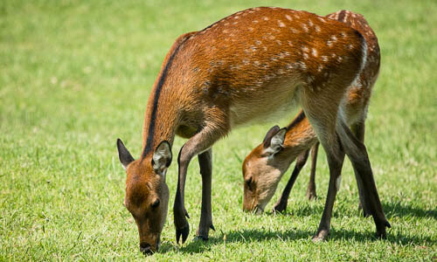
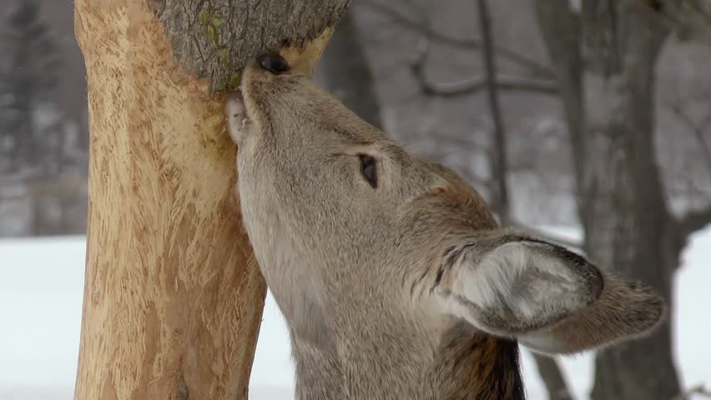
Feeding
Japan
Preferred plants
Adaptability

Slide 34
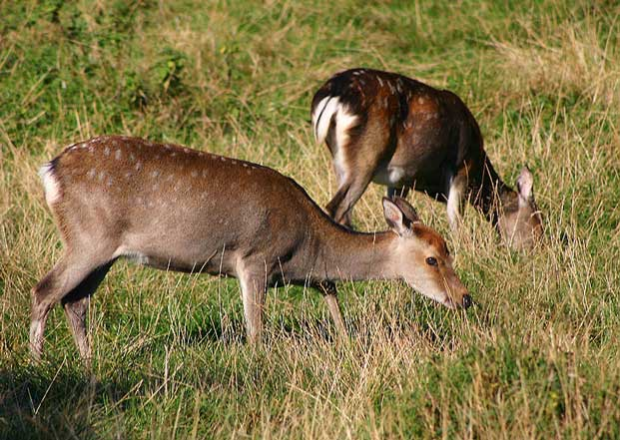
Sika Deer Diet
Out-competing other species
Damaging the vegetation
Expensive and time consuming methods

Slide 35
Sika Deer Diet
Out-competing other species
Damaging the vegetation
Expensive and time consuming methods

Slide 36
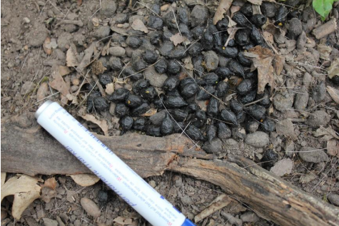
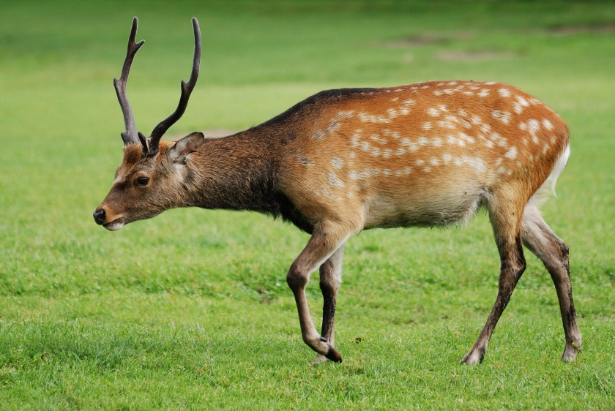
Preliminary study on sika deer diet
Faecal sample collection
DNA metabarcoding
FTIR spectroscopy analysis

Slide 37
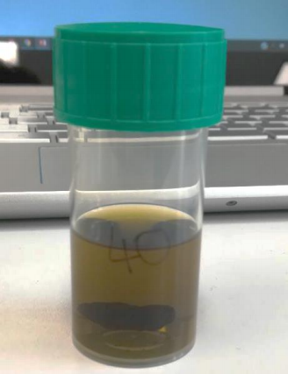
Preliminary study on sika deer diet
Faecal sample collection
DNA metabarcoding
FTIR spectroscopy analysis

Slide 38
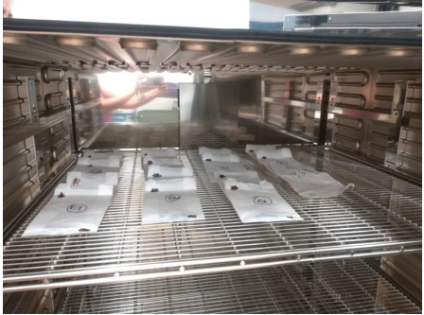
Preliminary study on sika deer diet
Faecal sample collection
DNA metabarcoding
FTIR spectroscopy analysis

Slide 39
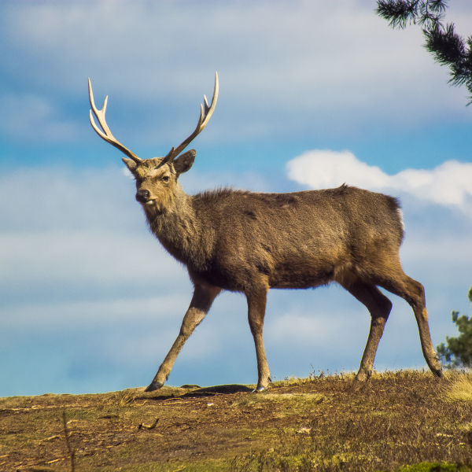
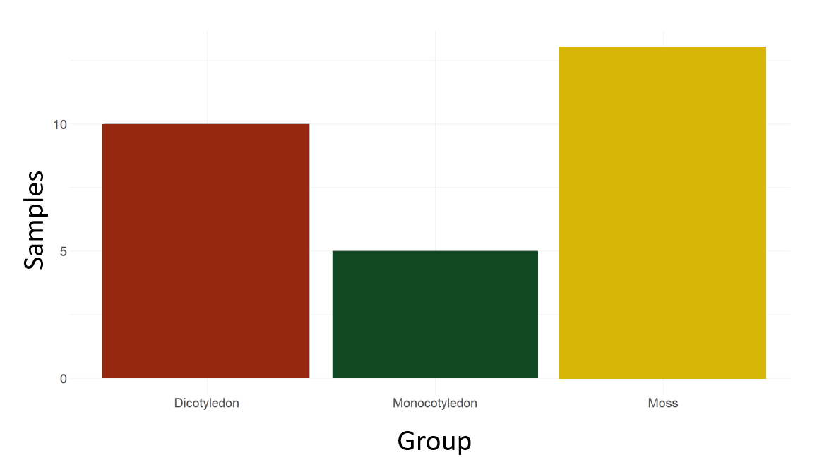
R
40 samples, 23 sequenced
Results
28 taxa

Slide 40
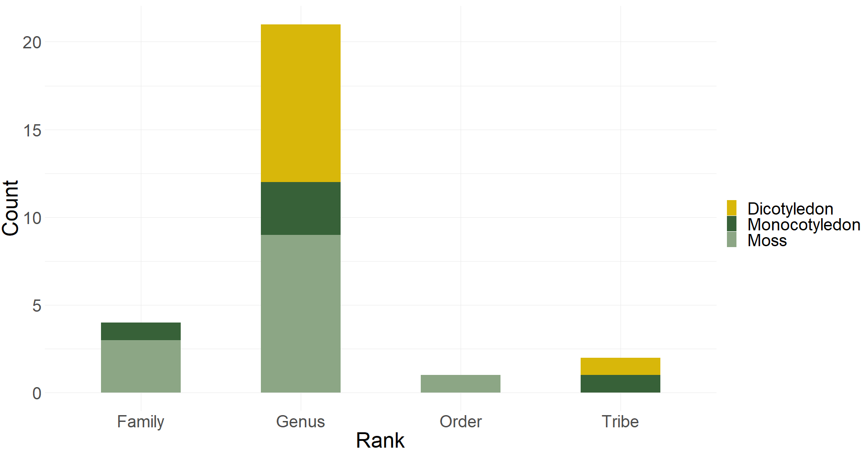
R
Results

Slide 41
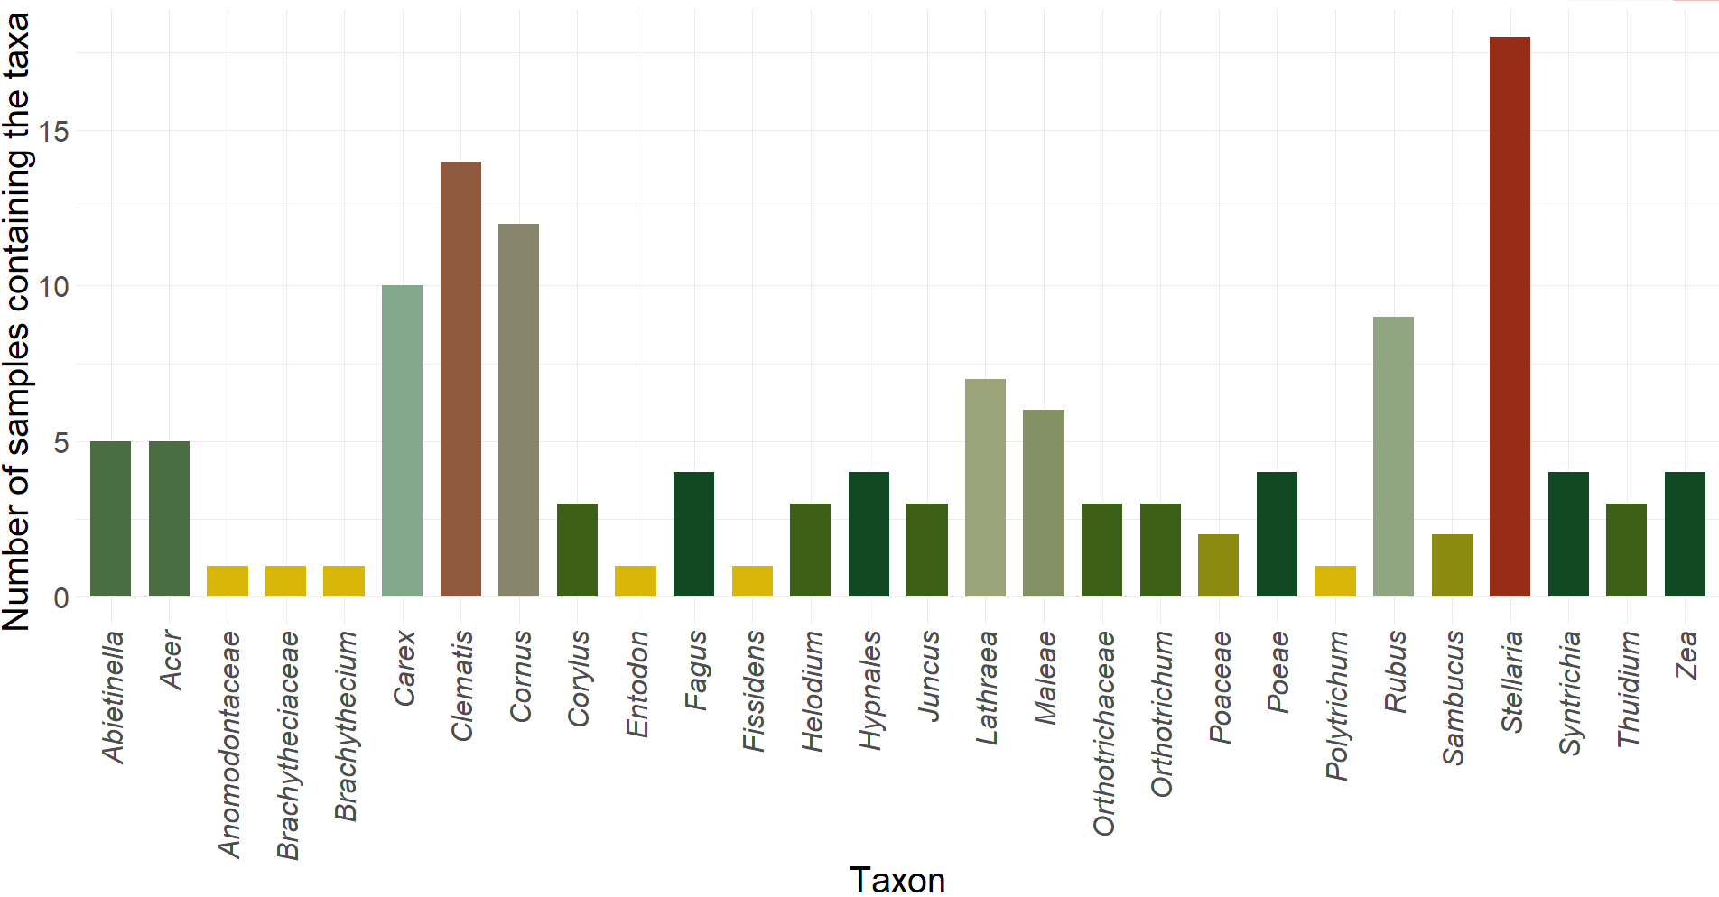
Results

Slide 42
Results

Slide 43
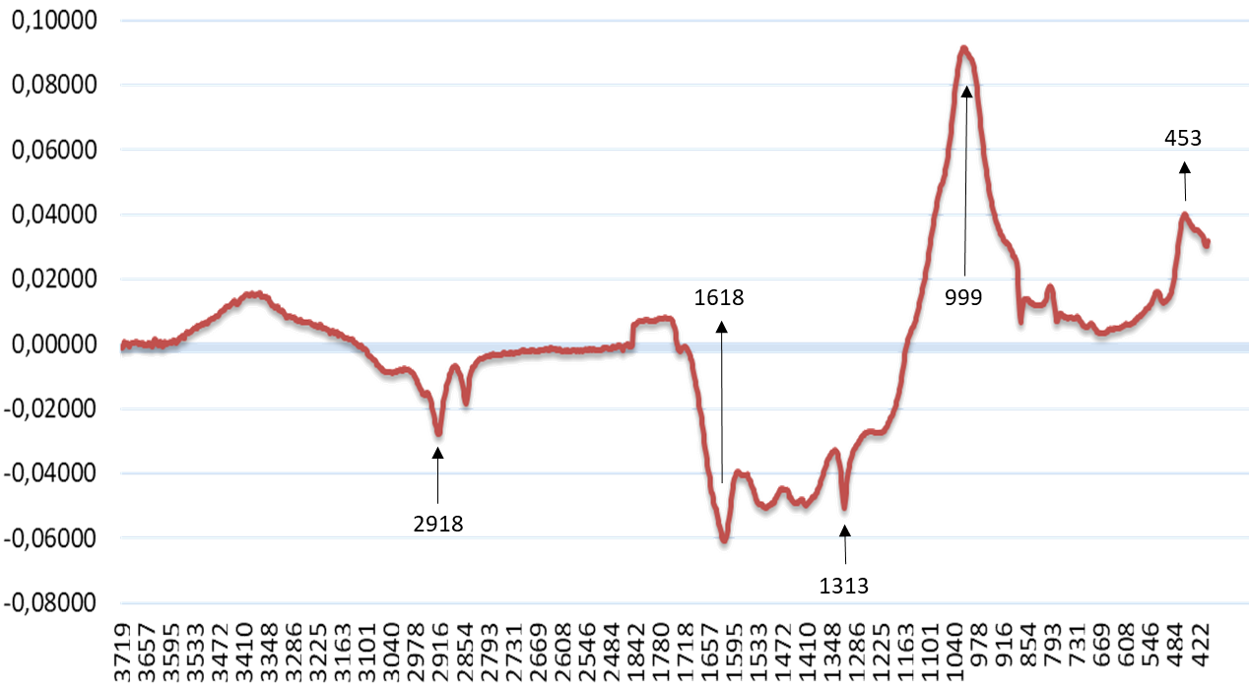
Results

Slide 44
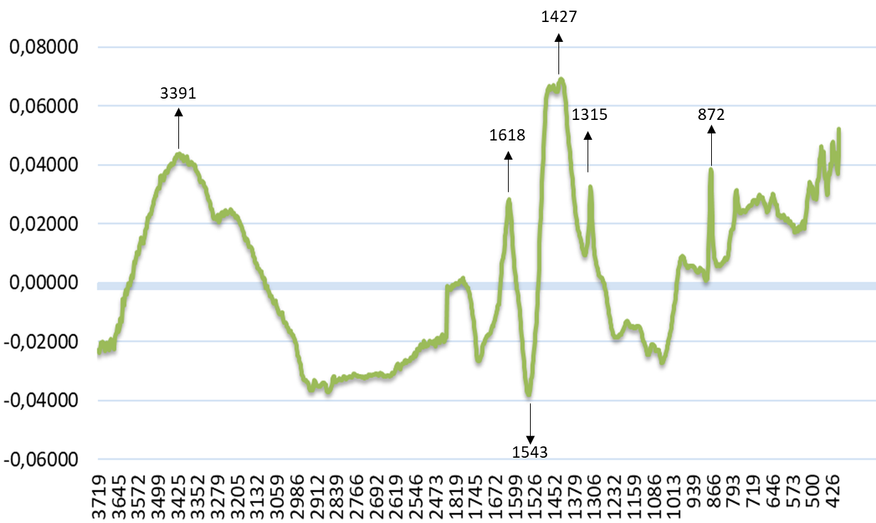
Results

Slide 45
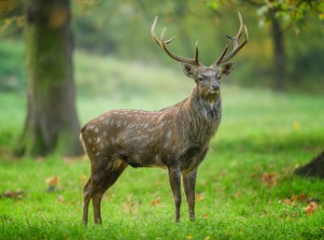
Results
Preliminary Study
Preferred taxa?
Suitable methods

Slide 46
Comparison of spectra with undigested vegetation
Comparison with faecal matter of sika from a second subpopulation
Comparison with faecal matter of other ungulates

Slide 47
Need of more samples
Cleaner samples for FTIR

Slide 48
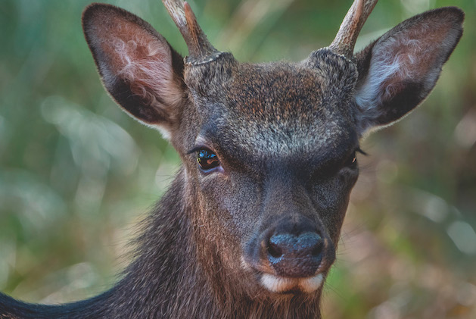
General Discussion
Highly detrimental species
Literature does not cover all the aspects of the species ecology and management
Management is not a widely discussed topic
Management of the species needs improvement
Ad hoc studies are necessary when describing the species’ diet and food habits.

Slide 49
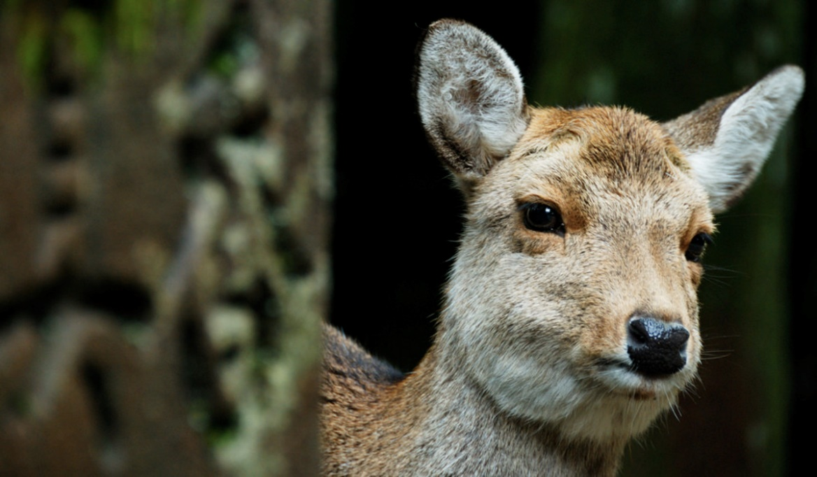
General Conclusions
research trends and discussed topic
blind spots and unexplored issues related to the species
the management of one of the biggest and most invasive populations of Europe
the diet of a severely unobserved alien population
the testing of methods of analysis for future studies
possible future perspectives.

Slide 50
General Conclusions
Ongoing issue
Necessity of ad hoc studies for the diet
Suitability of more modern and rapid methods of analysis
Importance of causes of death reports for the species
Implement the utilization of hunting bags

Slide 51
Saggiomo, L., F. Picone, B. Esattore, A. Sommese. “An Overview of Understudied Interaction Types amongst Large Carnivores.” Food Webs, vol. 12, 2017, pp. 35–39., doi:10.1016/j.fooweb.2017.01.001.
Mori, E., G., Mazza, L. Saggiomo, A Sommese, B. Esattore. “Strangers Coming from the Sahara: An Update of the Worldwide Distribution, Potential Impacts and Conservation Opportunities of Alien Aoudad.” Annales Zoologici Fennici, vol. 54, no. 5-6, 2017, pp. 373–386., doi:10.5735/086.054.0501.
Urošević, M. I., B. Esattore, L. Saggiomo, Z. A., Ristić, & N. I. Stojanac, “Animal Welfare Standards in Red Deer (Cervus elaphus) Farming.” Archives of Veterinary Medicine, vol. 11, no. 2, 2019, pp. 11–20., doi:10.46784/e-avm.v11i2.22.
Saggiomo, L., Esattore, B. and Picone, F. “What Are We Talking about? Sika Deer (Cervus nippon): A Bibliometric Network Analysis.” Ecological Informatics, vol. 60, 2020, p. 101146., doi:10.1016/j.ecoinf.2020.101146.
Esattore, B., V. Slipogor, L. Saggiomo, M. Seltmann, “How Not to Judge a Deer by Its Cover”: A Personality Assessment Study on Captive Adult Red Deer Males (Cervus elaphus).” Behavioural Processes, vol. 186, 2021, p. 104361., doi:10.1016/j.beproc.2021.104361.
Saggiomo L., B Esattore, L Bartoš. “Evaluating the Management Success of an Alien Species Through Its Hunting Bags: The Case of the Sika Deer (Cervus nippon) in the Czech Republic.” Acta Universitatis Agriculturae Et Silviculturae Mendelianae Brunensis, vol. 69, no. 3, 2021, pp. 327–336., doi:10.11118/actaun.2021.030.
Saggiomo L., B. Esattore, V., Bar. “The fox who cried wolf: A keywords and literature trend analysis on the phenomenon of mesopredator release” (Under review – Journal: Ecological Complexity)

Slide 52
4/2021 BEE 2021 (Online)
Contribution with an oral presentation: “Alien and Native Sika deer (Cervus nippon) : A bibliometric network analysis”
11/2020 Kostelecké inspirování (Online)
Contribution with an oral presentation: “Evaluating the management success of an alien species through its hunting bags: the case of the sika deer (Cervus nippon) in the Czech Republic”
09/2019 93rd Annual Meeting of the German Society for Mammalian Biology. Dresden, Germany
Contribution with an oral presentation: “Mid Infrared Spectroscopy, Micro Histological analysis, and DNA Barcoding of Sika Deer Faecal Samples in Lower Austria”
09/2019 5th European Student Conference on Behaviour and Cognition. Vienna, Austria
Presentation of the Scientific Poster: ”Should I Stay or Should I go? Sika Deer Presence and Spreading in the Western Czech Republic”
02/2018 Zoologicke dny. Prague, Czech Republic
Presentation of the Scientific Poster: ”Sika deer presence and spreading in the western Czech Republic”

Slide 53
Special Thanks
Dr. Flavio Picone,
Dr. Bruno Esattore,
Dr. Andrea Sommese
Professor Luděk Bartoš
Dr. Emiliano Mori,
Dr. Giuseppe Mazza,
Dr. Vedrana Slipogor,
Dr. Martin Seltmann,
Prof. Miroslav Urosevic,
Prof. Zoran Ristic,
Dr. Nenad Stojanac,
Dr. Dejan Beukovic,
Marco Sensi,
Valentina Bar,
Vanessa Francia

Slide 54
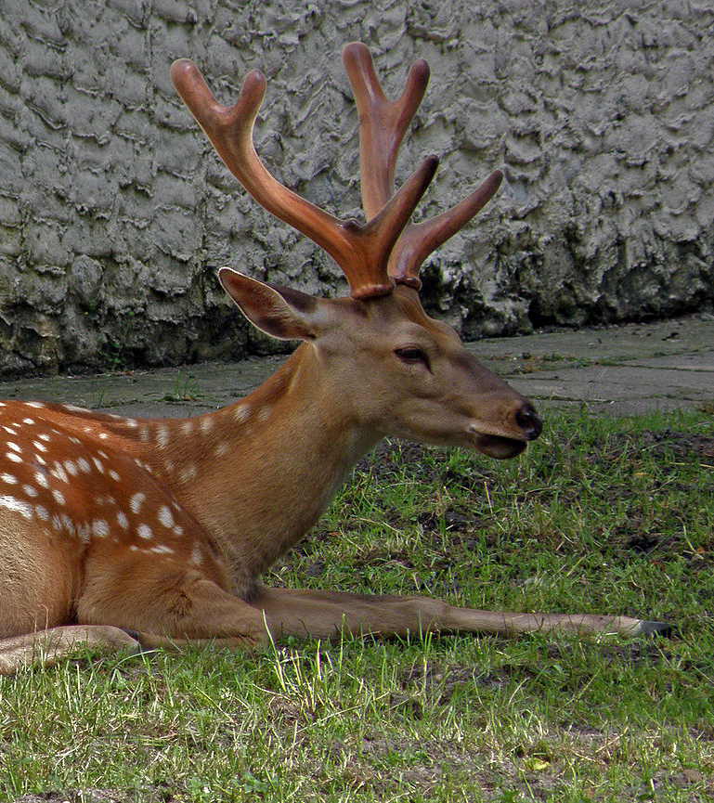

Slide 55
DNA barcoding
Multi-Species samples= DNA Metabarcoding

Slide 56
Spectroscopy
Absorption spectroscopy= FTIR

Slide 57
(“Cervus nippon” OR “Sika deer”)
Co-authorship of countries
Co-occurrence of keywords

Slide 58
Network Map
Clusters
Link Strength
Productivity

Slide 59
Network Map
Overlay Map
Clusters
Link Strength
Productivity
Old and new topics
Increased or decreased productivity

